Slide 1
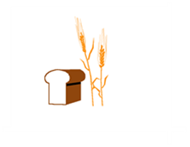
Hard Red Winter Wheat Quality Maps Based on Crop Survey by Plains Grains, Inc.
October 9, 2020

Slide 2
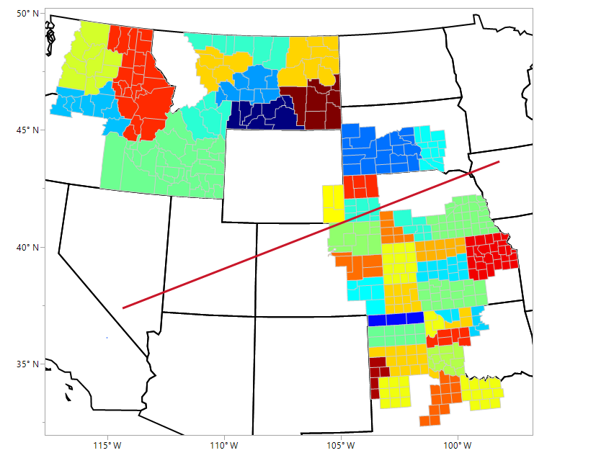
M02
P01
M03
M05
P03
M04
P02
M06
M07
M01
SD02
SD01
P04
N05
W01
N01
PNW
Tributary
N03
N04
C03
N02
K05
C02
K03
K04
K06
Gulf
Tributary
C01
K02
K01
O05
O03
O07
O04
O06
T06
O02
T05
O01
T04
T01
T02
T03

Slide 3
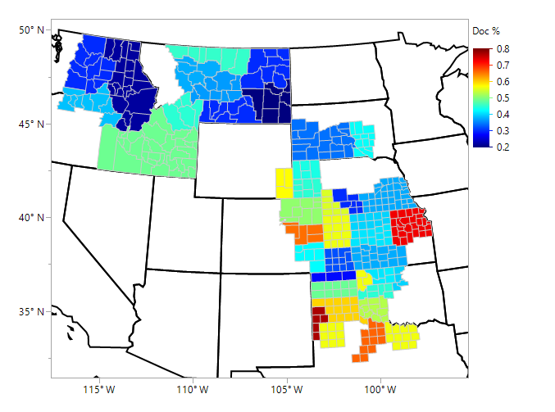
Dockage, % Average - Individual Samples

Slide 4
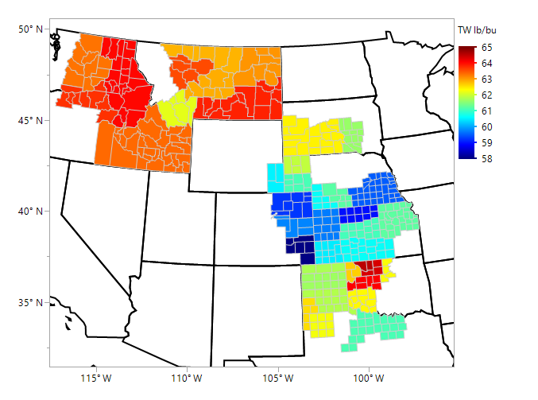
Test Weight, lbs/bu Average - Individual Samples

Slide 5
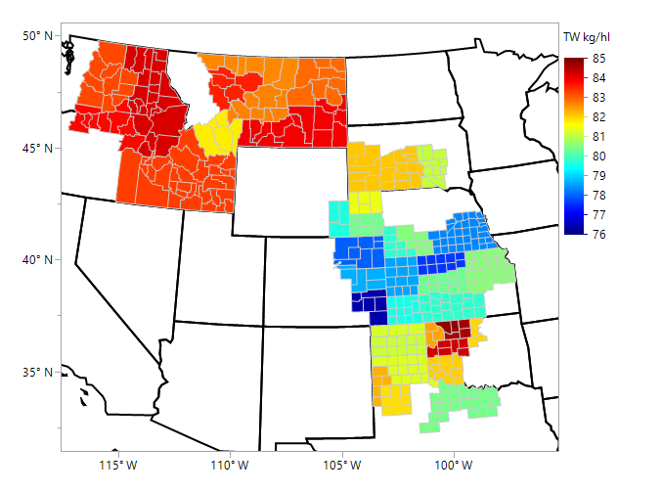
Test Weight, kg/hl Average - Individual Samples

Slide 6
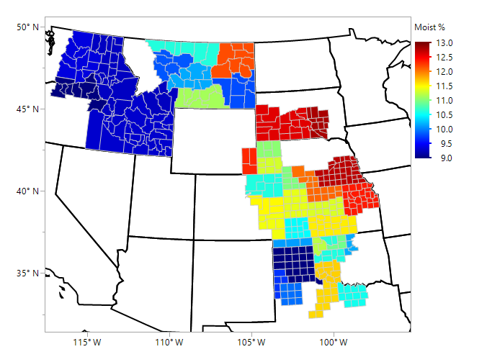
Wheat Moisture, % Average - Individual Samples

Slide 7
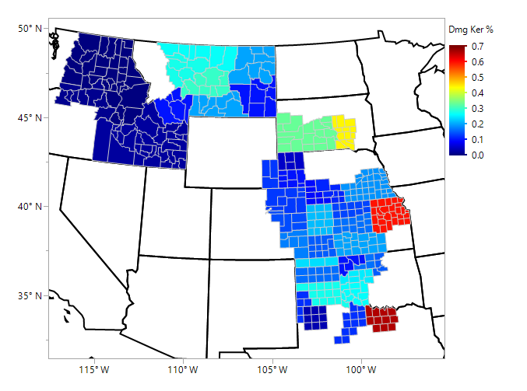
Damaged Kernels, % Average - Individual Samples

Slide 8
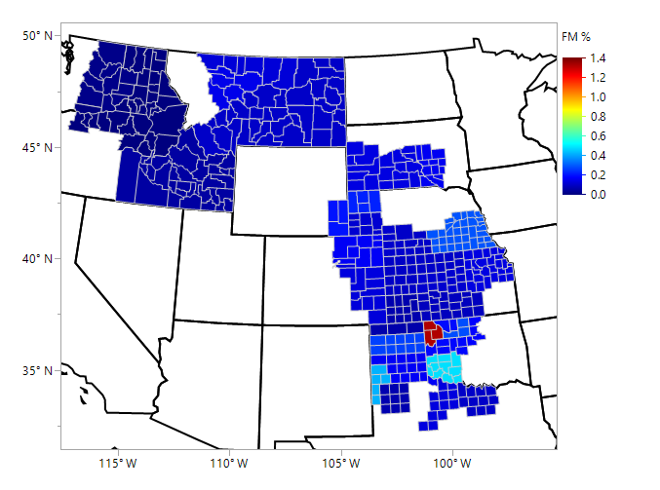
Foreign Material, % Average - Individual Samples

Slide 9
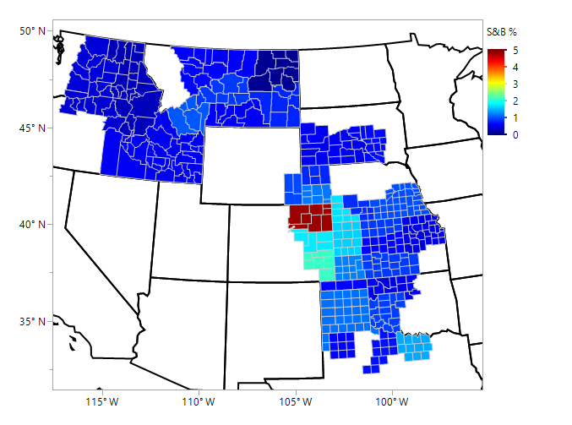
Shrunken & Broken, % Average - Individual Samples

Slide 10
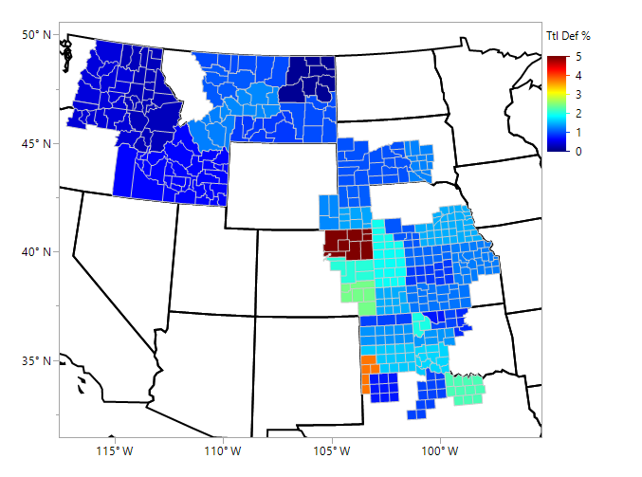
Total Defects, % Average - Individual Samples

Slide 11
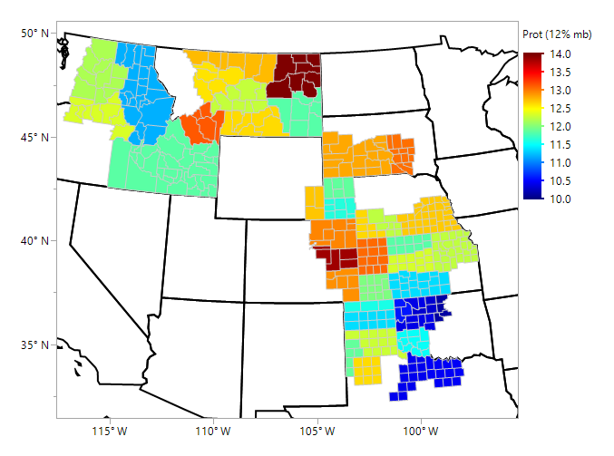
Wheat Protein (NIR, 12% mb), % Average - Individual Samples

Slide 12
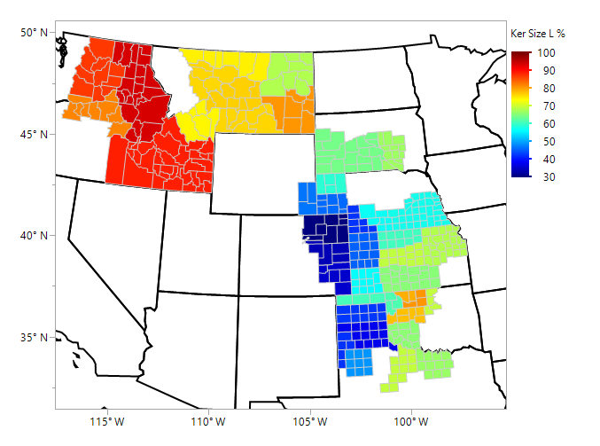
SKCS Kernel Size - Large (%) Average - Individual Samples

Slide 13
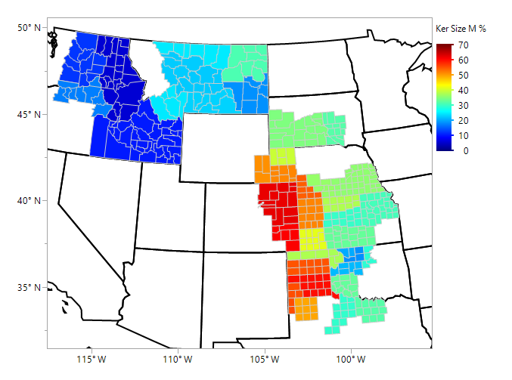
SKCS Kernel Size – Medium (%) Average - Individual Samples

Slide 14
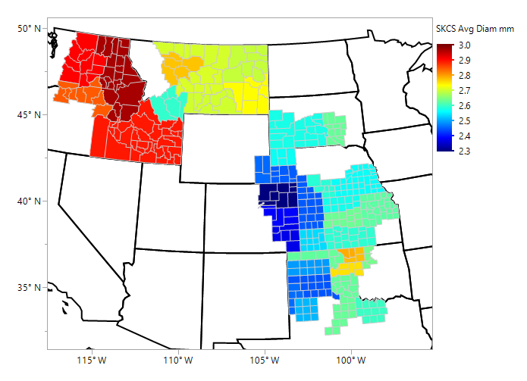
SKCS Kernel Diameter (mm) Average - Individual Samples

Slide 15
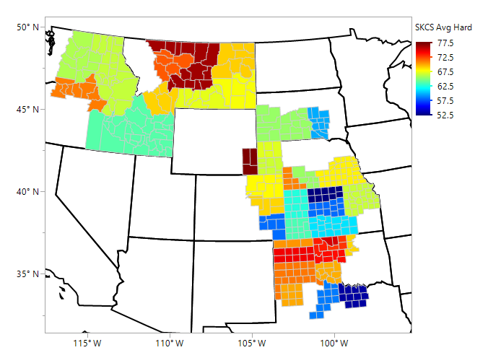
SKCS Hardness Average - Individual Samples

Slide 16
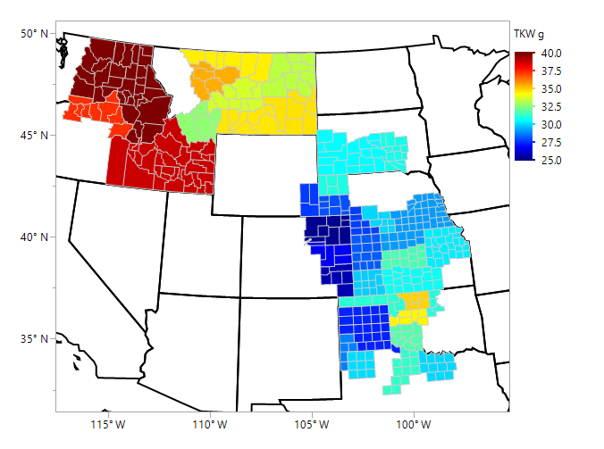
Thousand Kernel Weight, g Average - Individual Samples

Slide 17
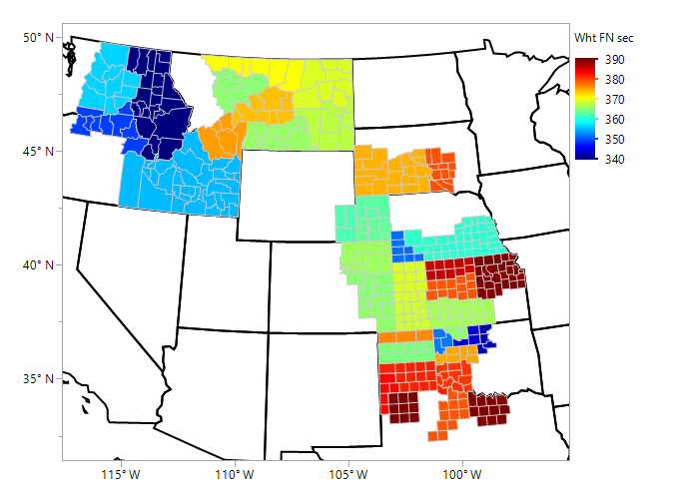
Wheat Falling Number, sec Average - Individual Samples

Slide 18
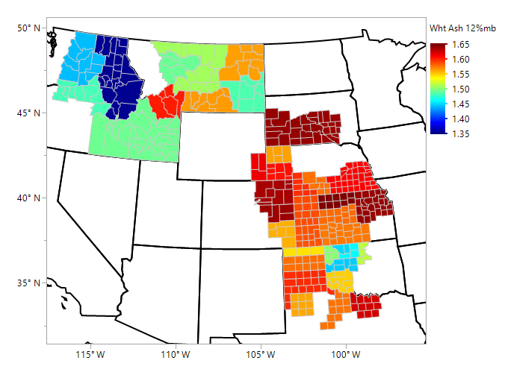
Wheat Ash (12% mb), % Average - Individual Samples

Slide 19
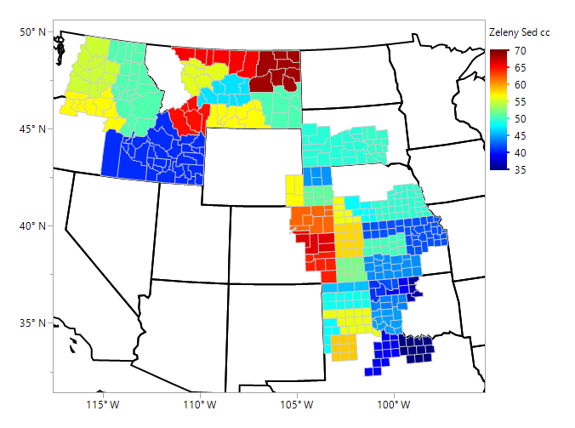
Zeleny Sedimentation, cc Average – Composite Samples

Slide 20
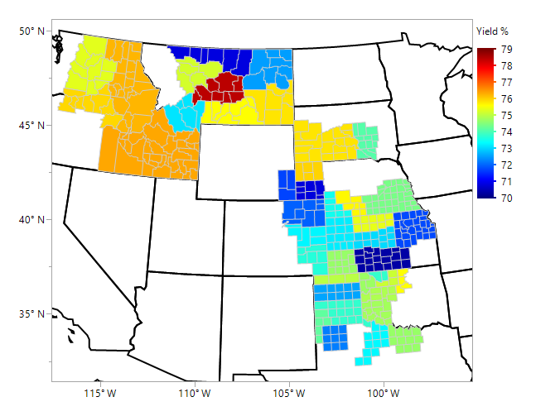
Buhler Flour Yield, % Average - Composite Samples

Slide 21
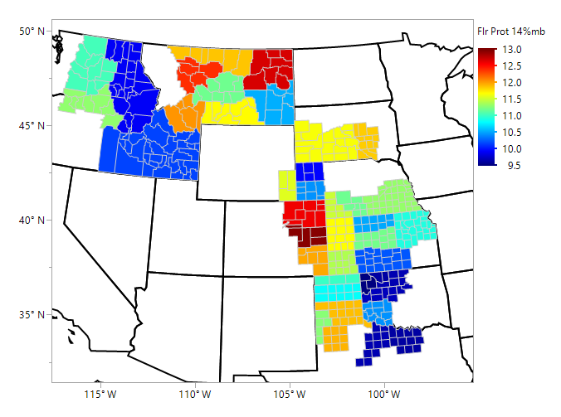
Flour Protein (NIR, 14% mb), % Average - Composite Samples

Slide 22
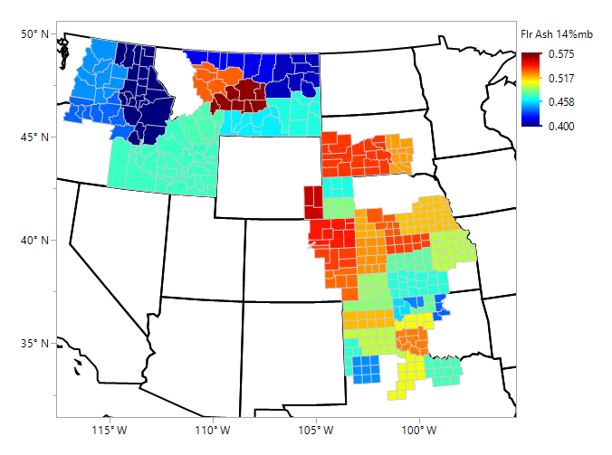
Flour Ash (14% mb), % Average - Composite Samples

Slide 23
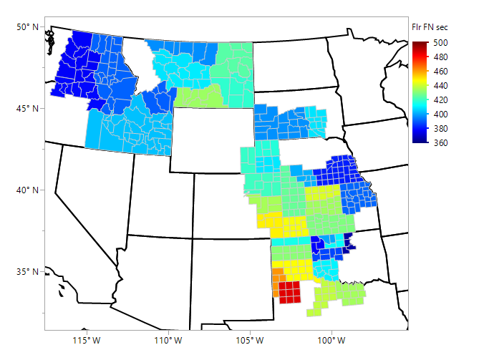
Flour Falling Number, sec Average - Composite Samples

Slide 24
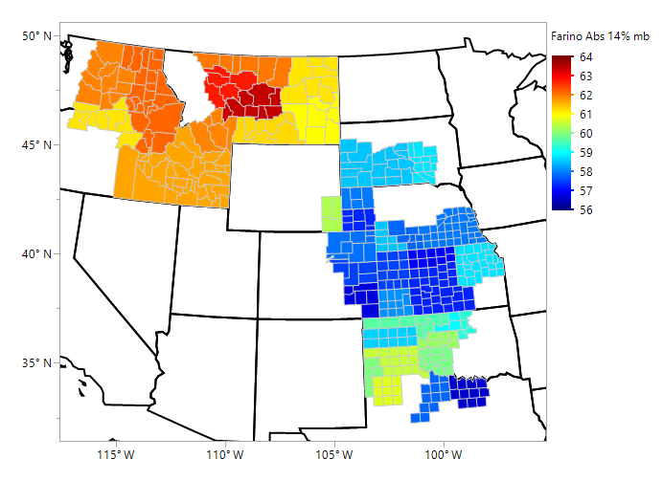
Farinograph Absorption (14% mb), % Average - Composite Samples

Slide 25
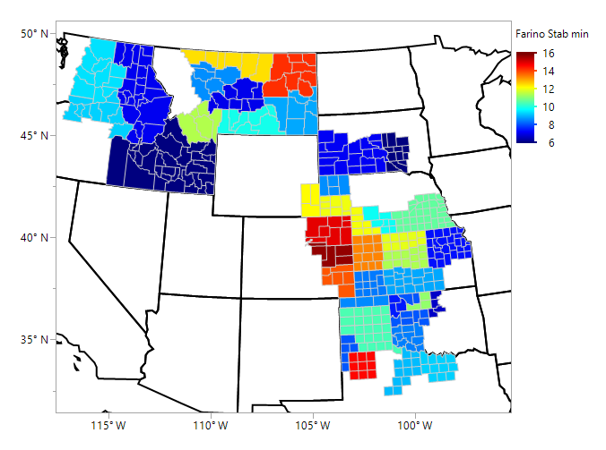
Farinograph Stability, min Average - Composite Samples

Slide 26
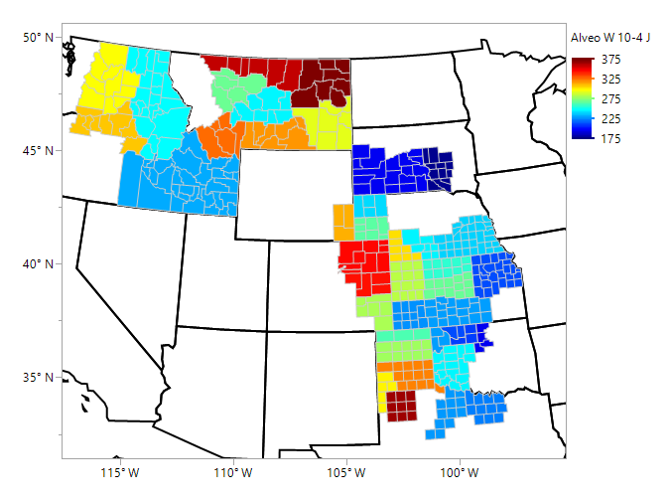
Alveograph W, j*10⁻⁴ Average - Composite Samples

Slide 27
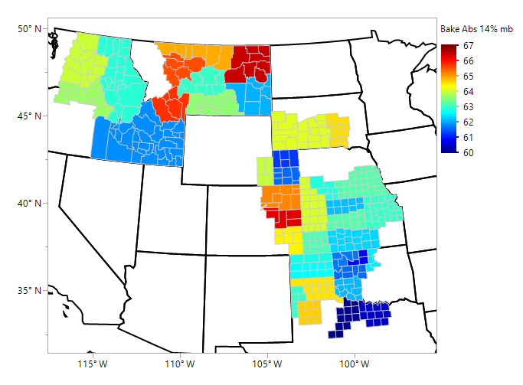
Bake Absorption, % Average - Composite Samples

Slide 28
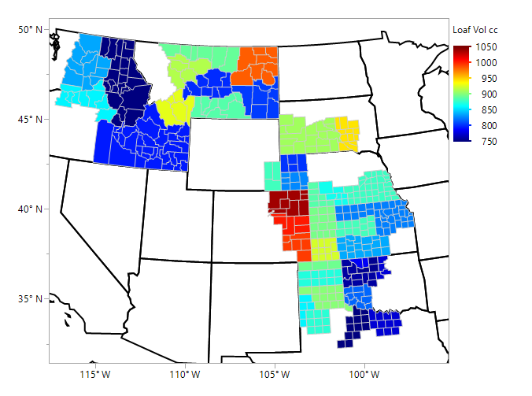
Loaf Volume, cc Average - Composite Samples

