Slide 1
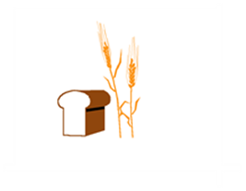
Hard Red Winter Wheat Quality Maps GULF and PNW Export Based on Crop Survey by Plains Grains, Inc.
October 7, 2019

Slide 2
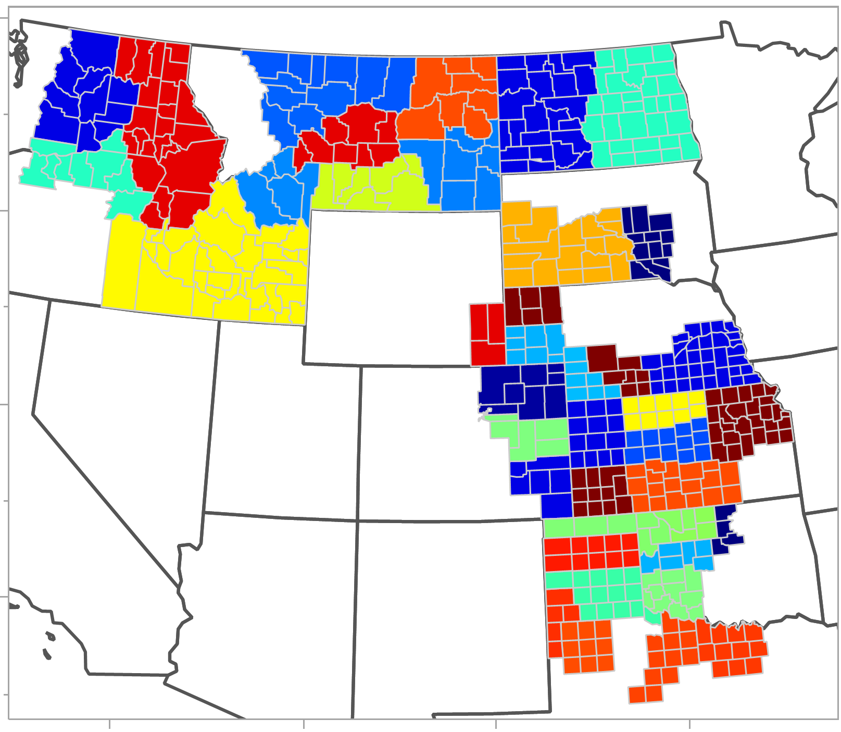
Plains Grains, Inc. Grainsheds and Export Areas
PNW
Gulf

Slide 3
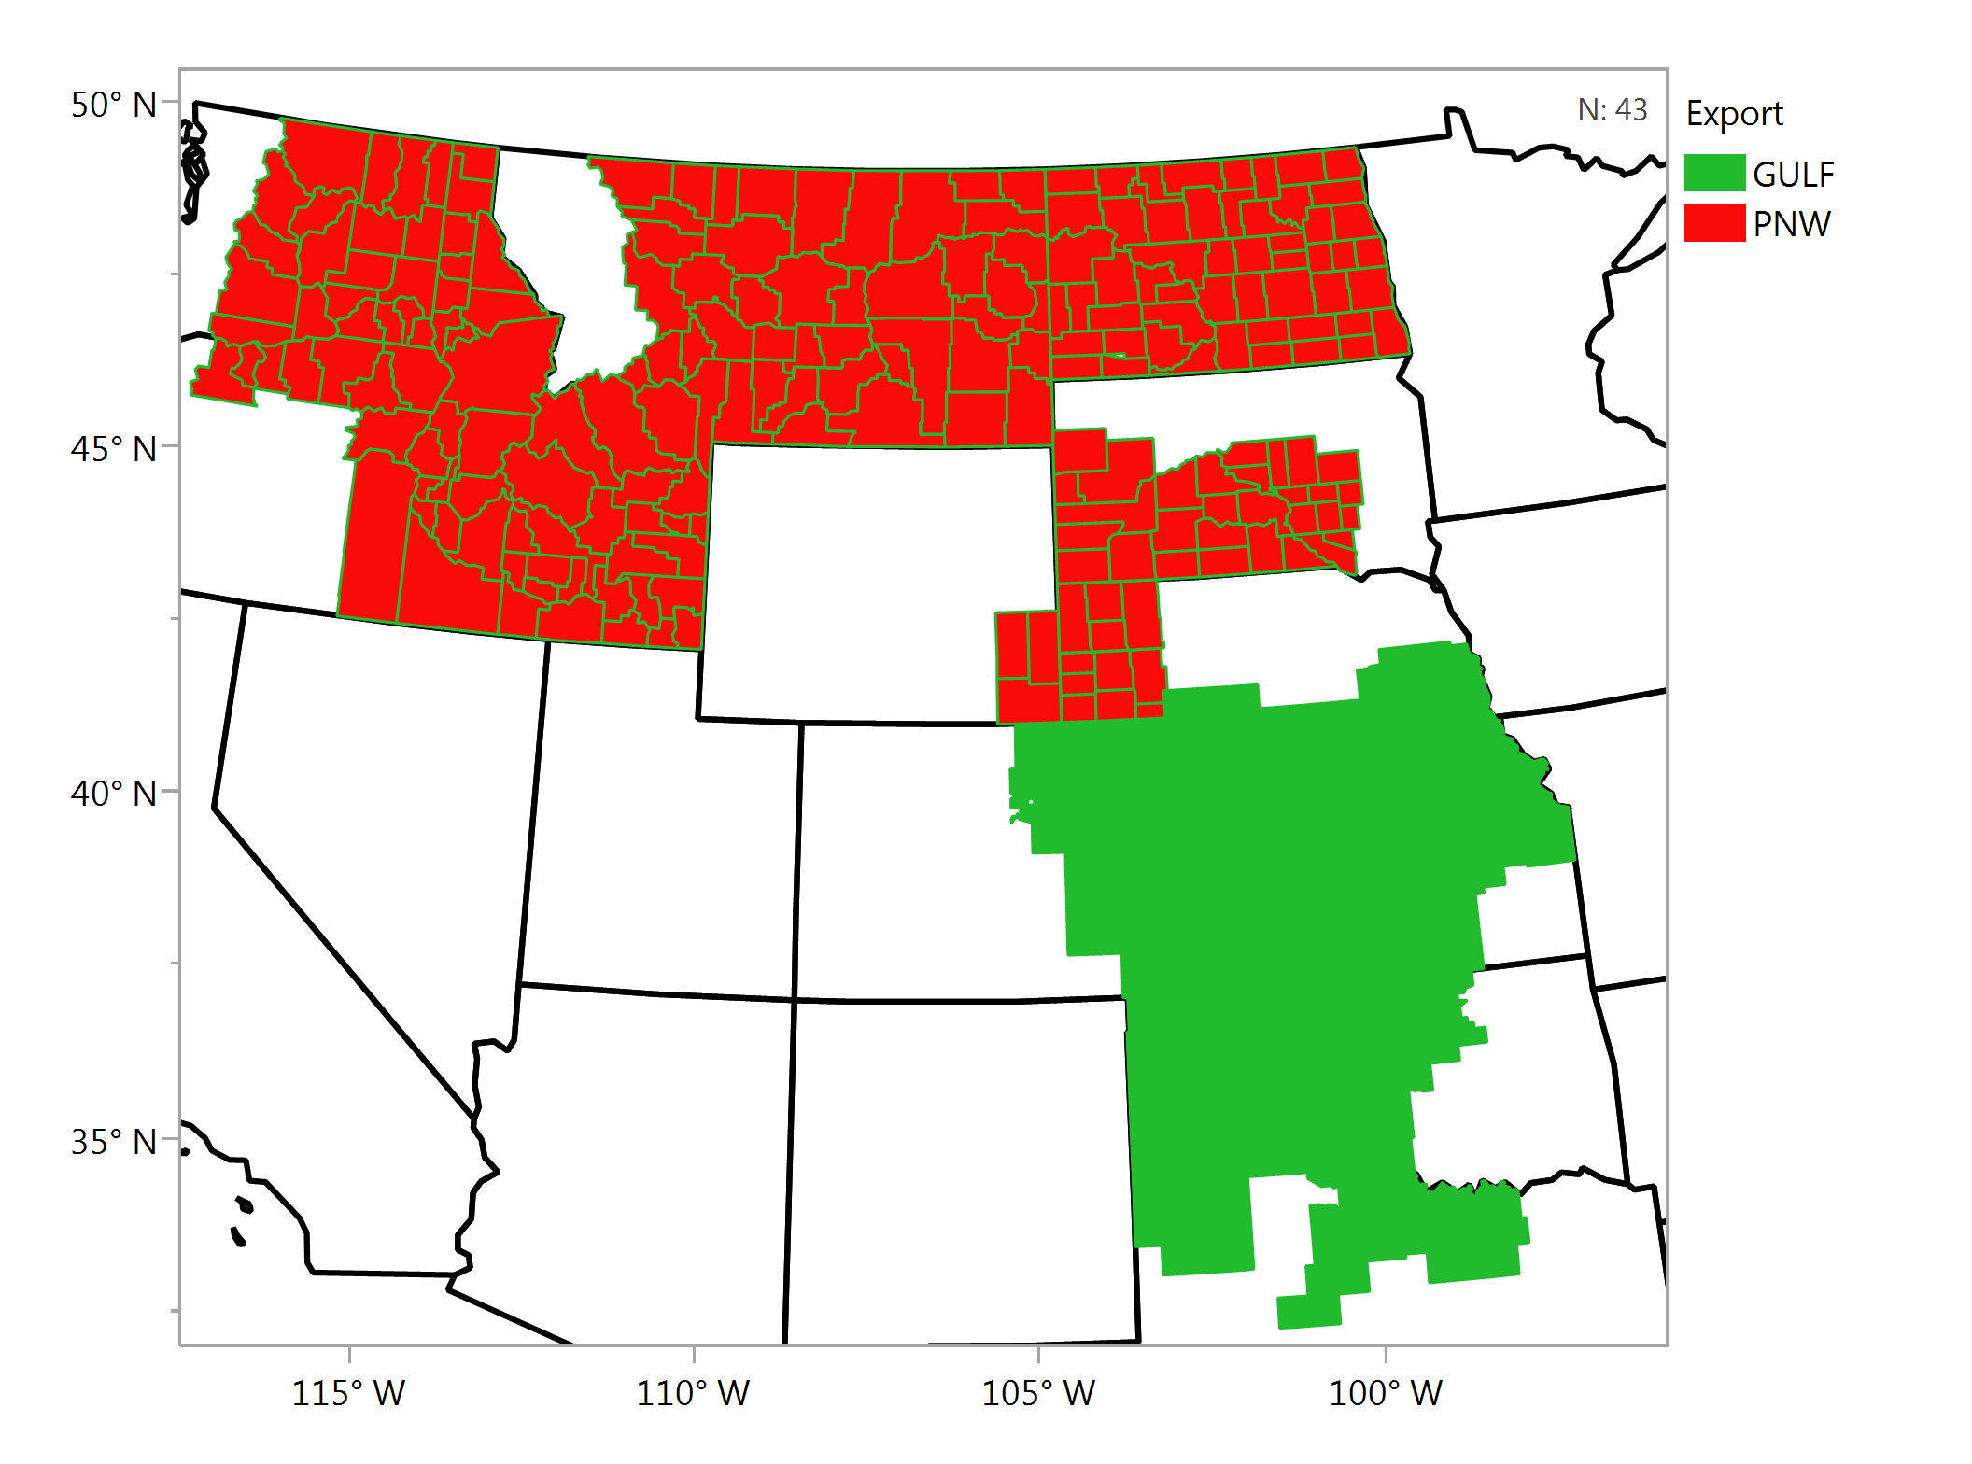
Plains Grains, Inc. Grainsheds and Export Areas

Slide 4
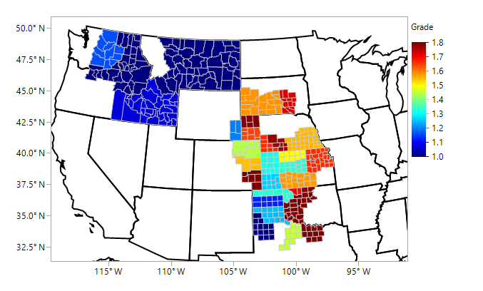
Wheat Grade Average - Individual Samples

Slide 5
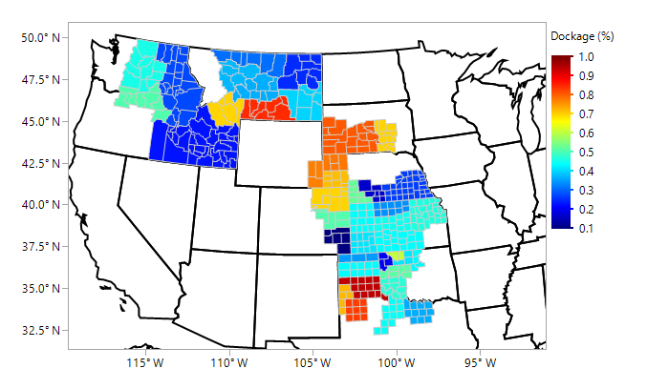
Dockage, % Average - Individual Samples

Slide 6
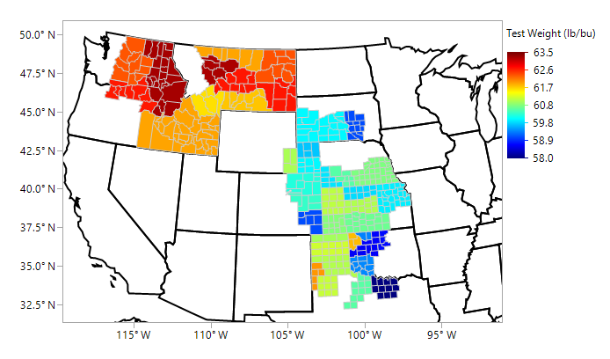
Test Weight, lbs/bu Average - Individual Samples

Slide 7
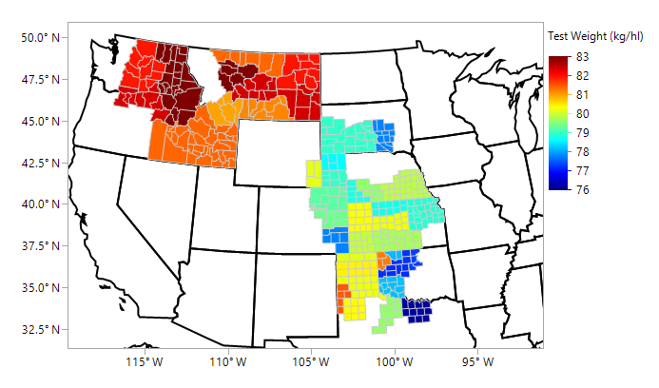
Test Weight, kg/hl Average - Individual Samples

Slide 8
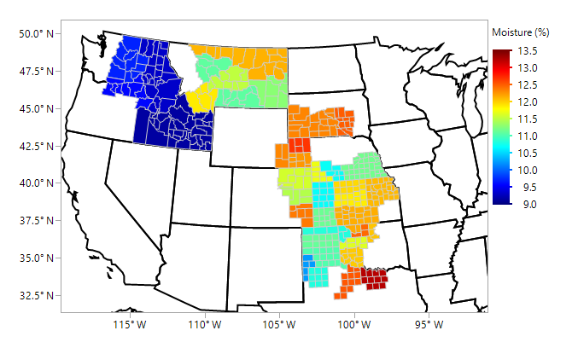
Wheat Moisture, % Average - Individual Samples

Slide 9
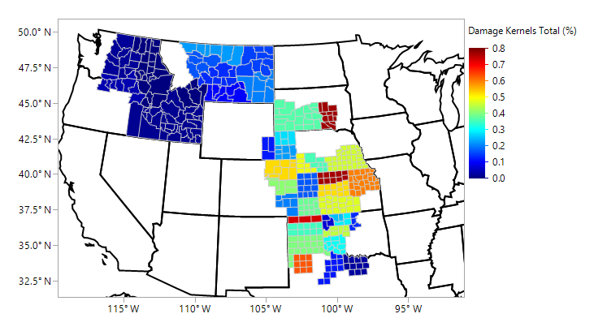
Damaged Kernels, % Average - Individual Samples

Slide 10
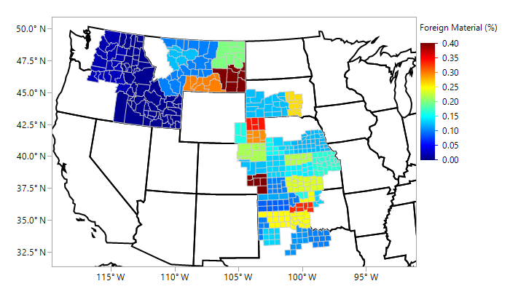
Foreign Material, % Average - Individual Samples

Slide 11
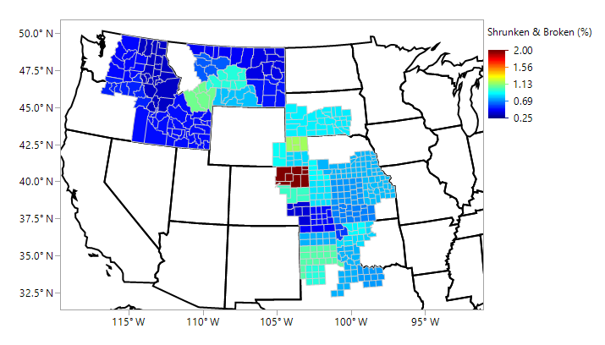
Shrunken & Broken, % Average - Individual Samples

Slide 12
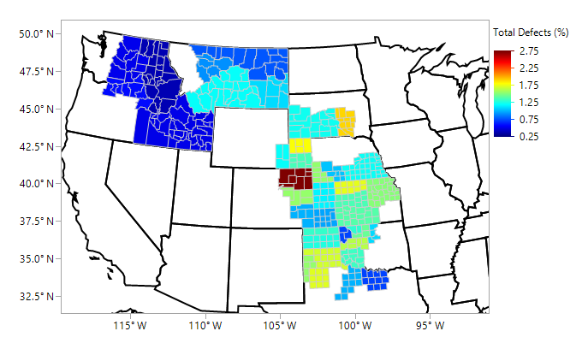
Total Defects, % Average - Individual Samples

Slide 13
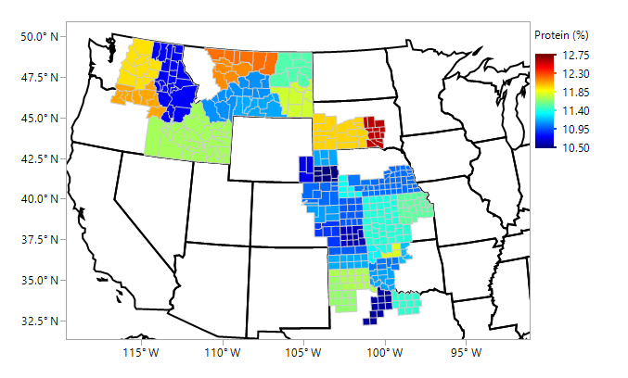
Wheat Protein, % Average - Individual Samples

Slide 14
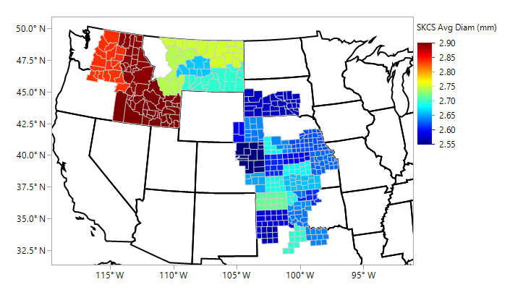
SKCS Kernel Diameter (mm) Average - Individual Samples

Slide 15
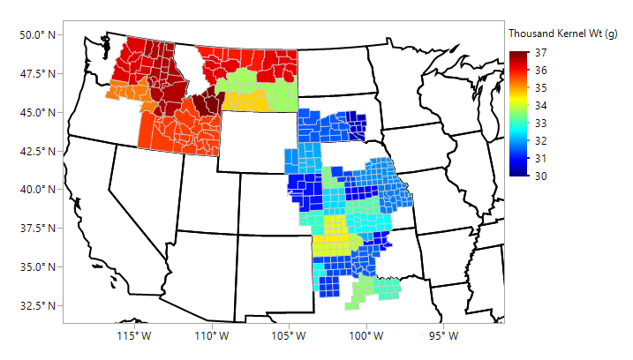
Thousand Kernel Weight, g Average - Individual Samples

Slide 16
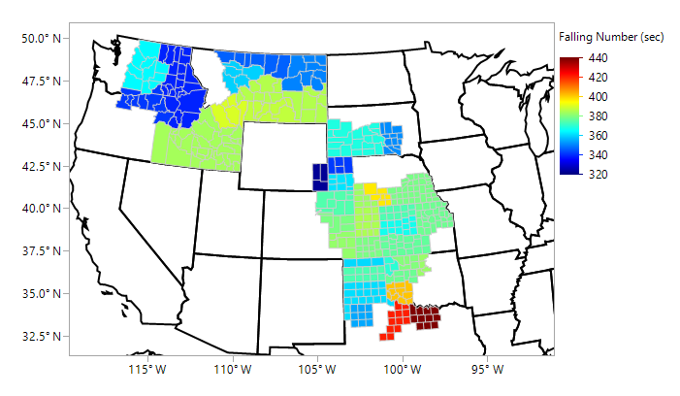
Wheat Falling Number, sec Average - Individual Samples

Slide 17
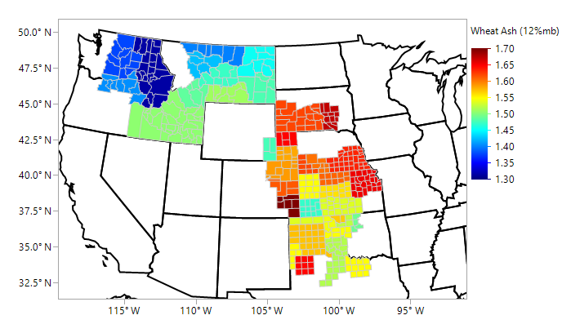
Wheat Ash (12% mb), % Average - Individual Samples

