Slide 1
Hard Red Winter Wheat Quality Maps Based on Crop Survey by Plains Grains, Inc.
October 10, 2018

Slide 2
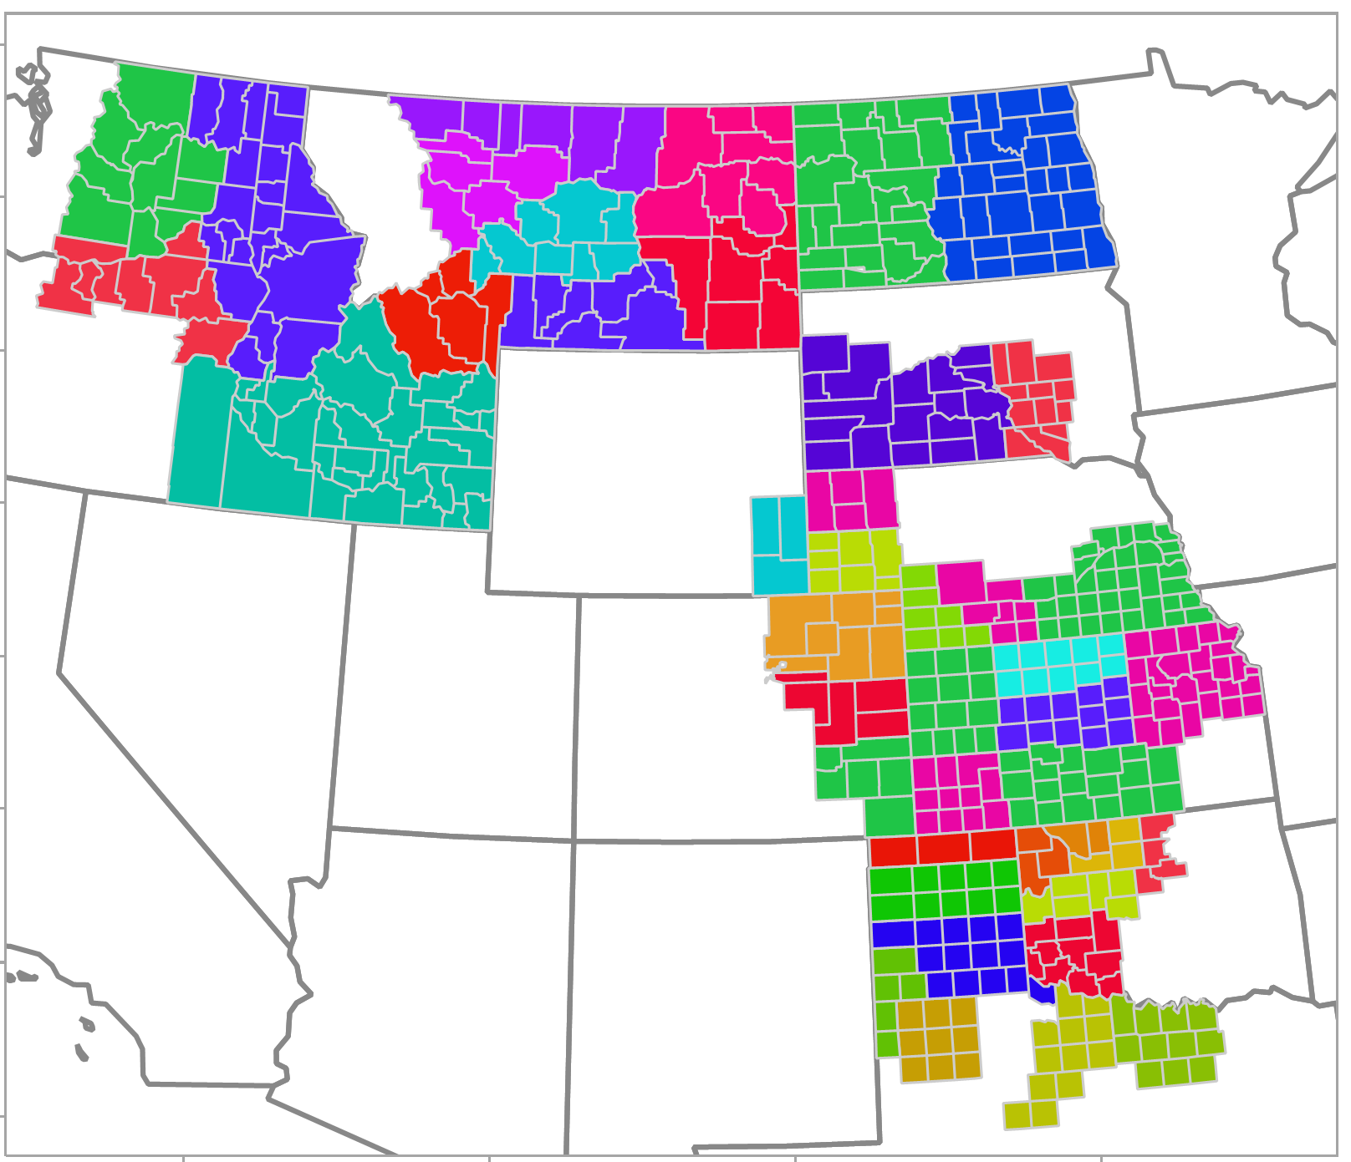
Plains Grains, Inc. Grainsheds and Export Areas
PNW
Gulf

Slide 3
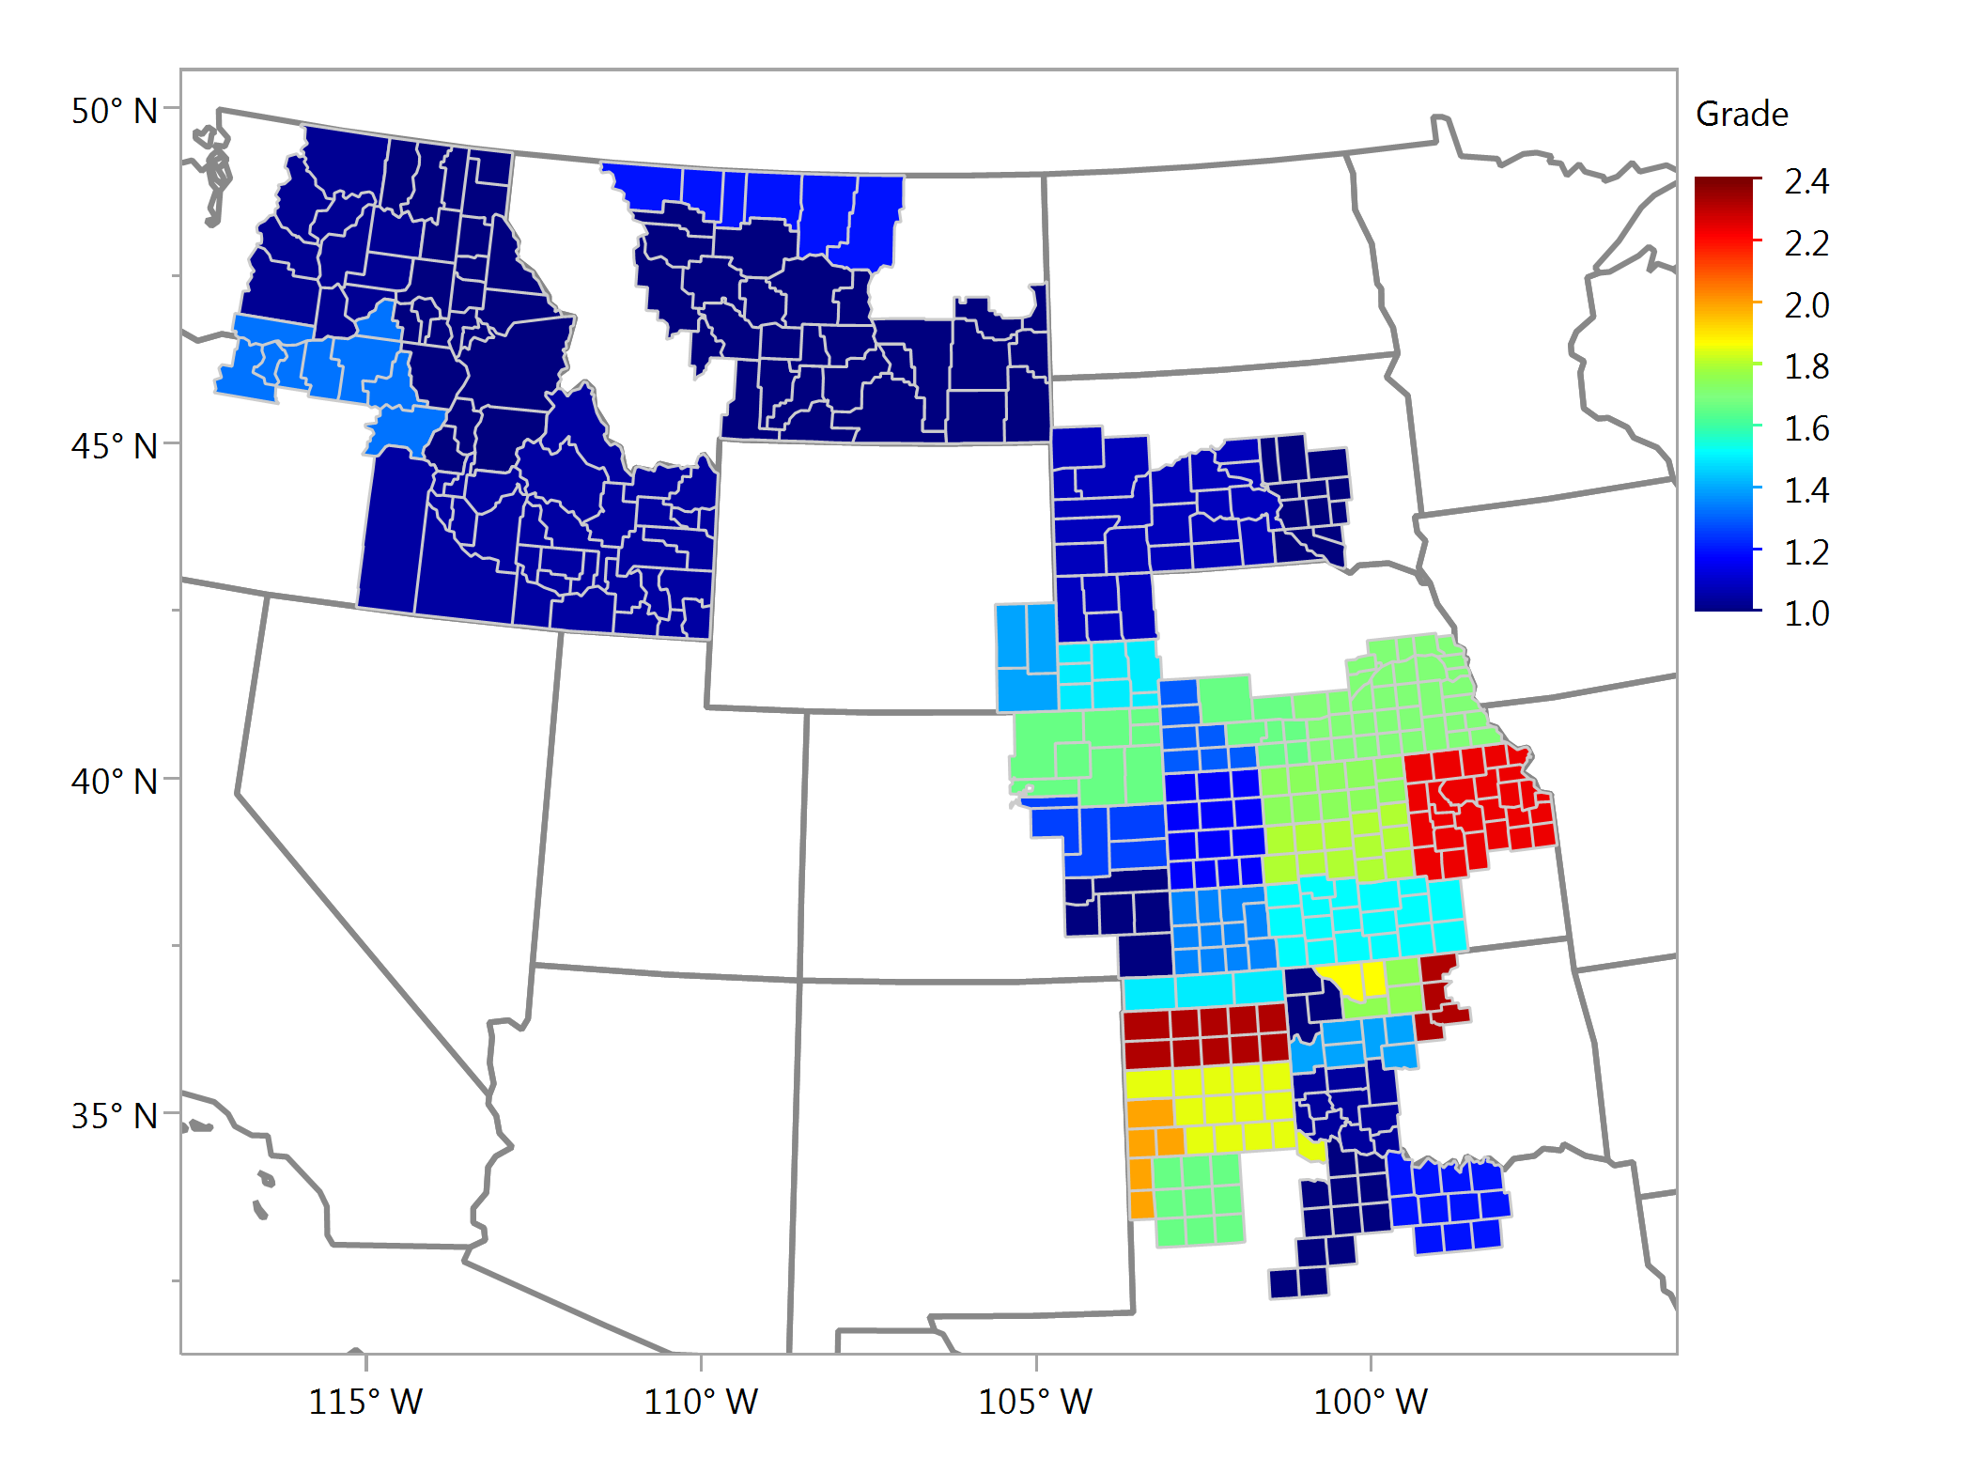
Wheat Grade Average - Individual Samples

Slide 4
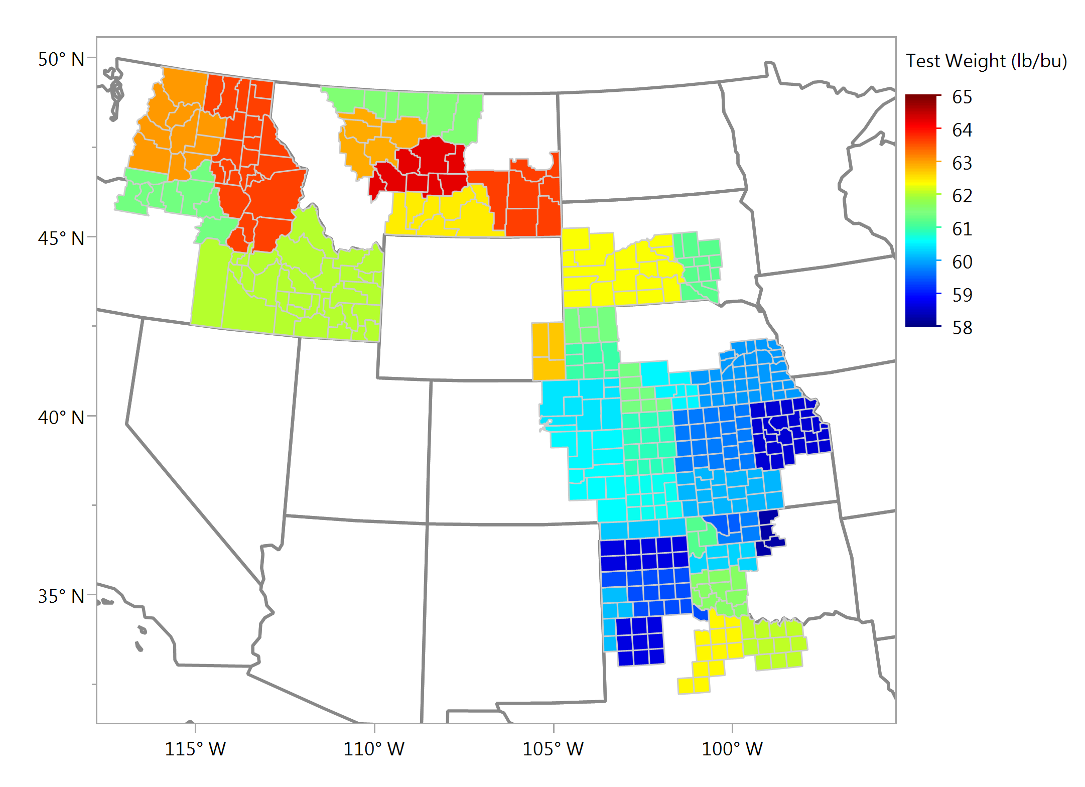
Test Weight, lbs/bu Average - Individual Samples

Slide 5
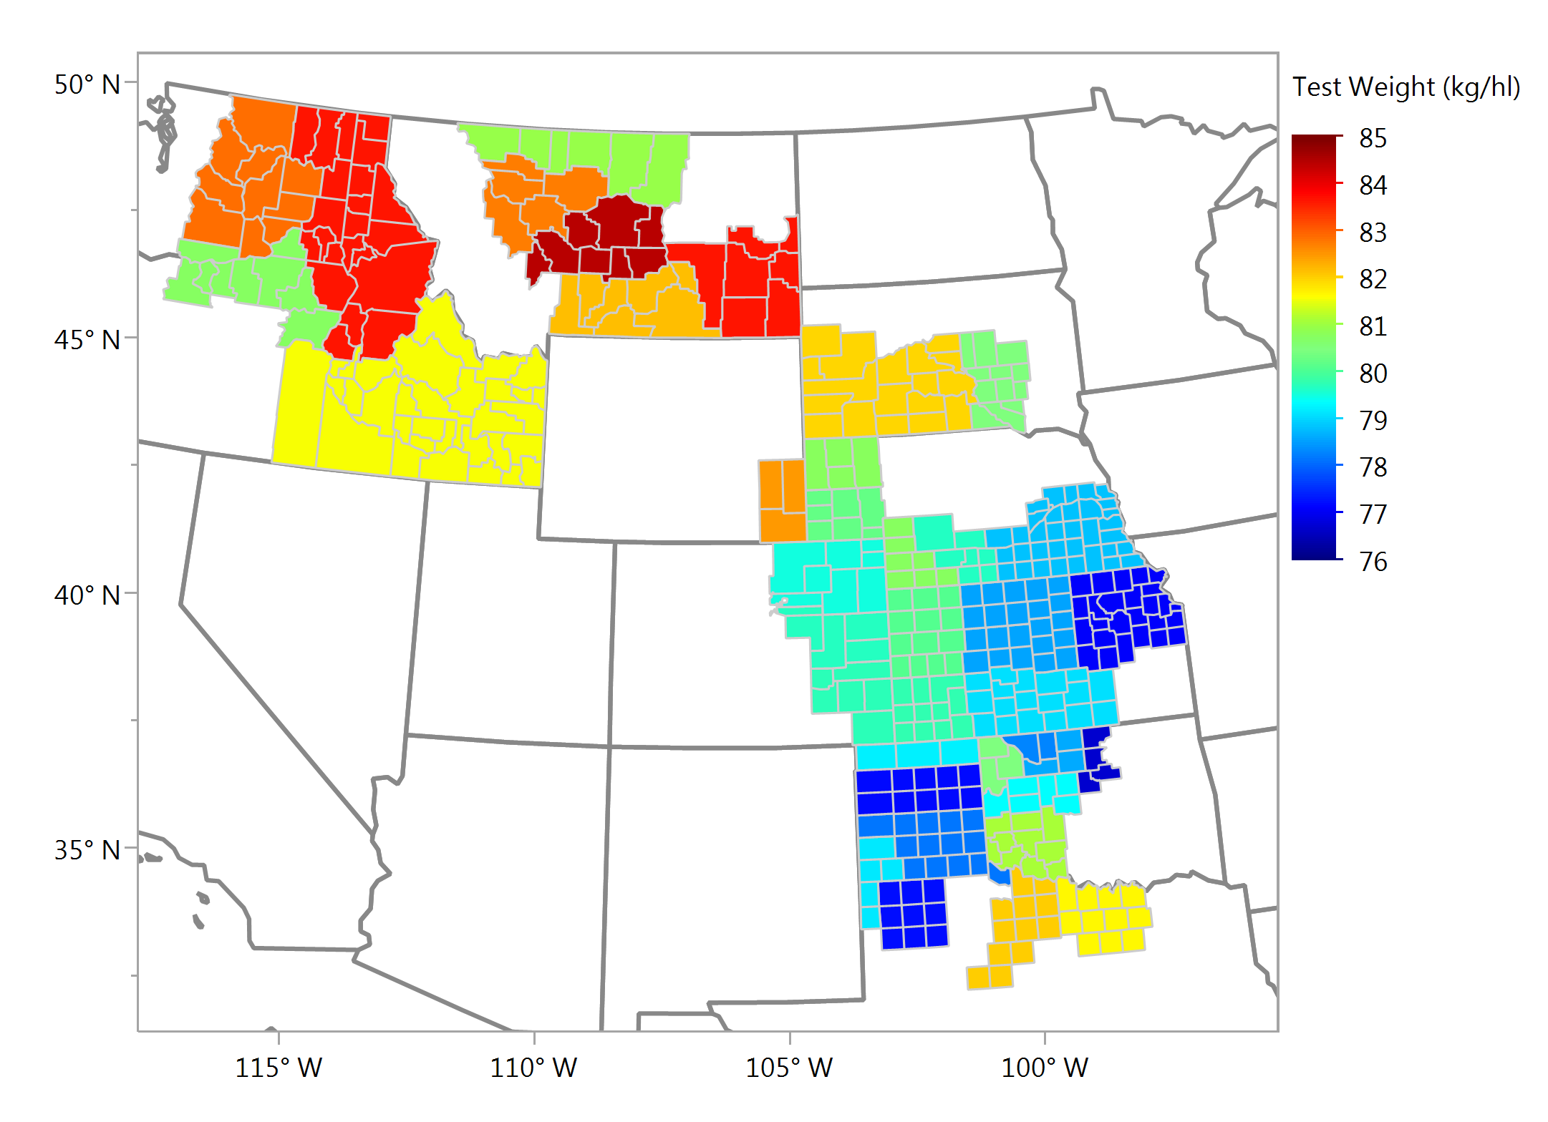
Test Weight, kg/hl Average - Individual Samples

Slide 6
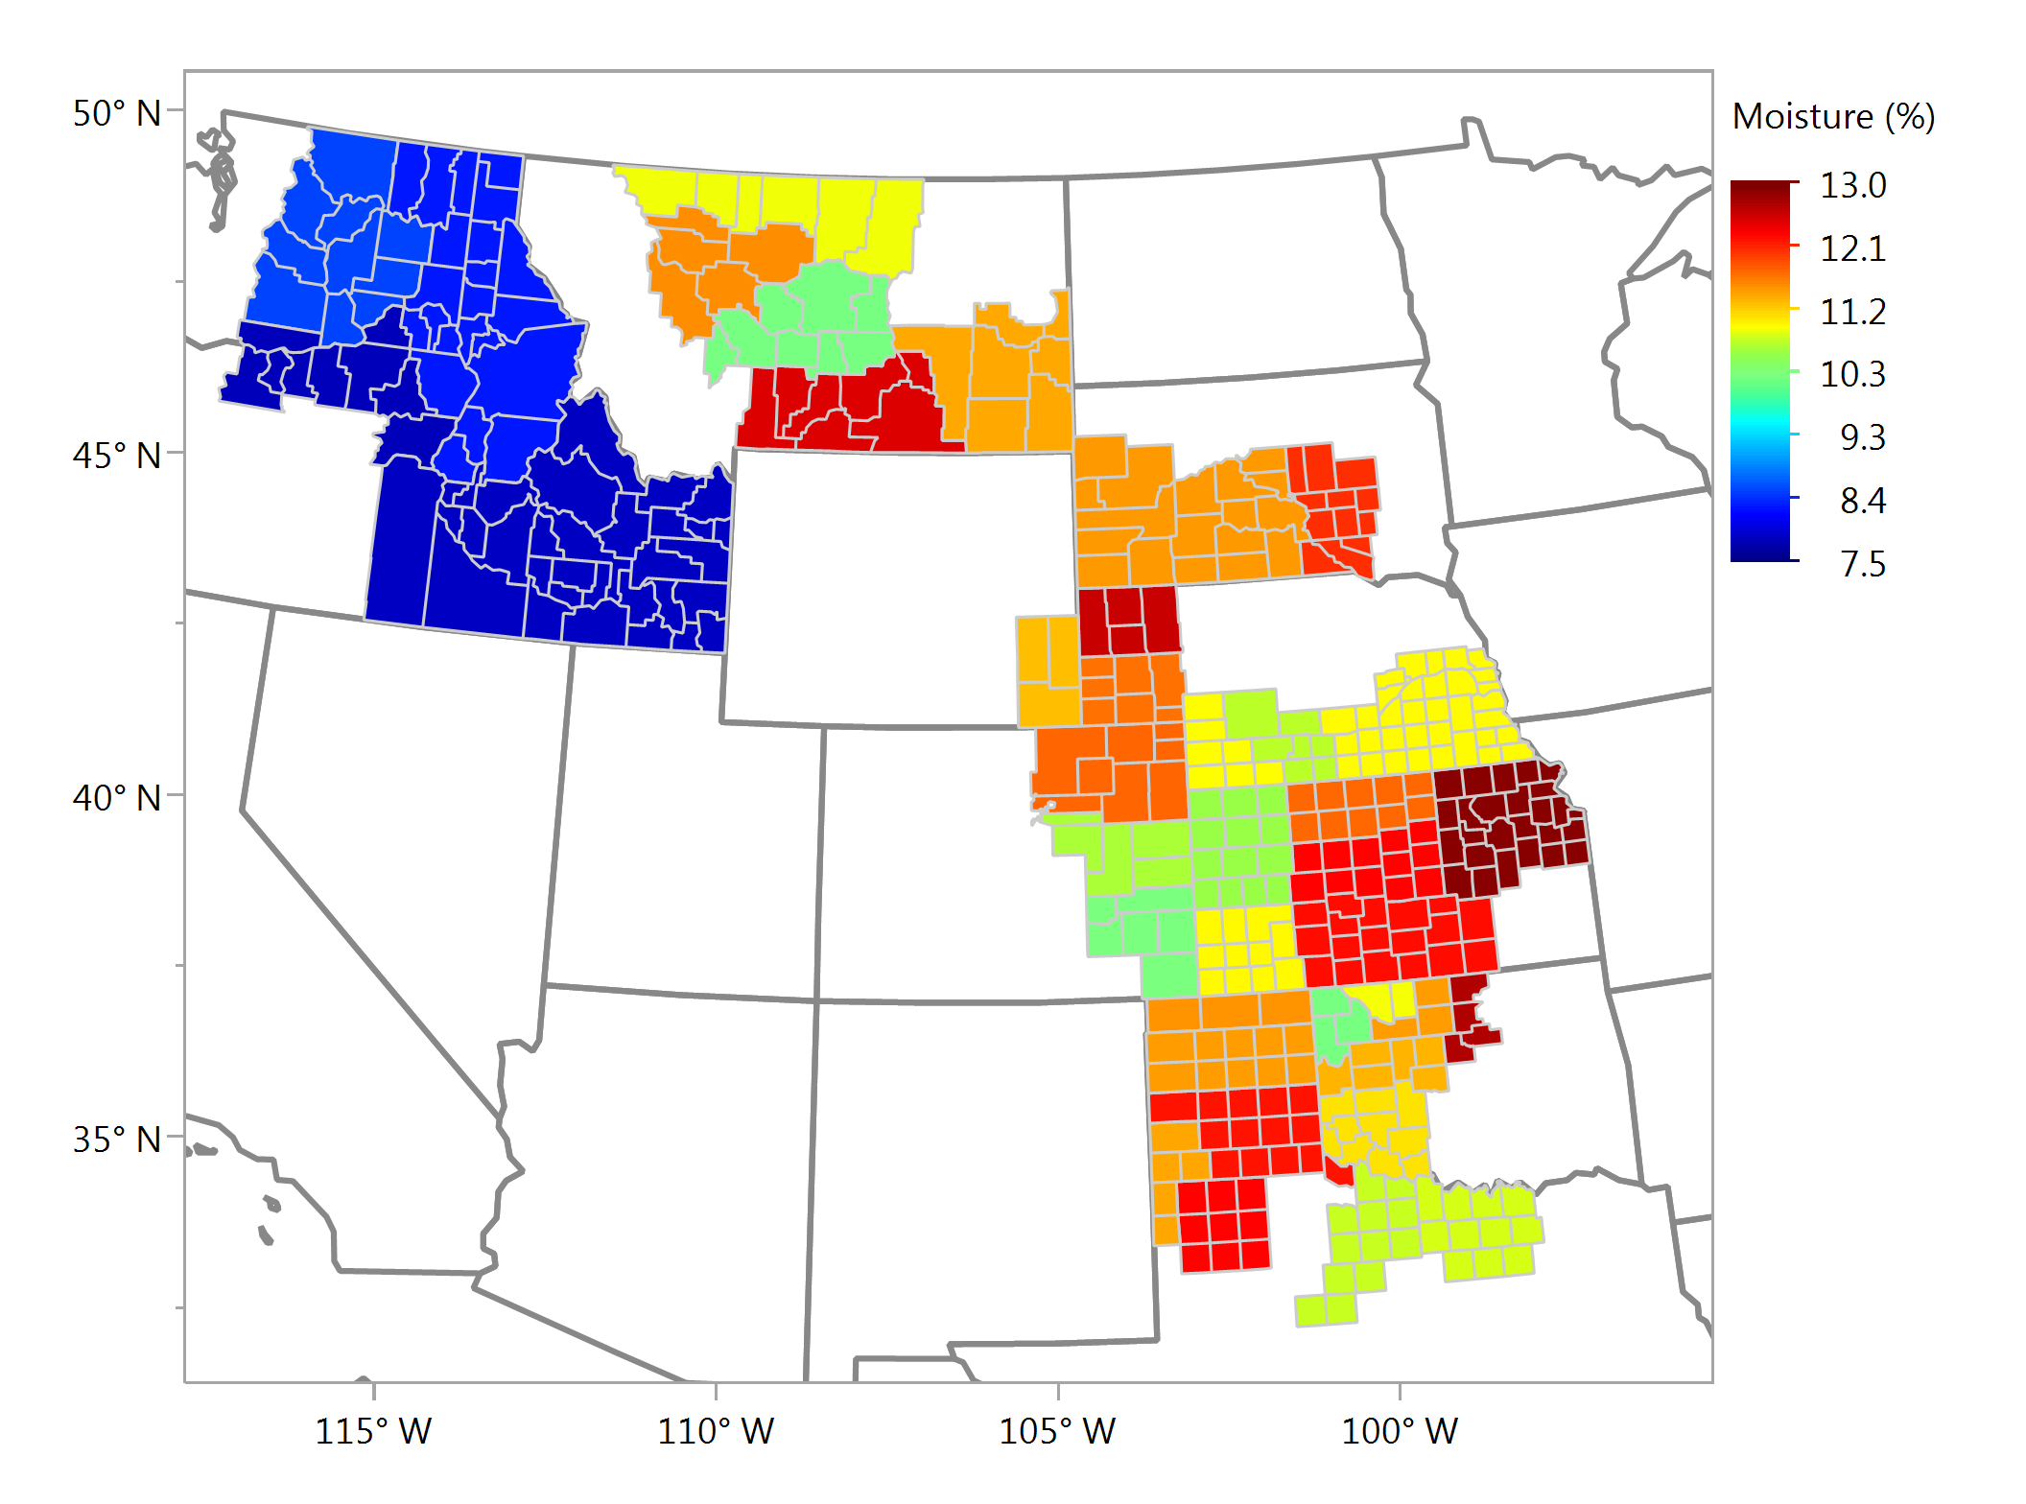
Wheat Moisture, % Average - Individual Samples

Slide 7
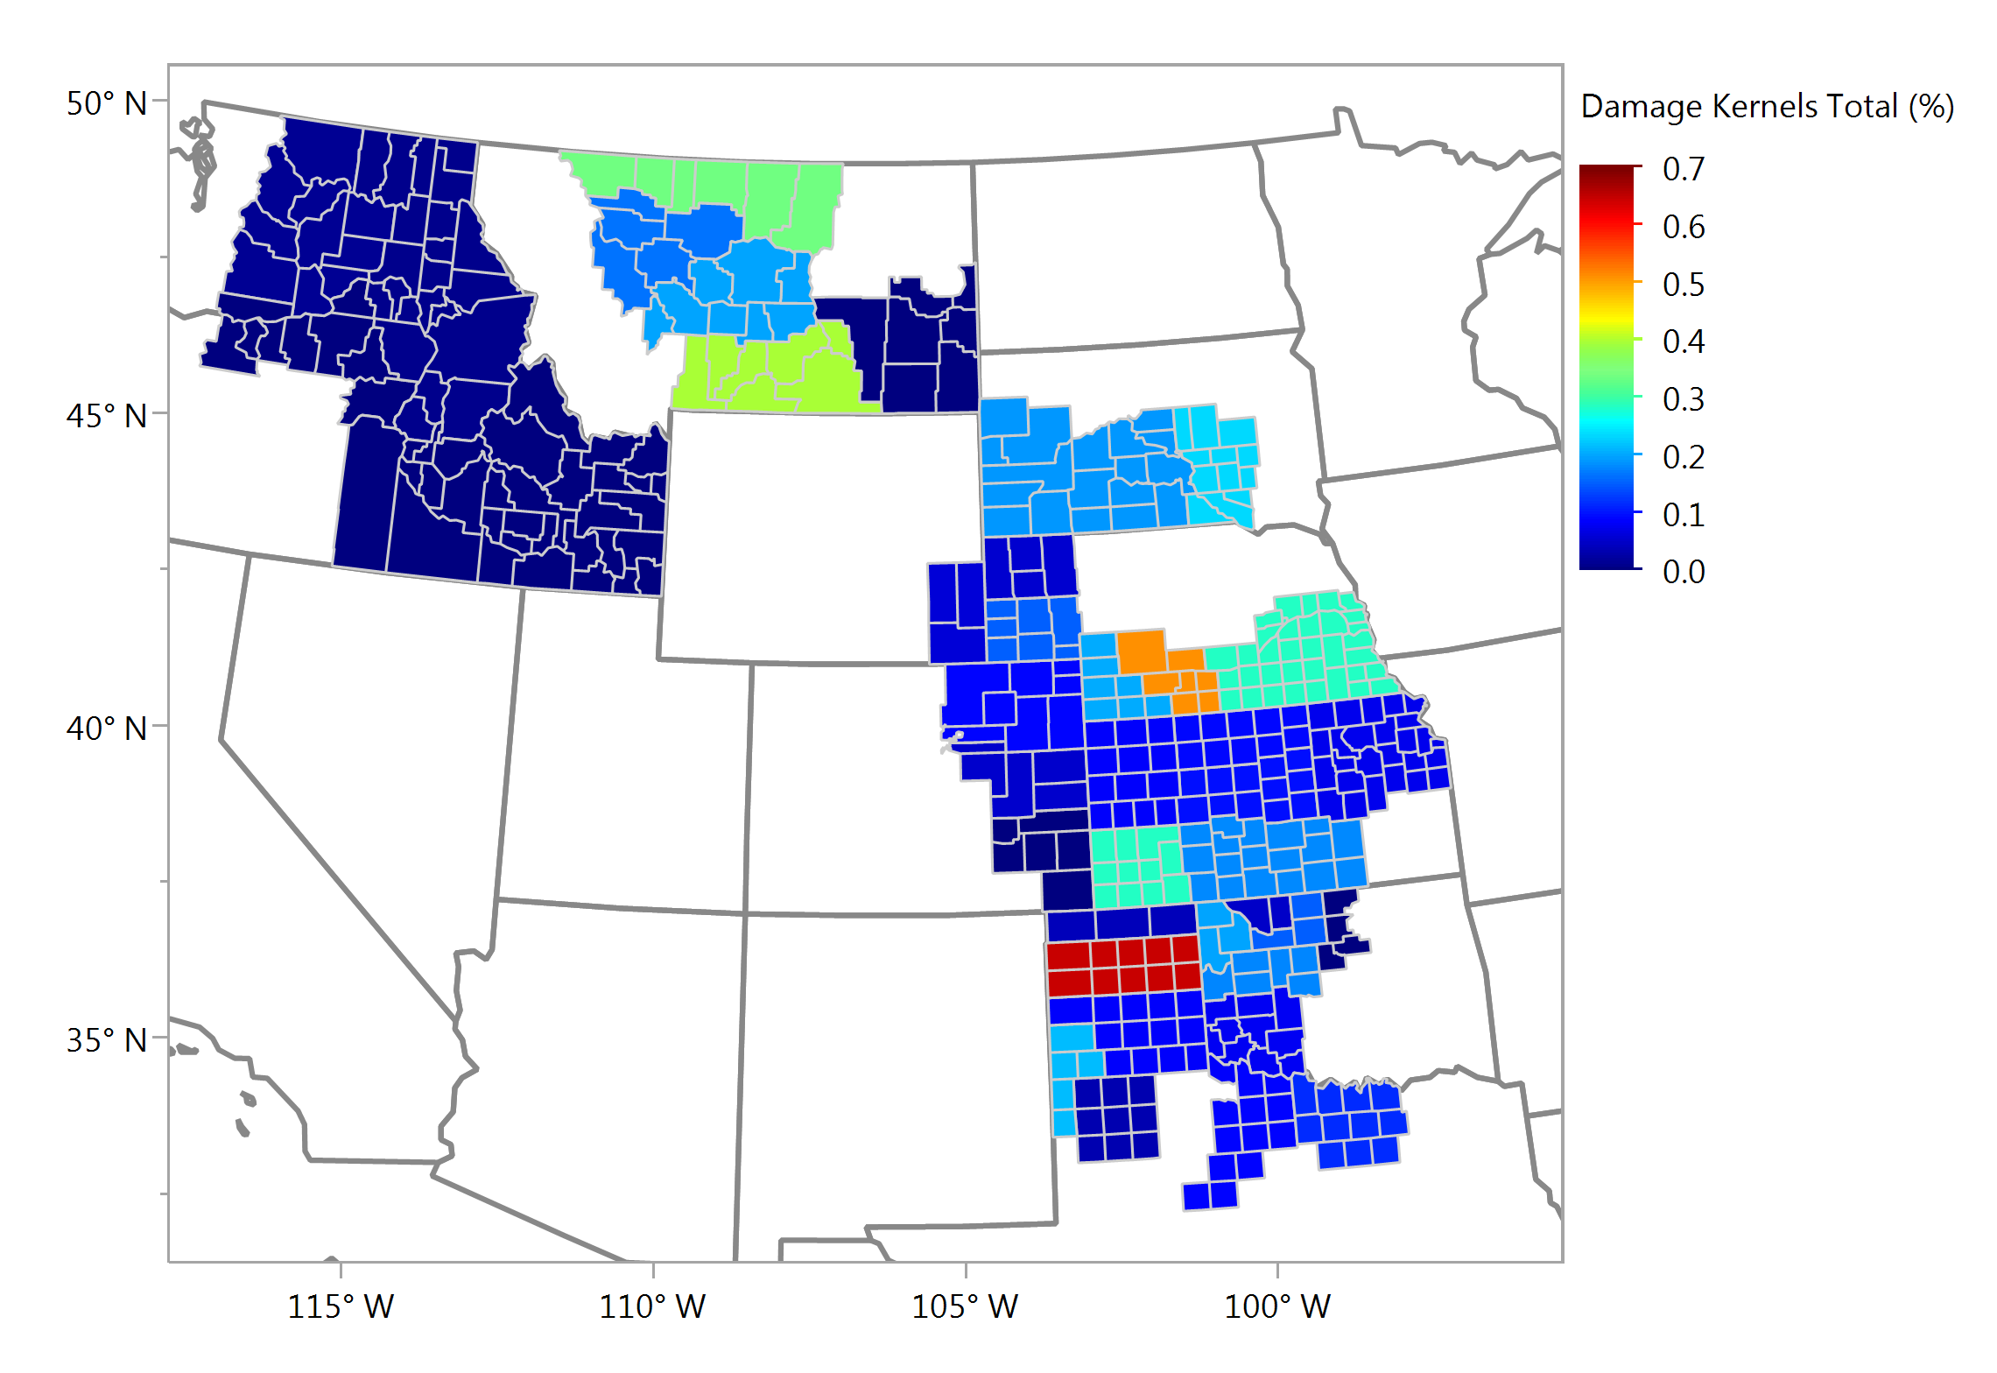
Damaged Kernels, % Average - Individual Samples

Slide 8
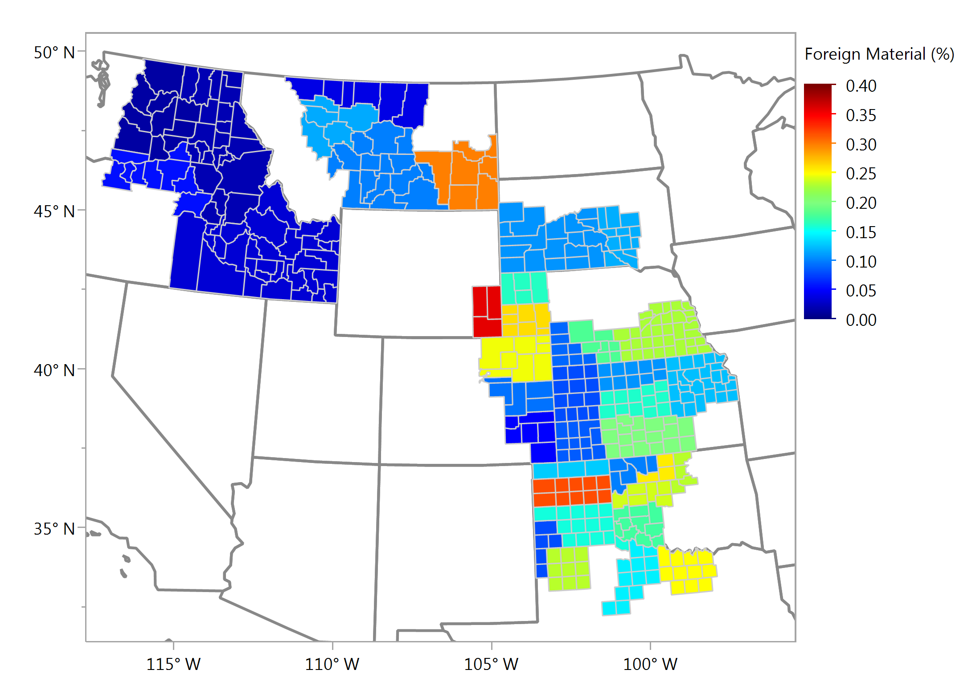
Foreign Material, % Average - Individual Samples

Slide 9
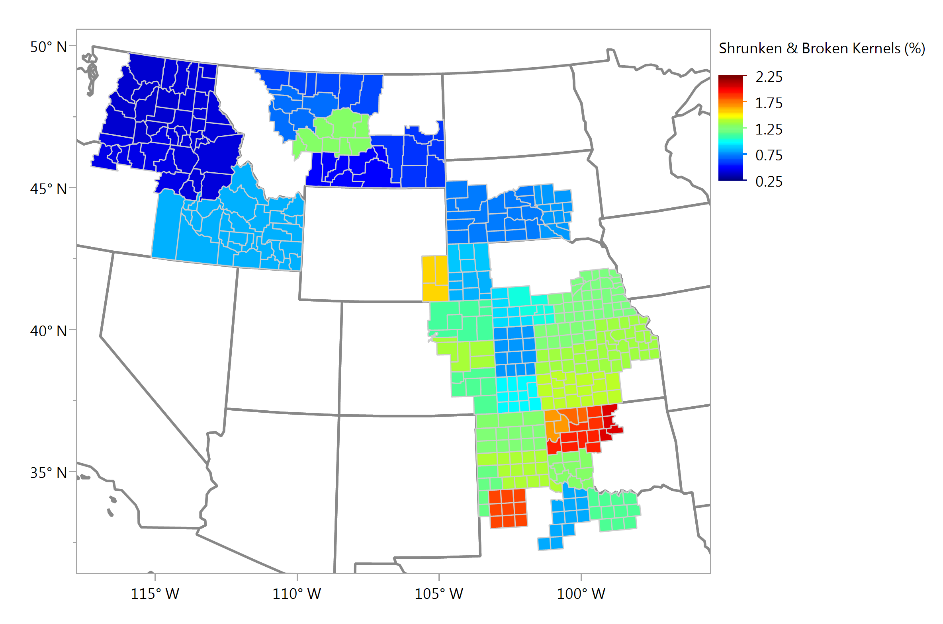
Shrunken & Broken, % Average - Individual Samples

Slide 10
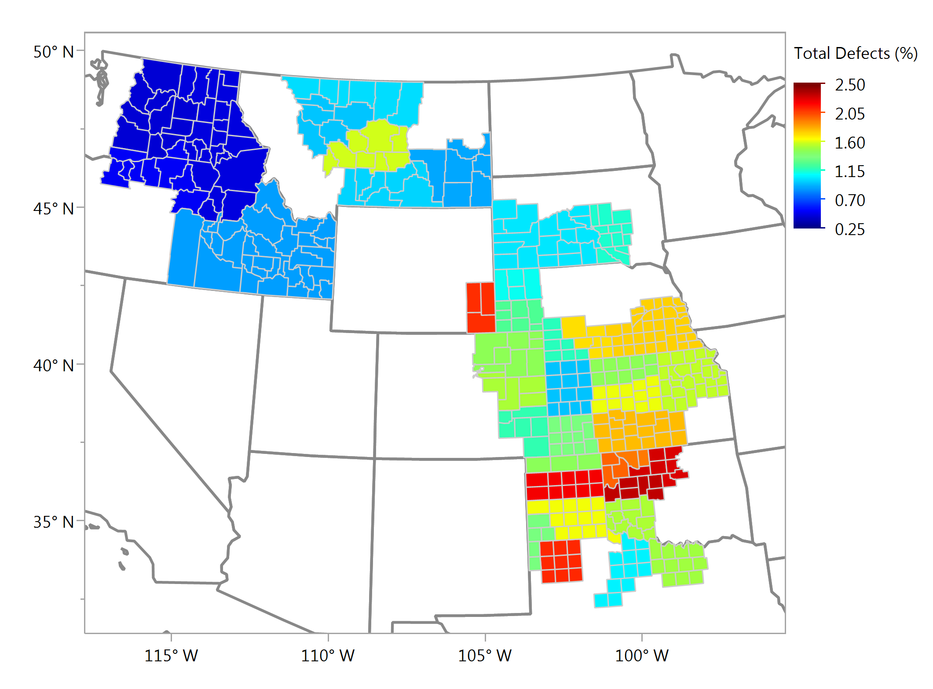
Total Defects, % Average - Individual Samples

Slide 11
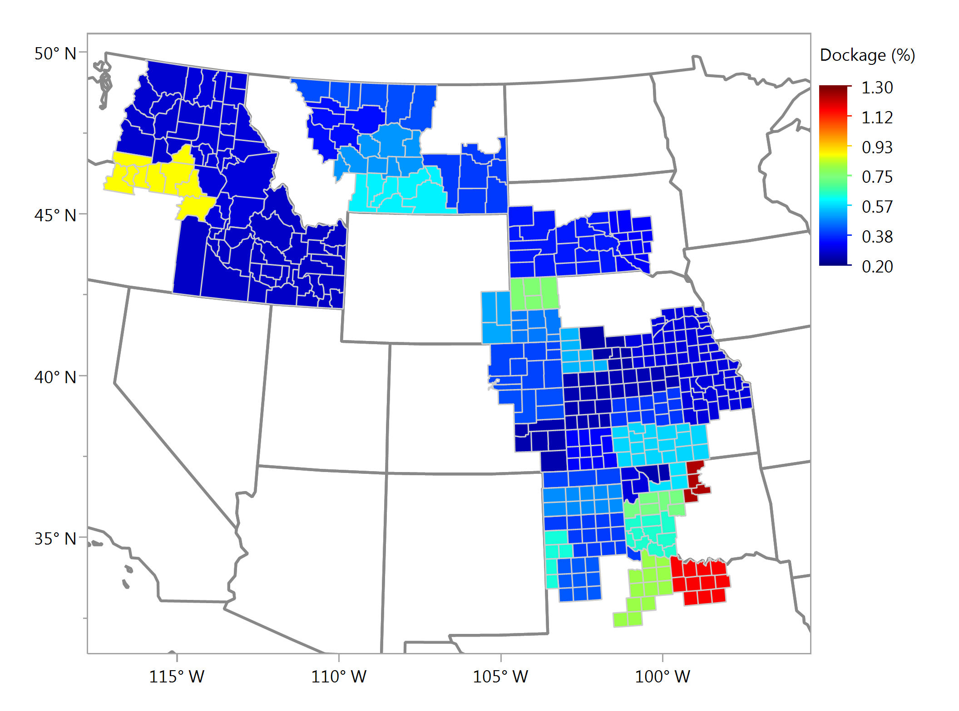
Dockage, % Average - Individual Samples

Slide 12
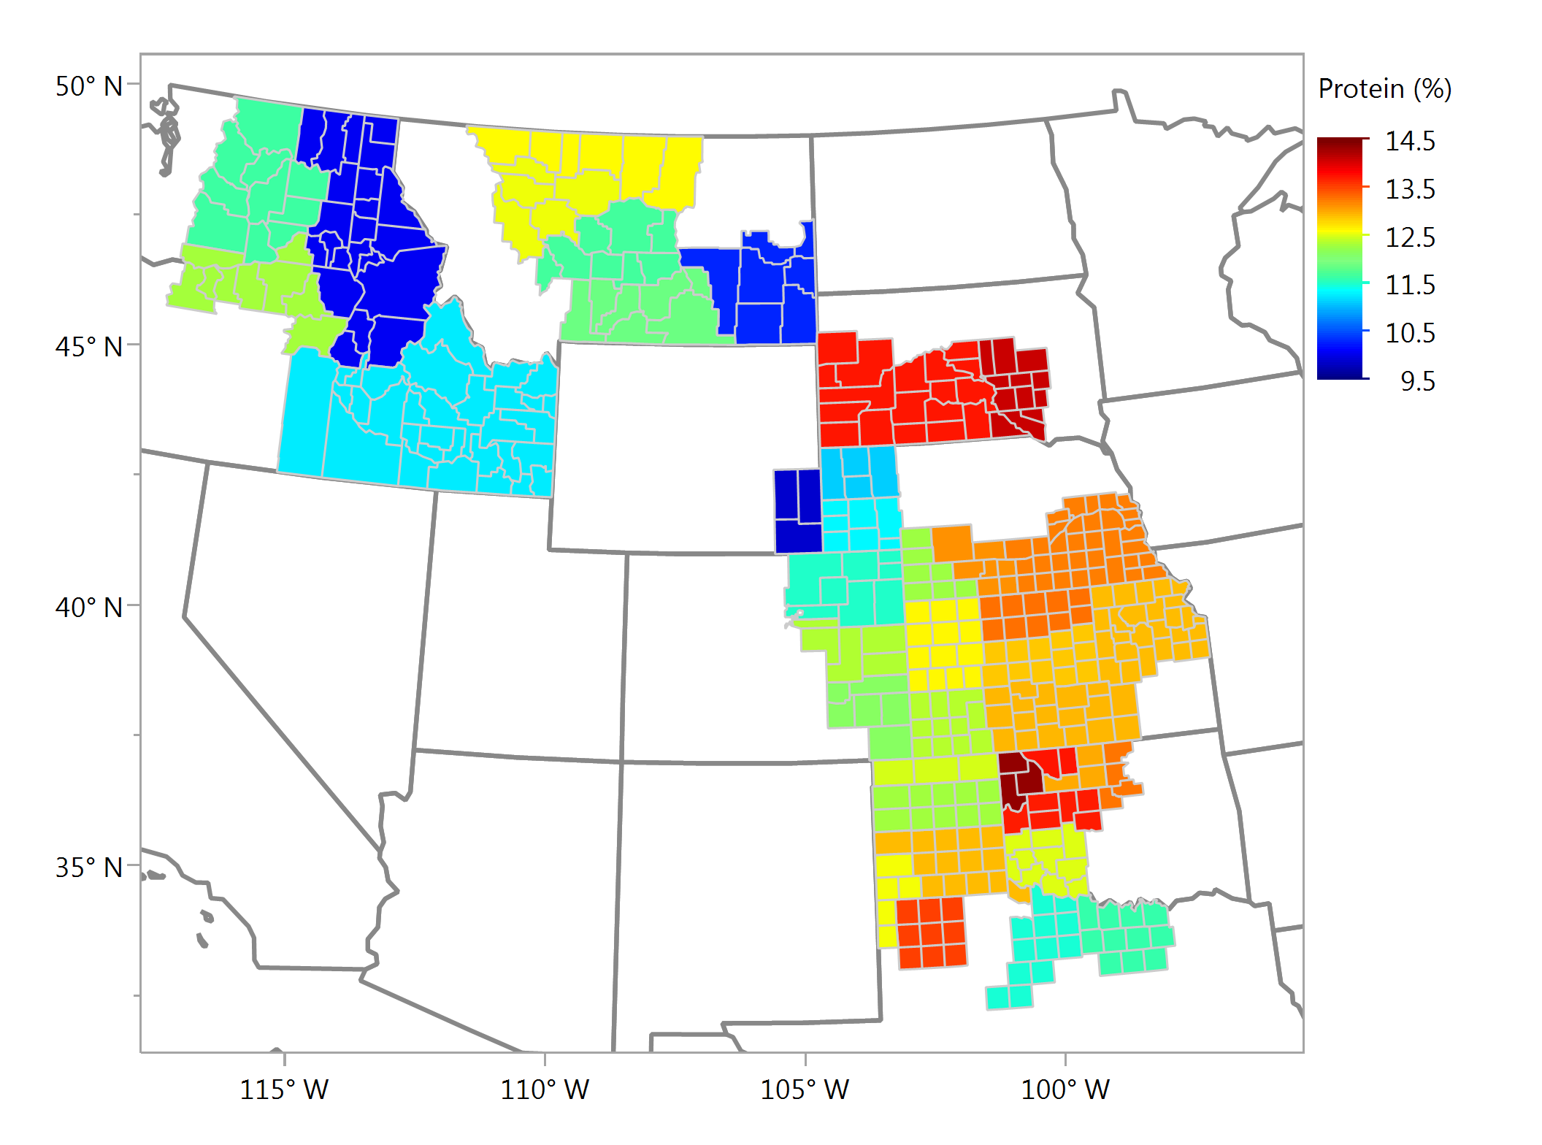
Wheat Protein, % Average - Individual Samples

Slide 13
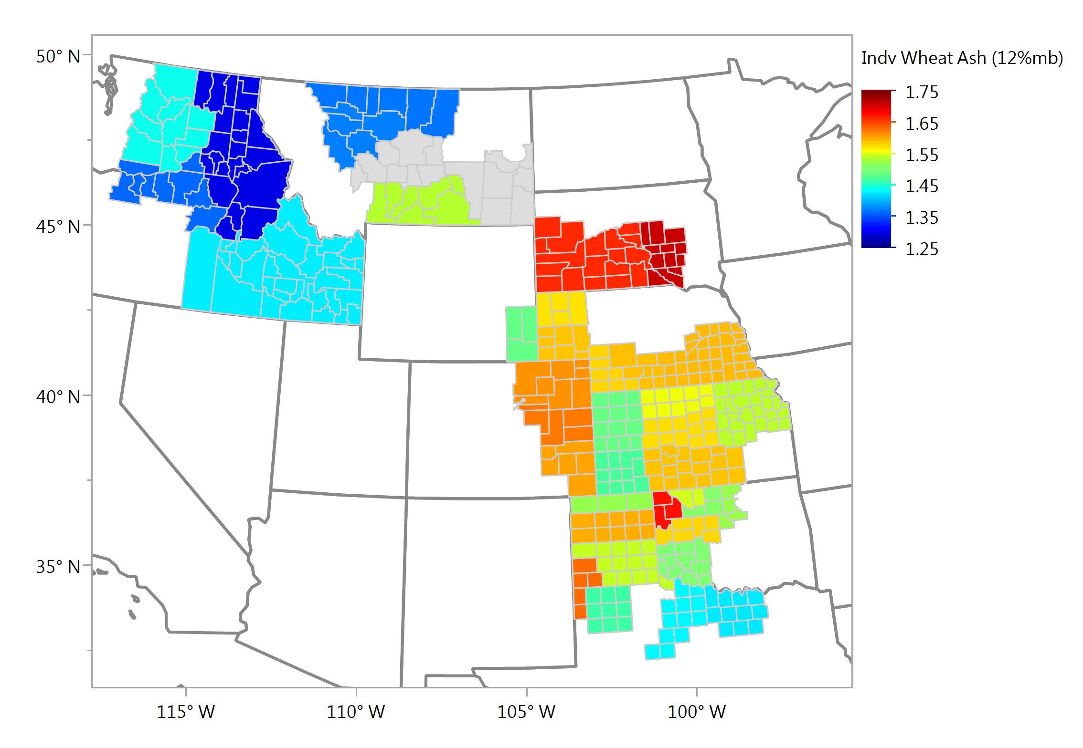
Wheat Ash (12% mb), % Average - Individual Samples

Slide 14
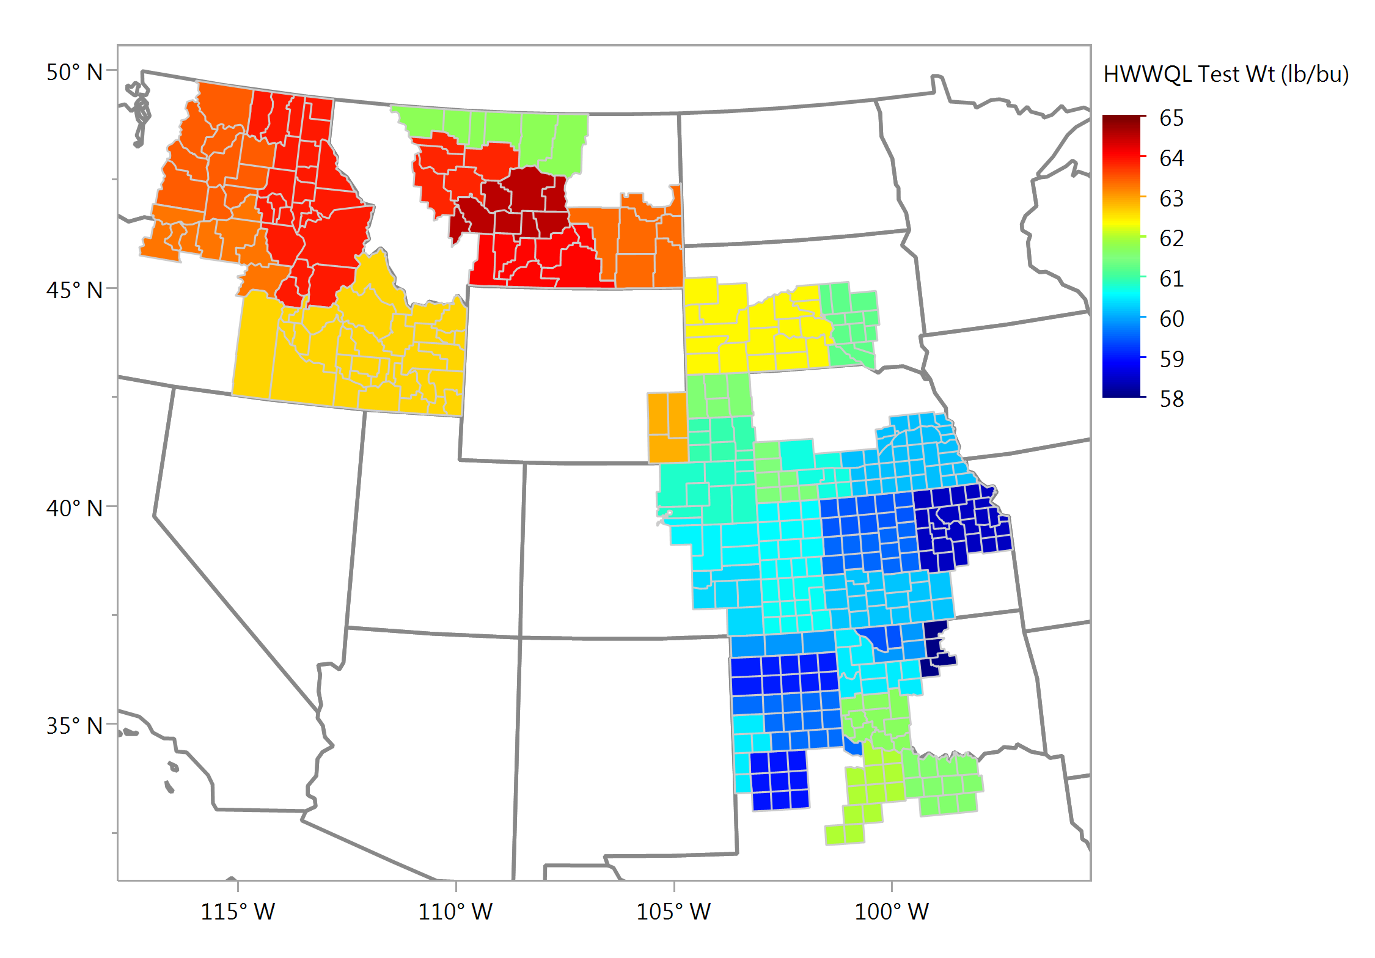
Test Weight, lbs/bu Average - Individual HWWQL Samples

Slide 15
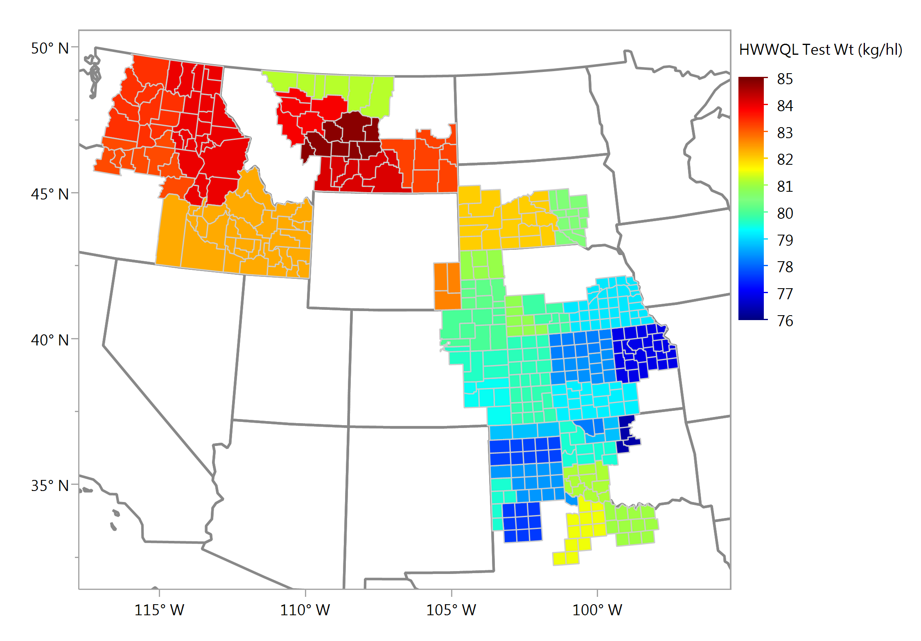
Test Weight, kg/hl Average - Individual HWWQL Samples

Slide 16
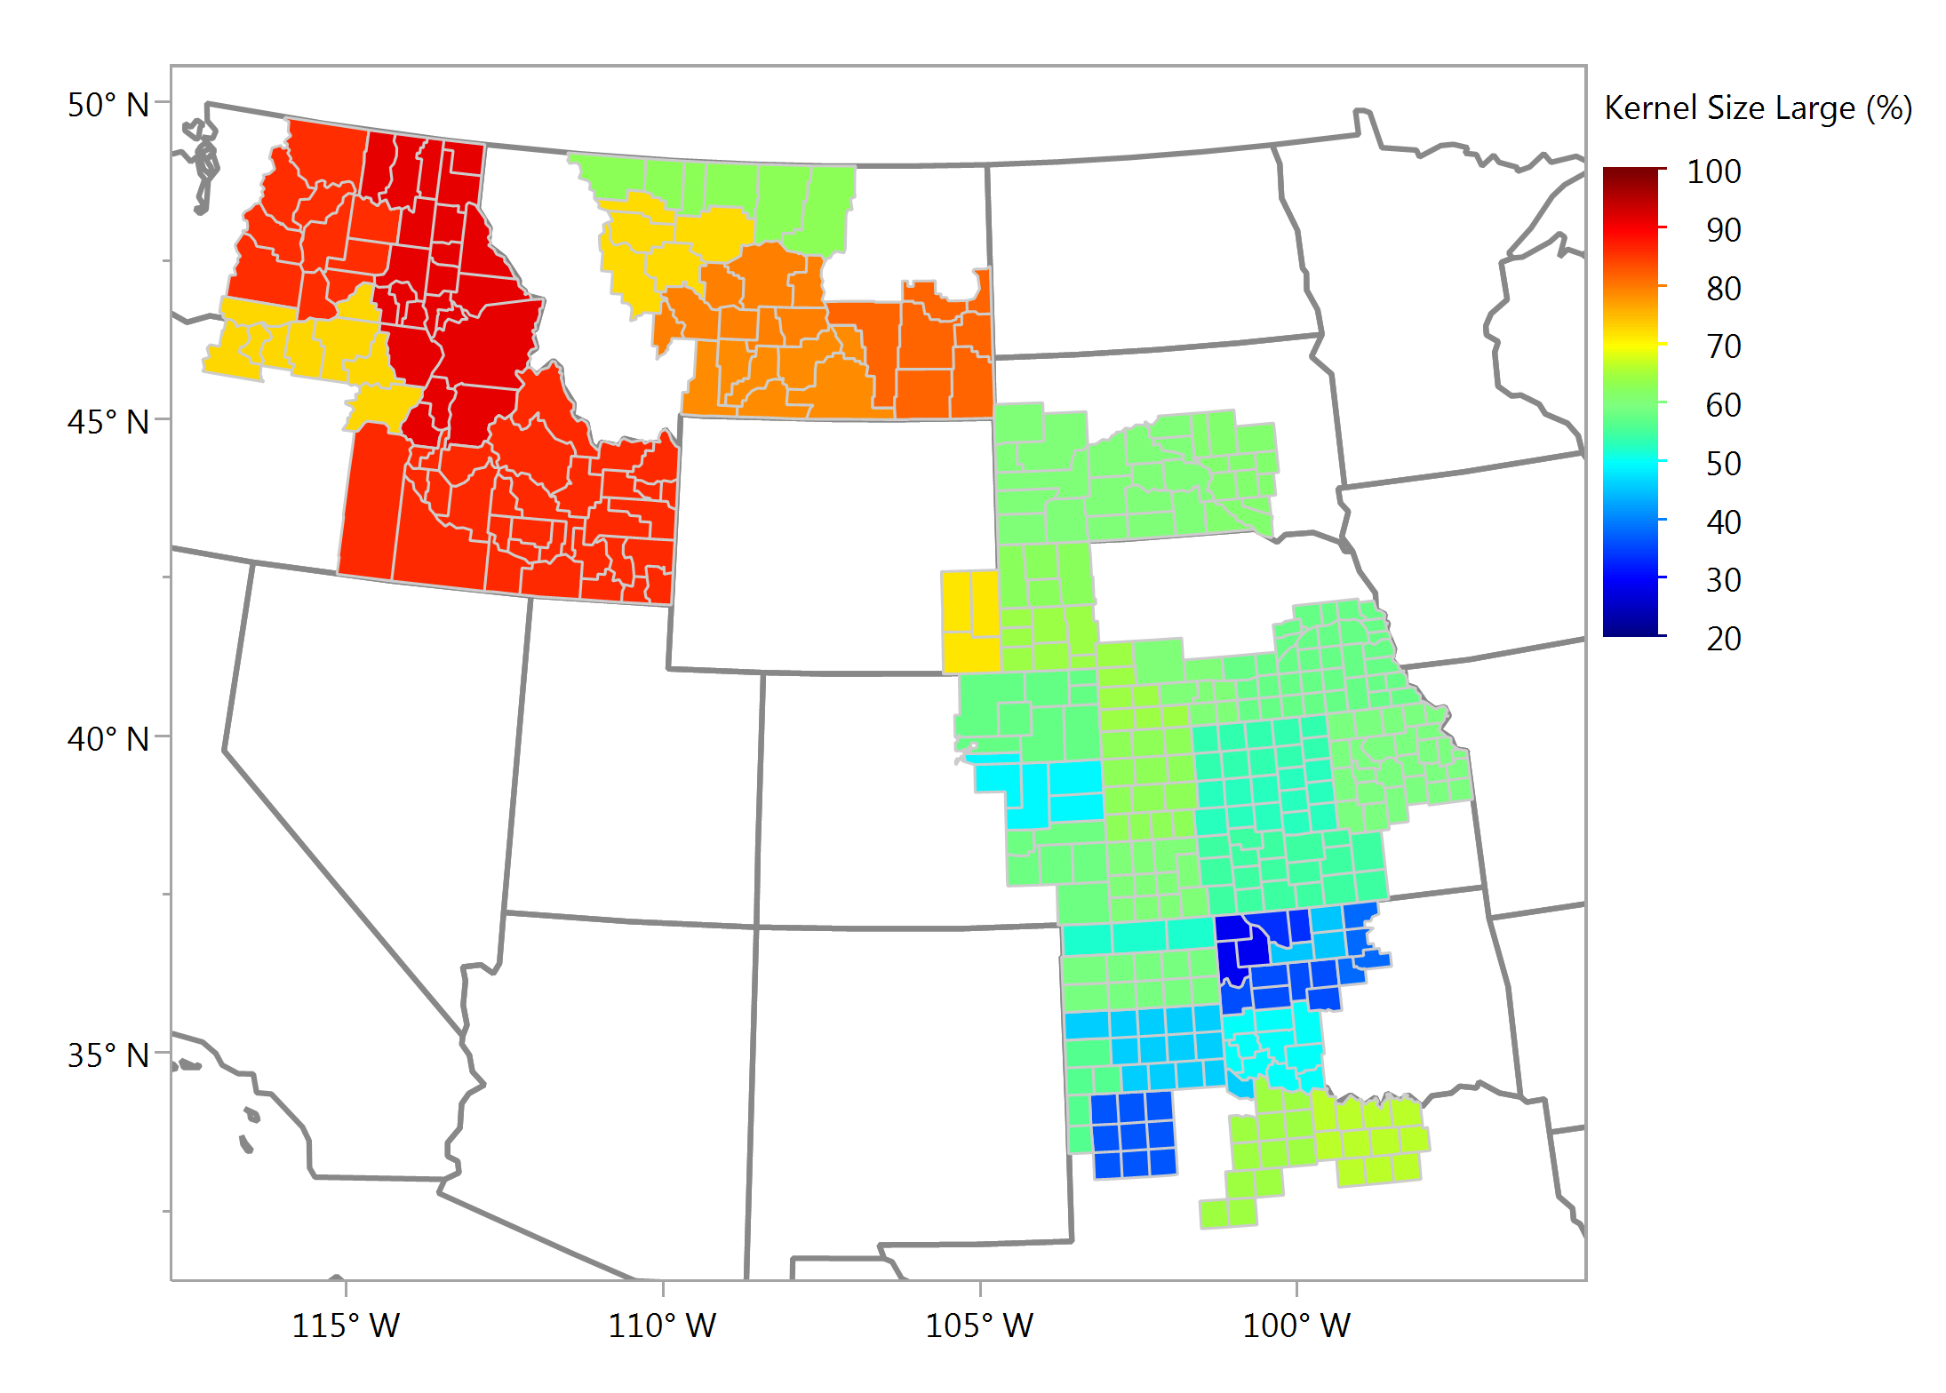
Kernel Size, Large, % Average - Individual Samples

Slide 17
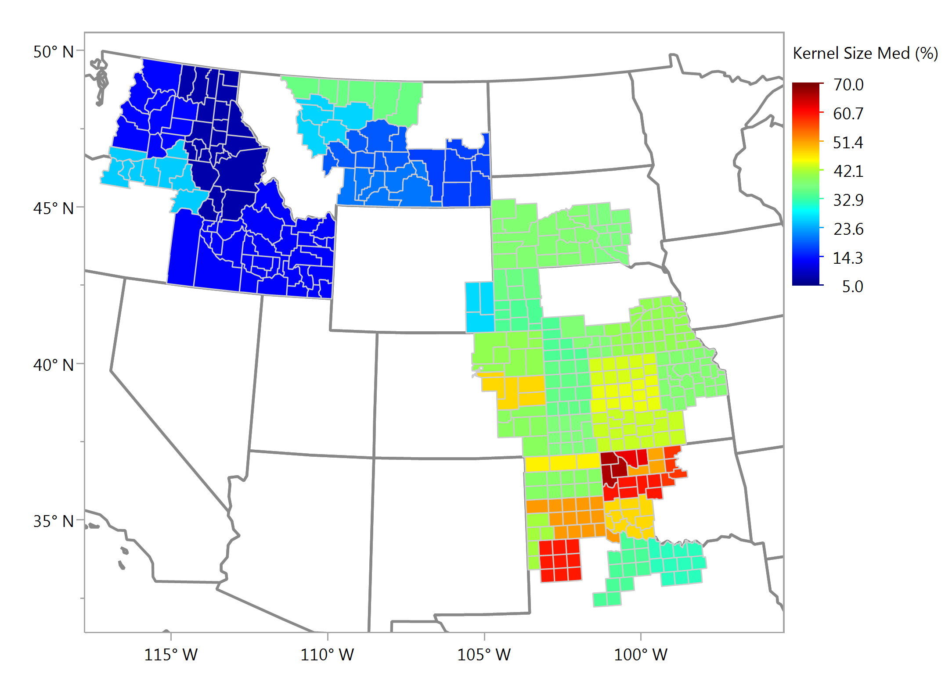
Kernel Size, Medium, % Average - Individual Samples

Slide 18
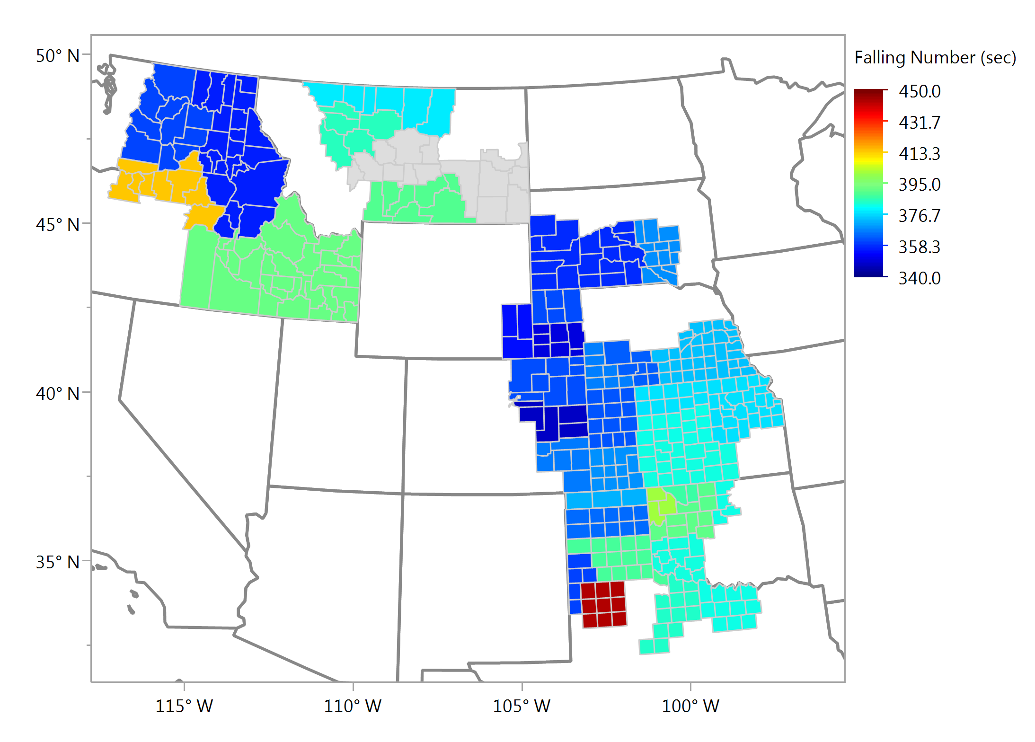
Wheat Falling Number, sec Average - Individual Samples

Slide 19
Wheat Ash (12% mb), % Average - Individual Samples

