Slide 1
Hard Red Winter Flour Quality Maps Based on Crop Survey by Plains Grains, Inc.
October 12, 2018

Slide 2
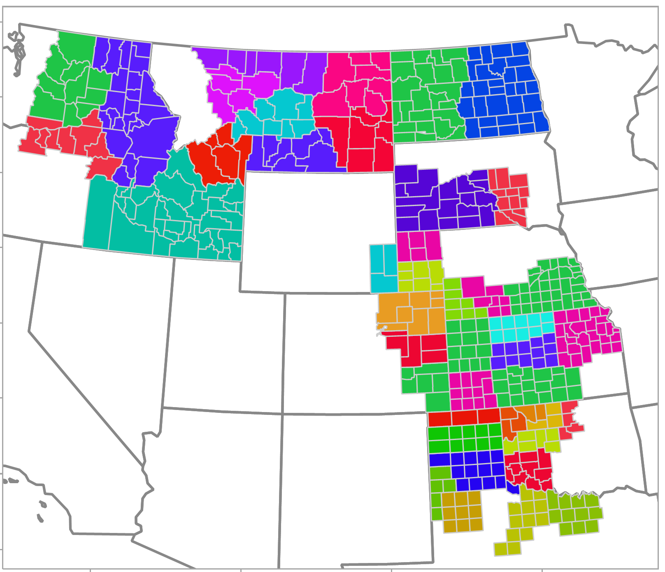
Plains Grains, Inc. Grainsheds and Export Areas
PNW
Gulf

Slide 3
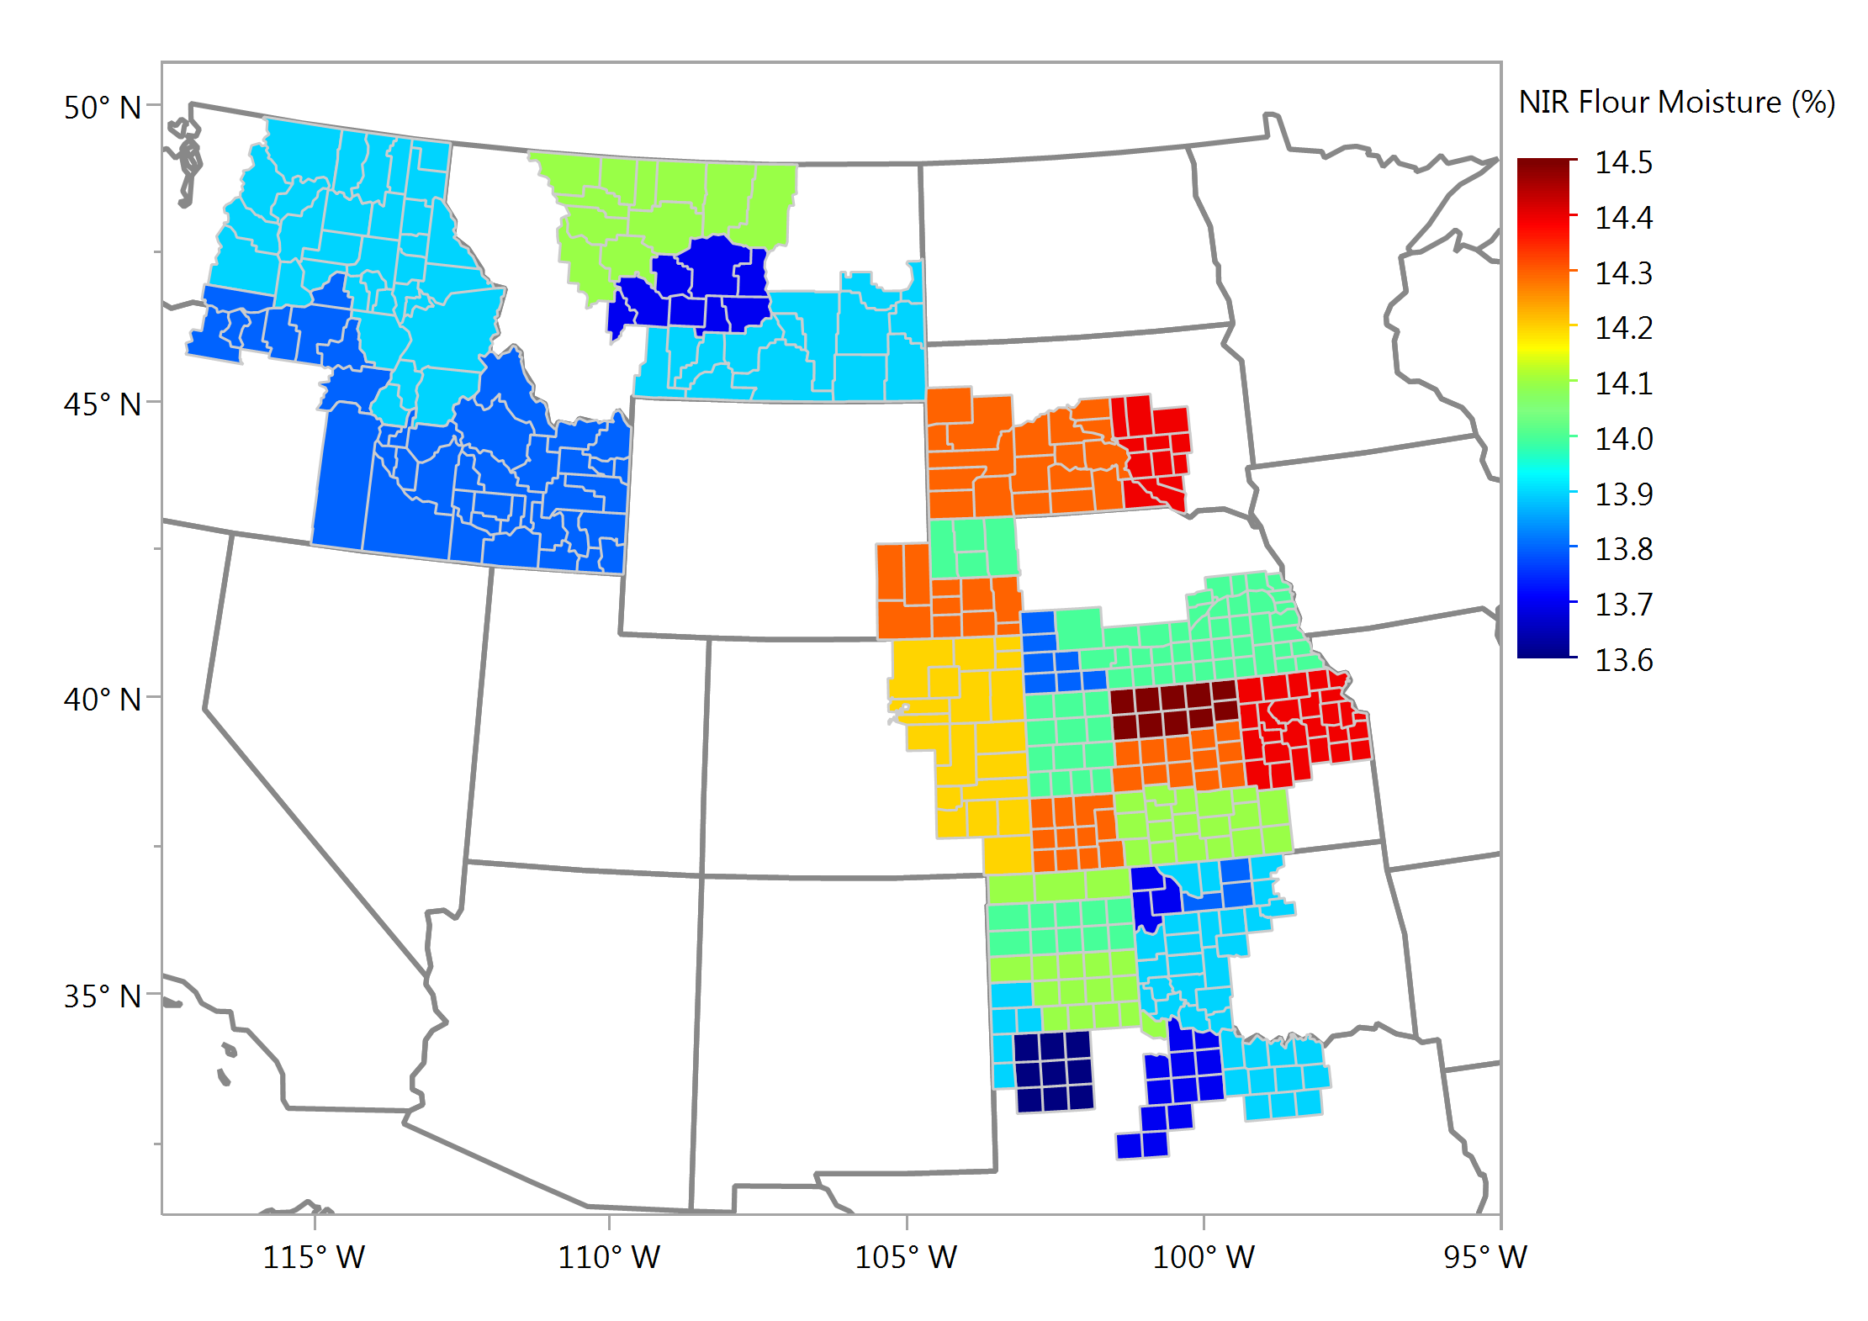
Flour Moisture (NIR), % Composite Samples

Slide 4
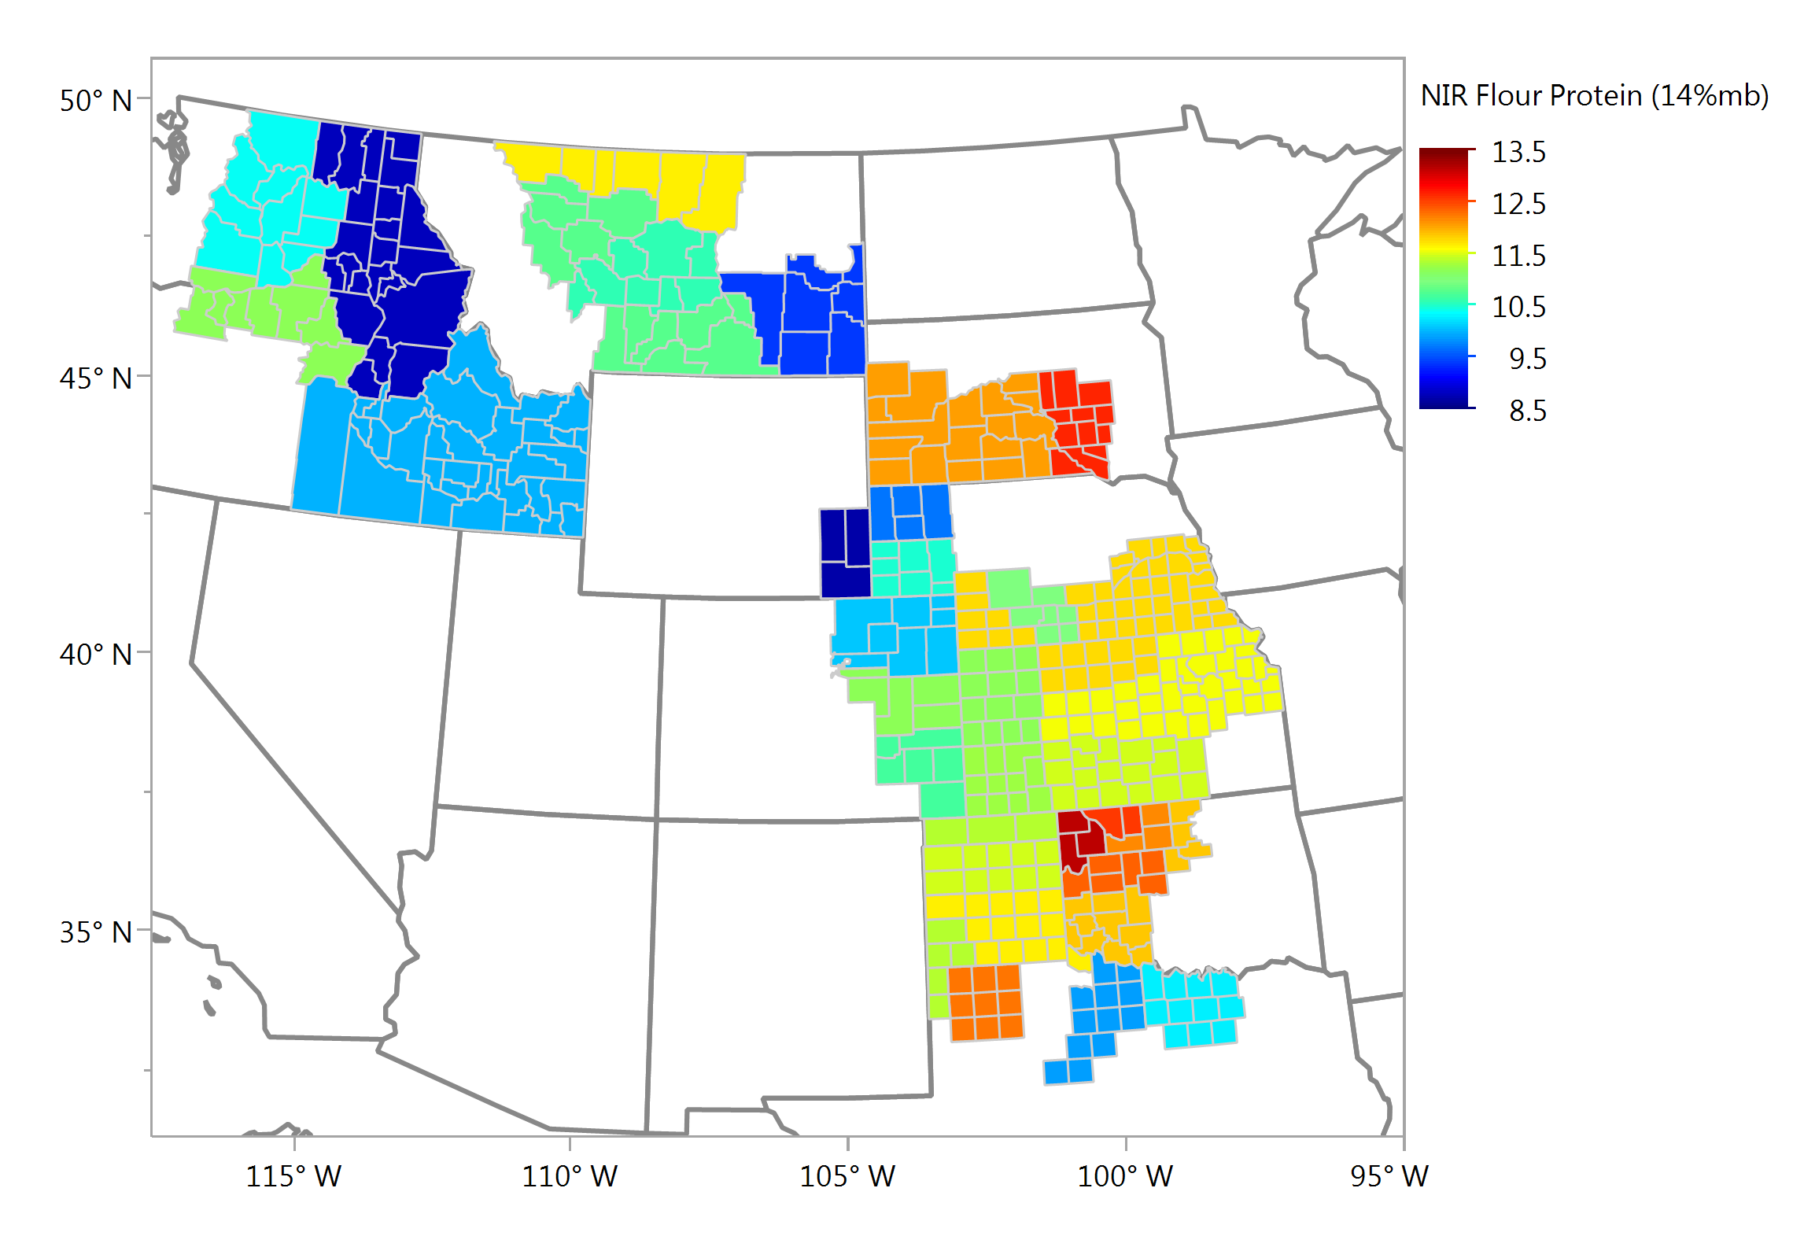
Flour Protein (NIR, 14% mb), % Composite Samples

Slide 5
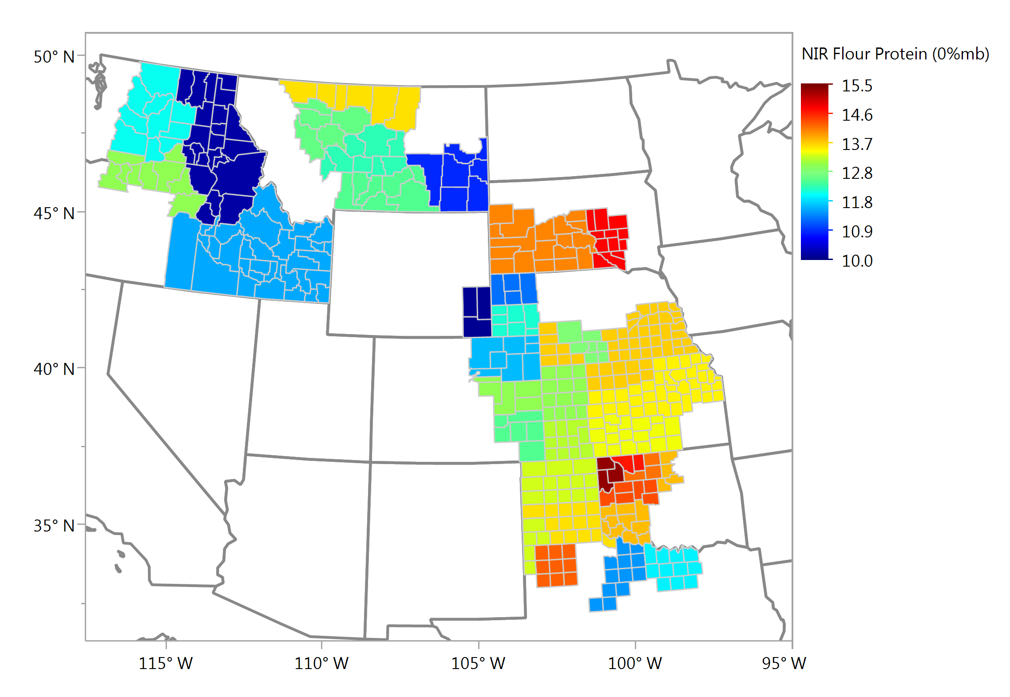
Flour Protein (NIR, mfb), % Composite Samples

Slide 6
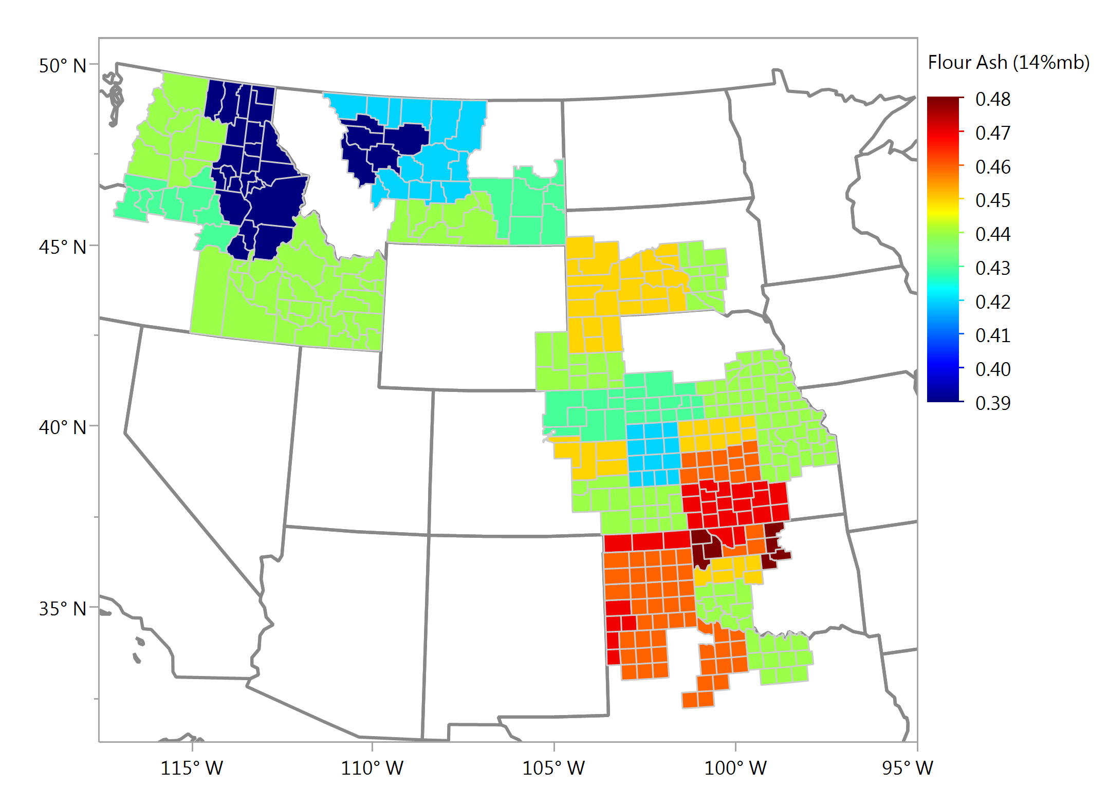
Flour Ash (14% mb), % Composite Samples

Slide 7
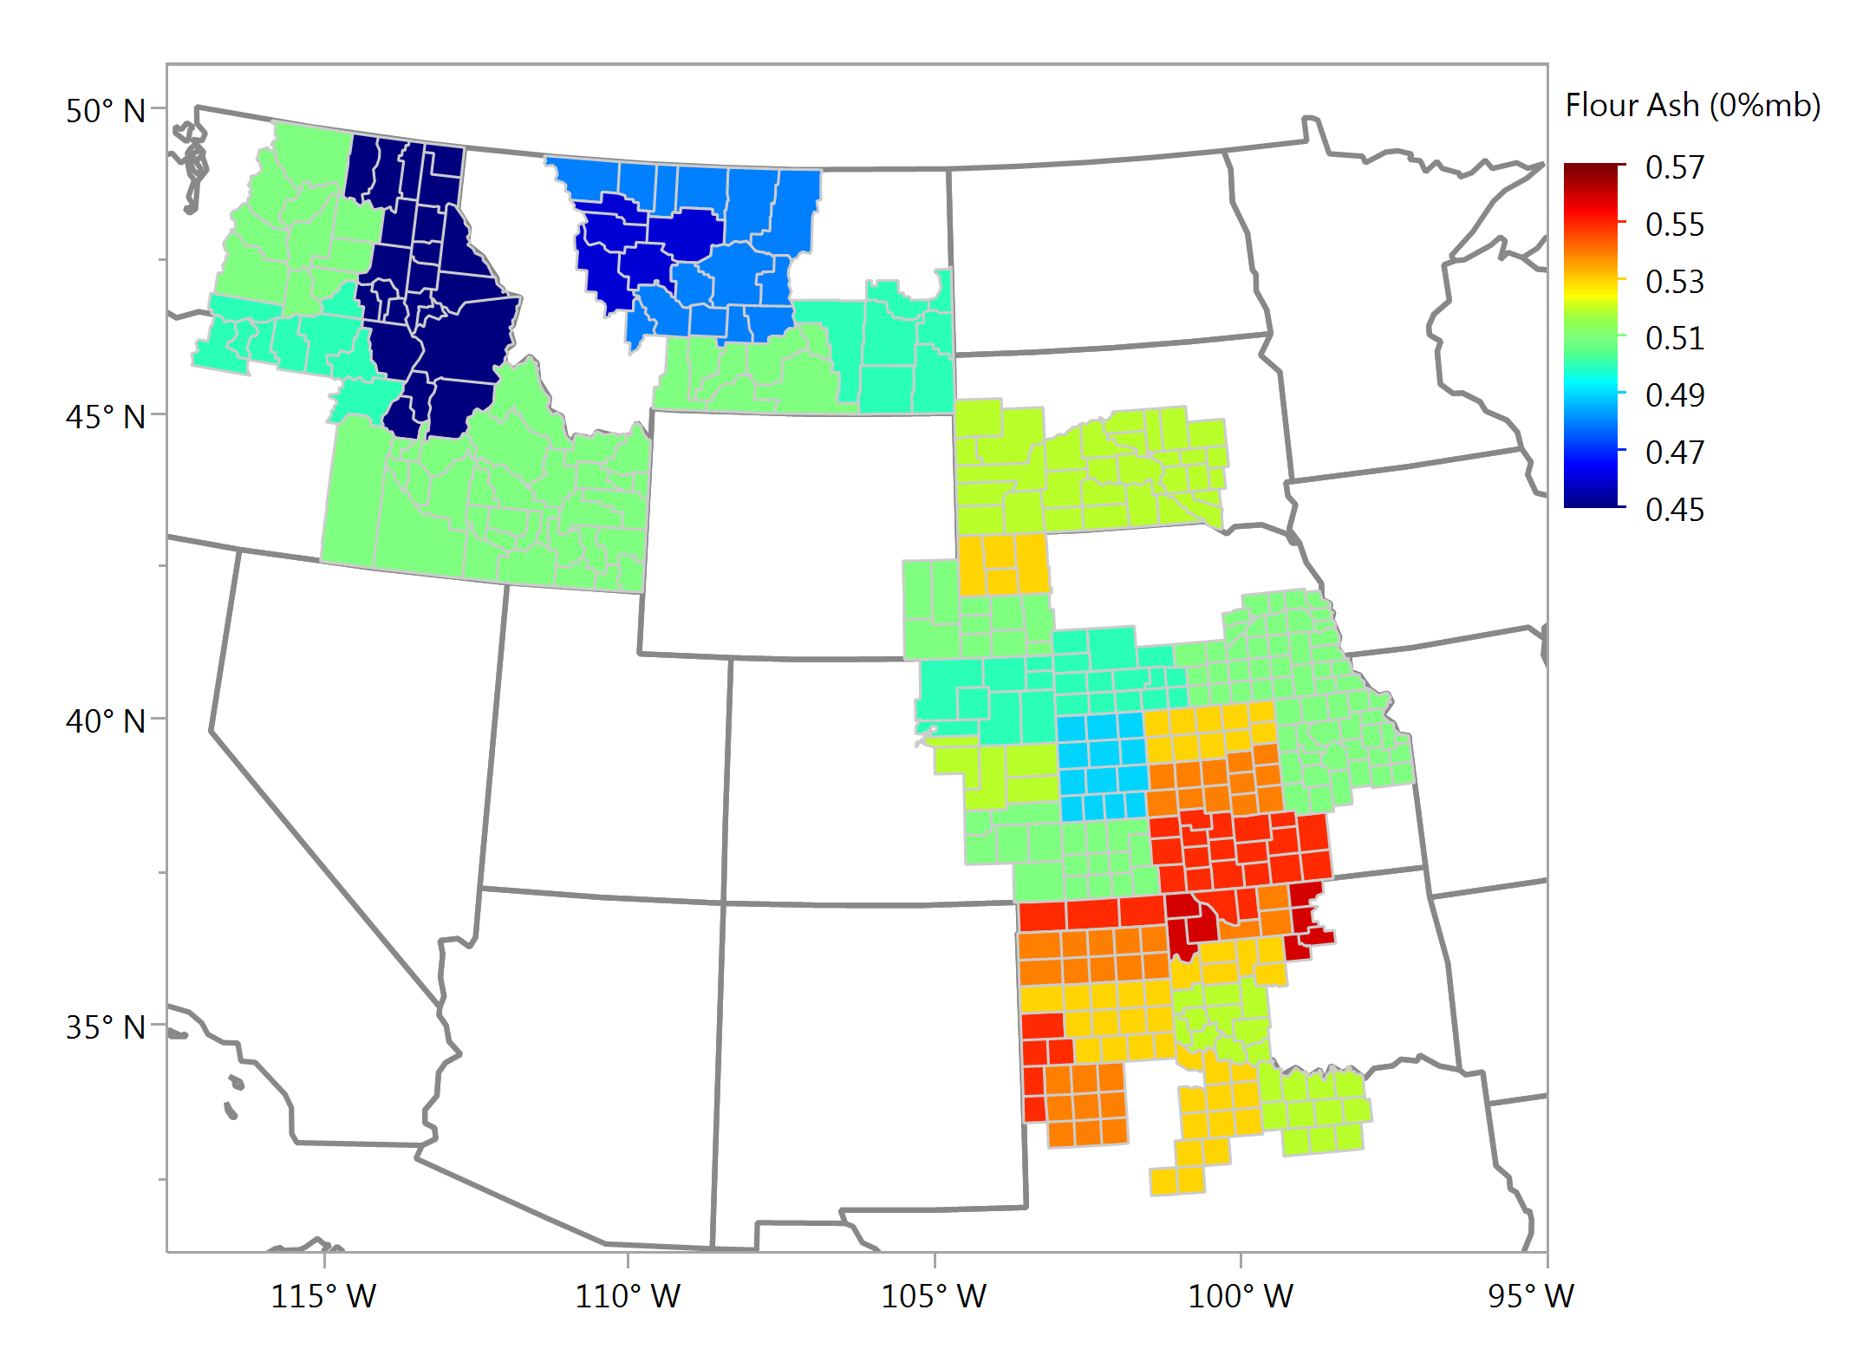
Flour Ash (mfb), % Composite Samples

Slide 8
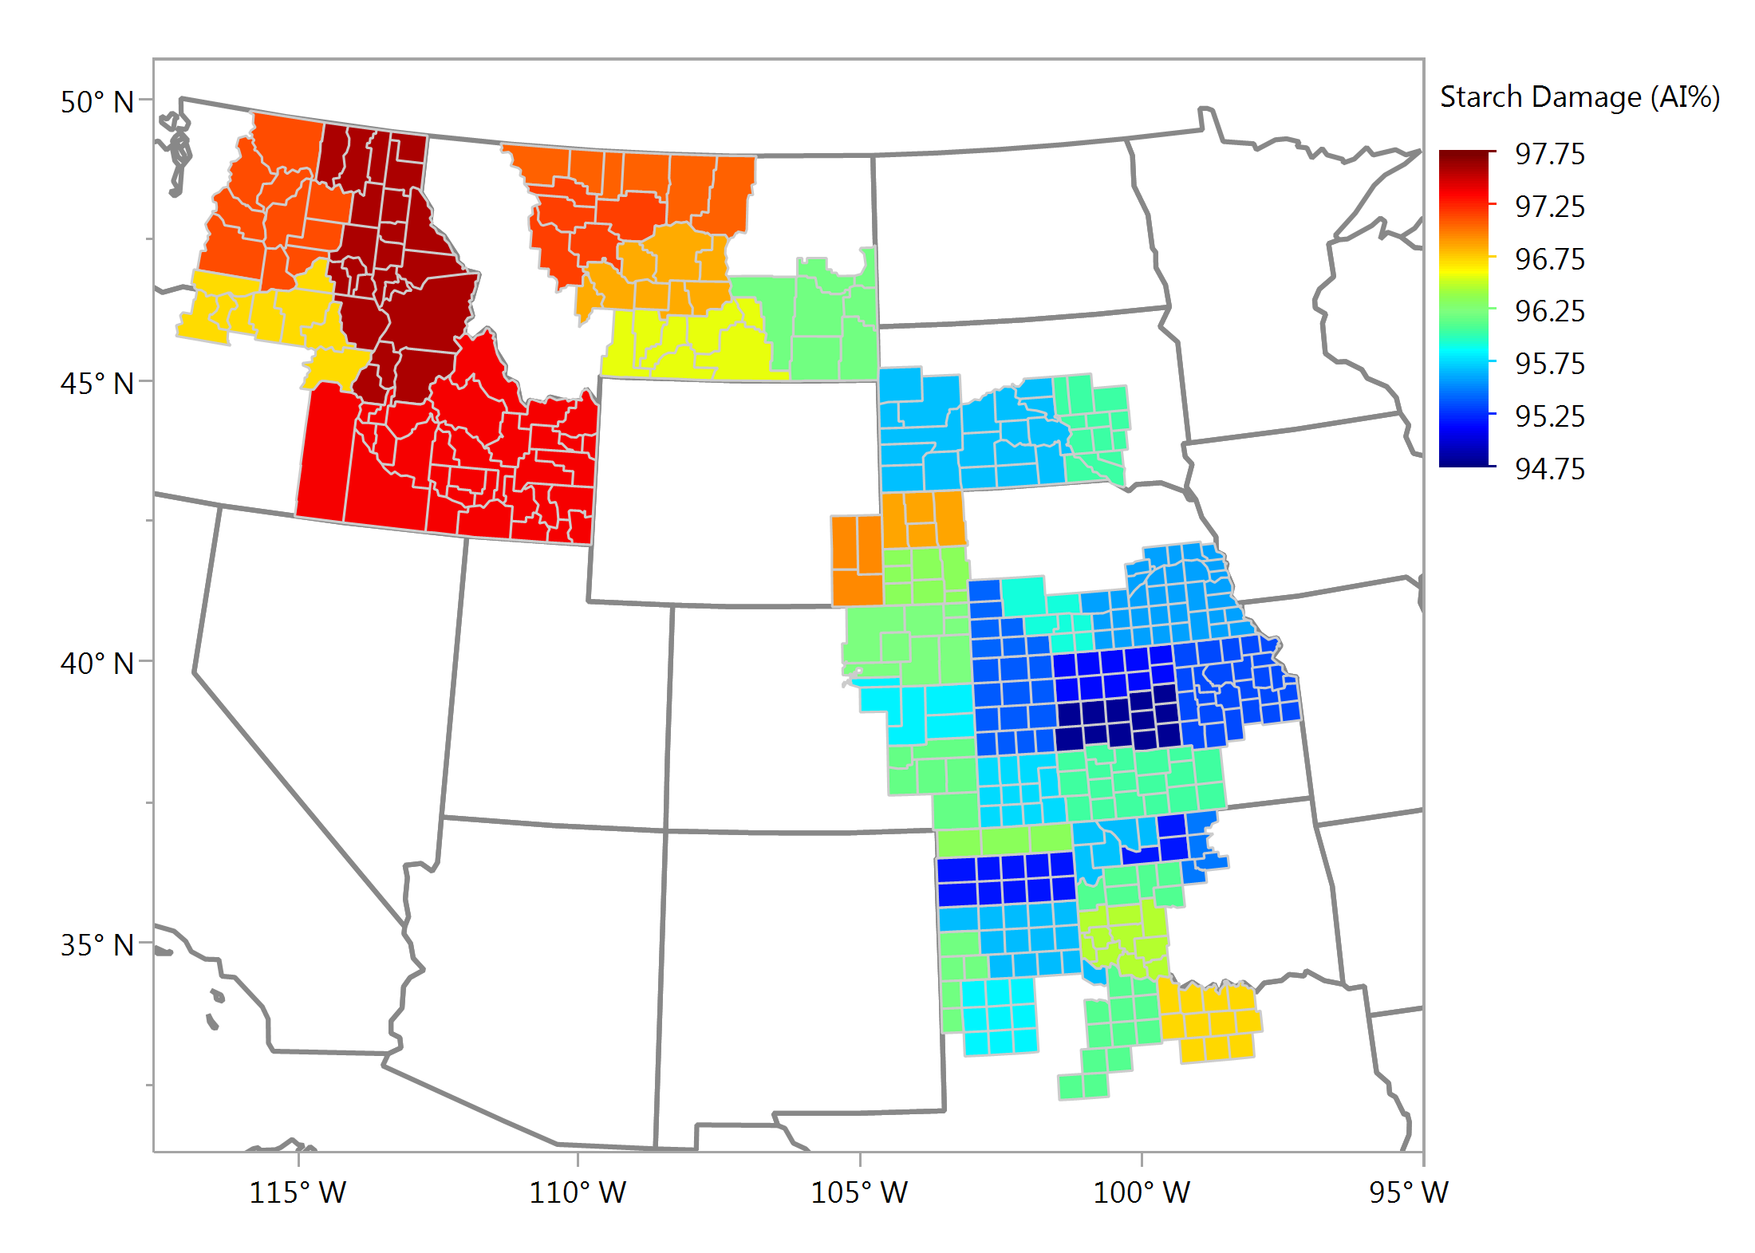
Starch Damage (As Is), % Composite Samples

Slide 9
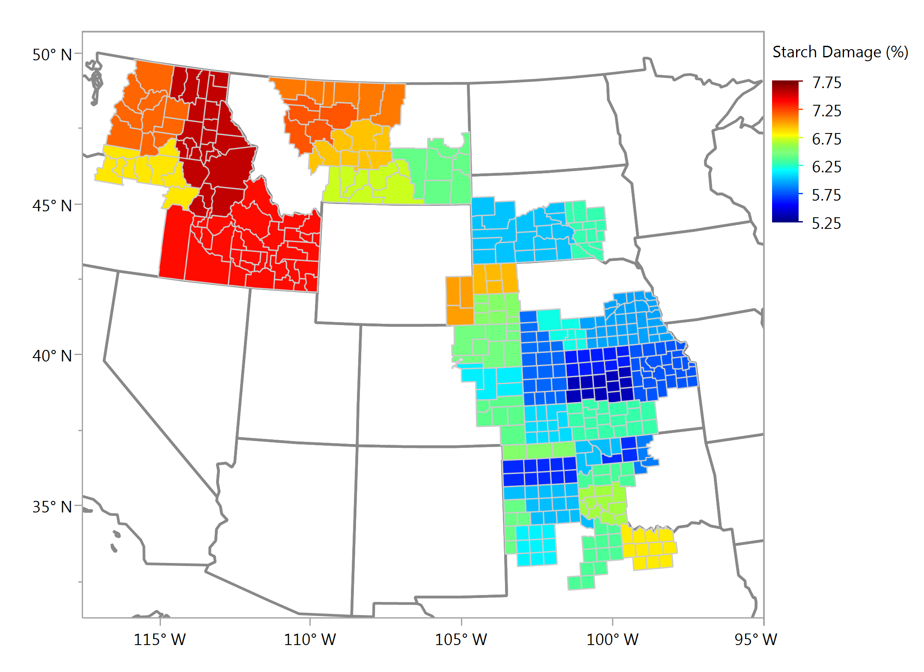
Starch Damage, % Composite Samples

Slide 10
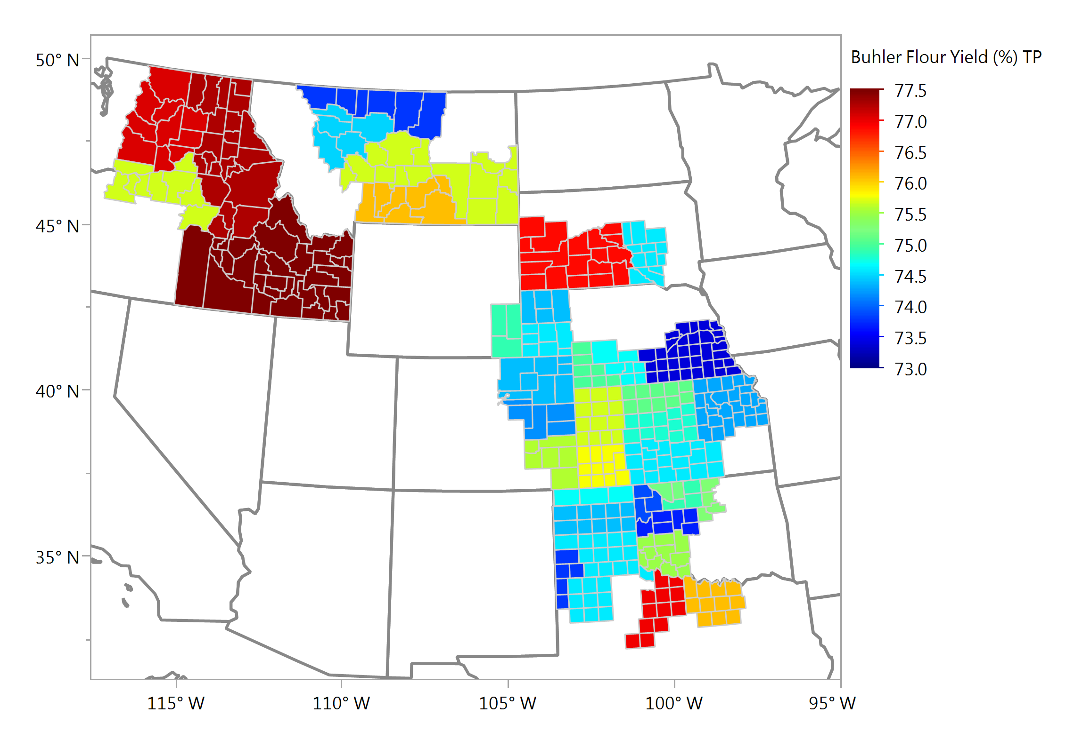
Buhler Flour Yield, % Composite Samples

Slide 11
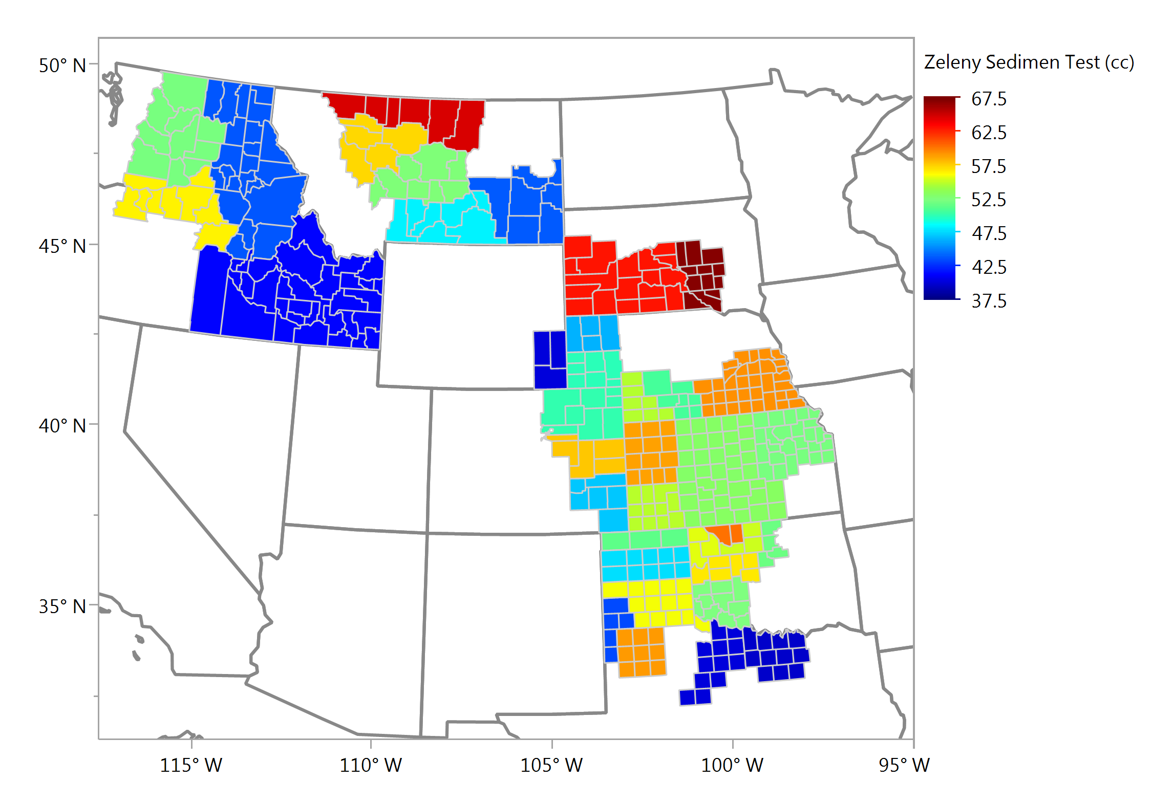
Zeleny Sedimentation, cc Composite Samples

Slide 12
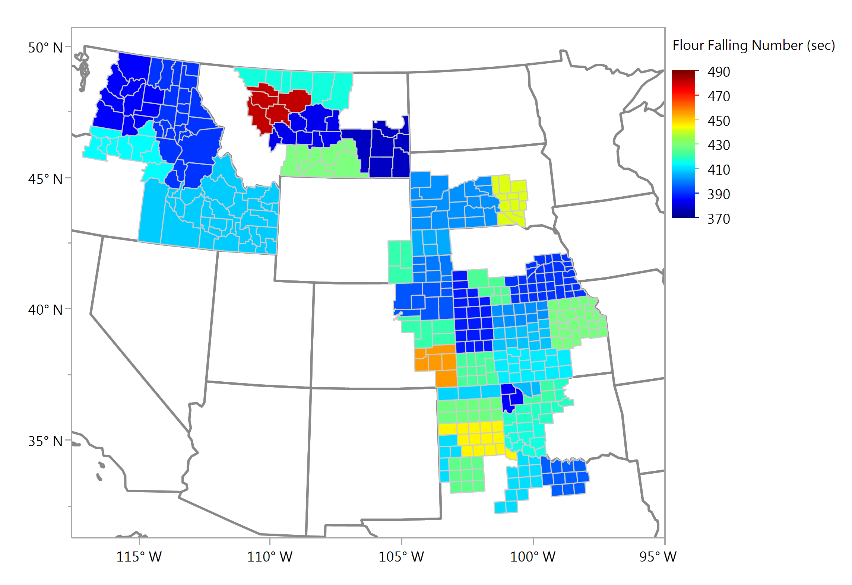
Flour Falling Number, sec Composite Samples

Slide 13
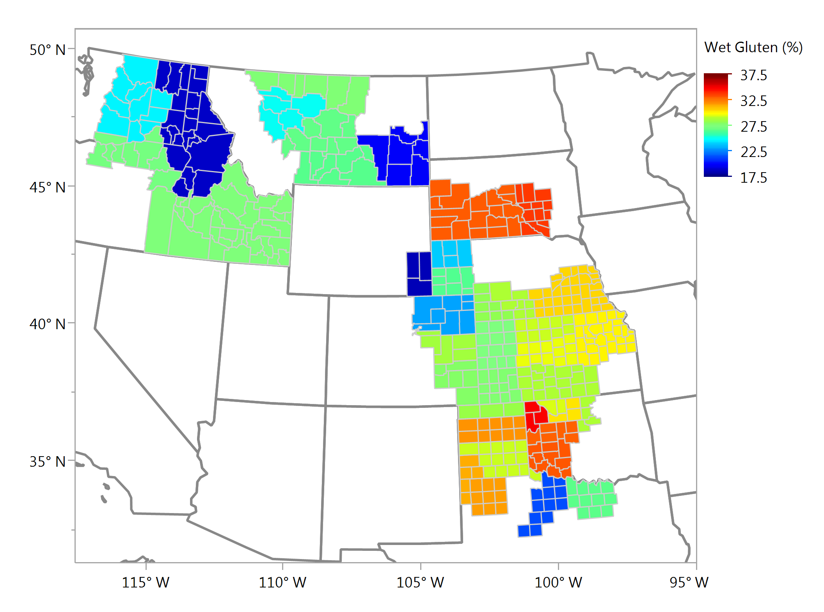
Wet Gluten, % Composite Samples

Slide 14
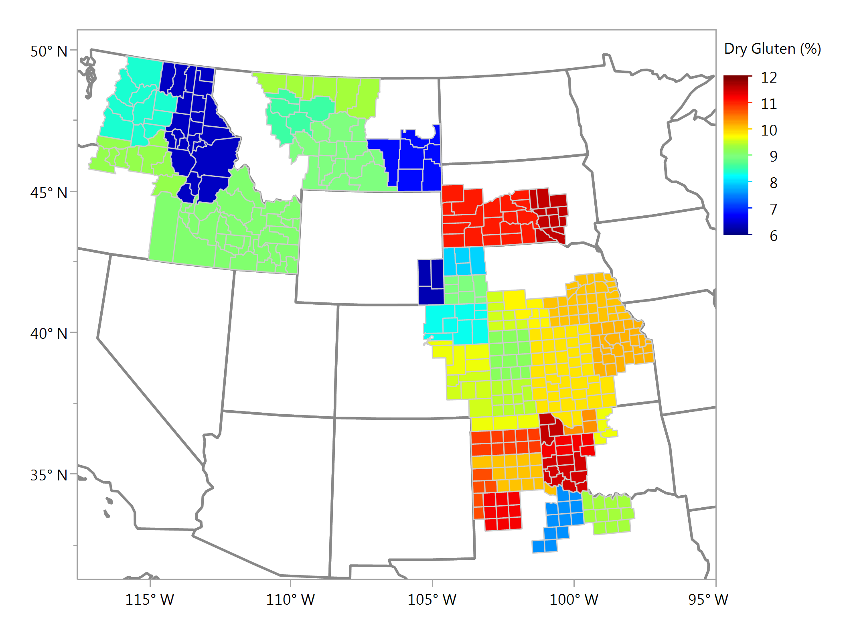
Dry Gluten, % Composite Samples

Slide 15
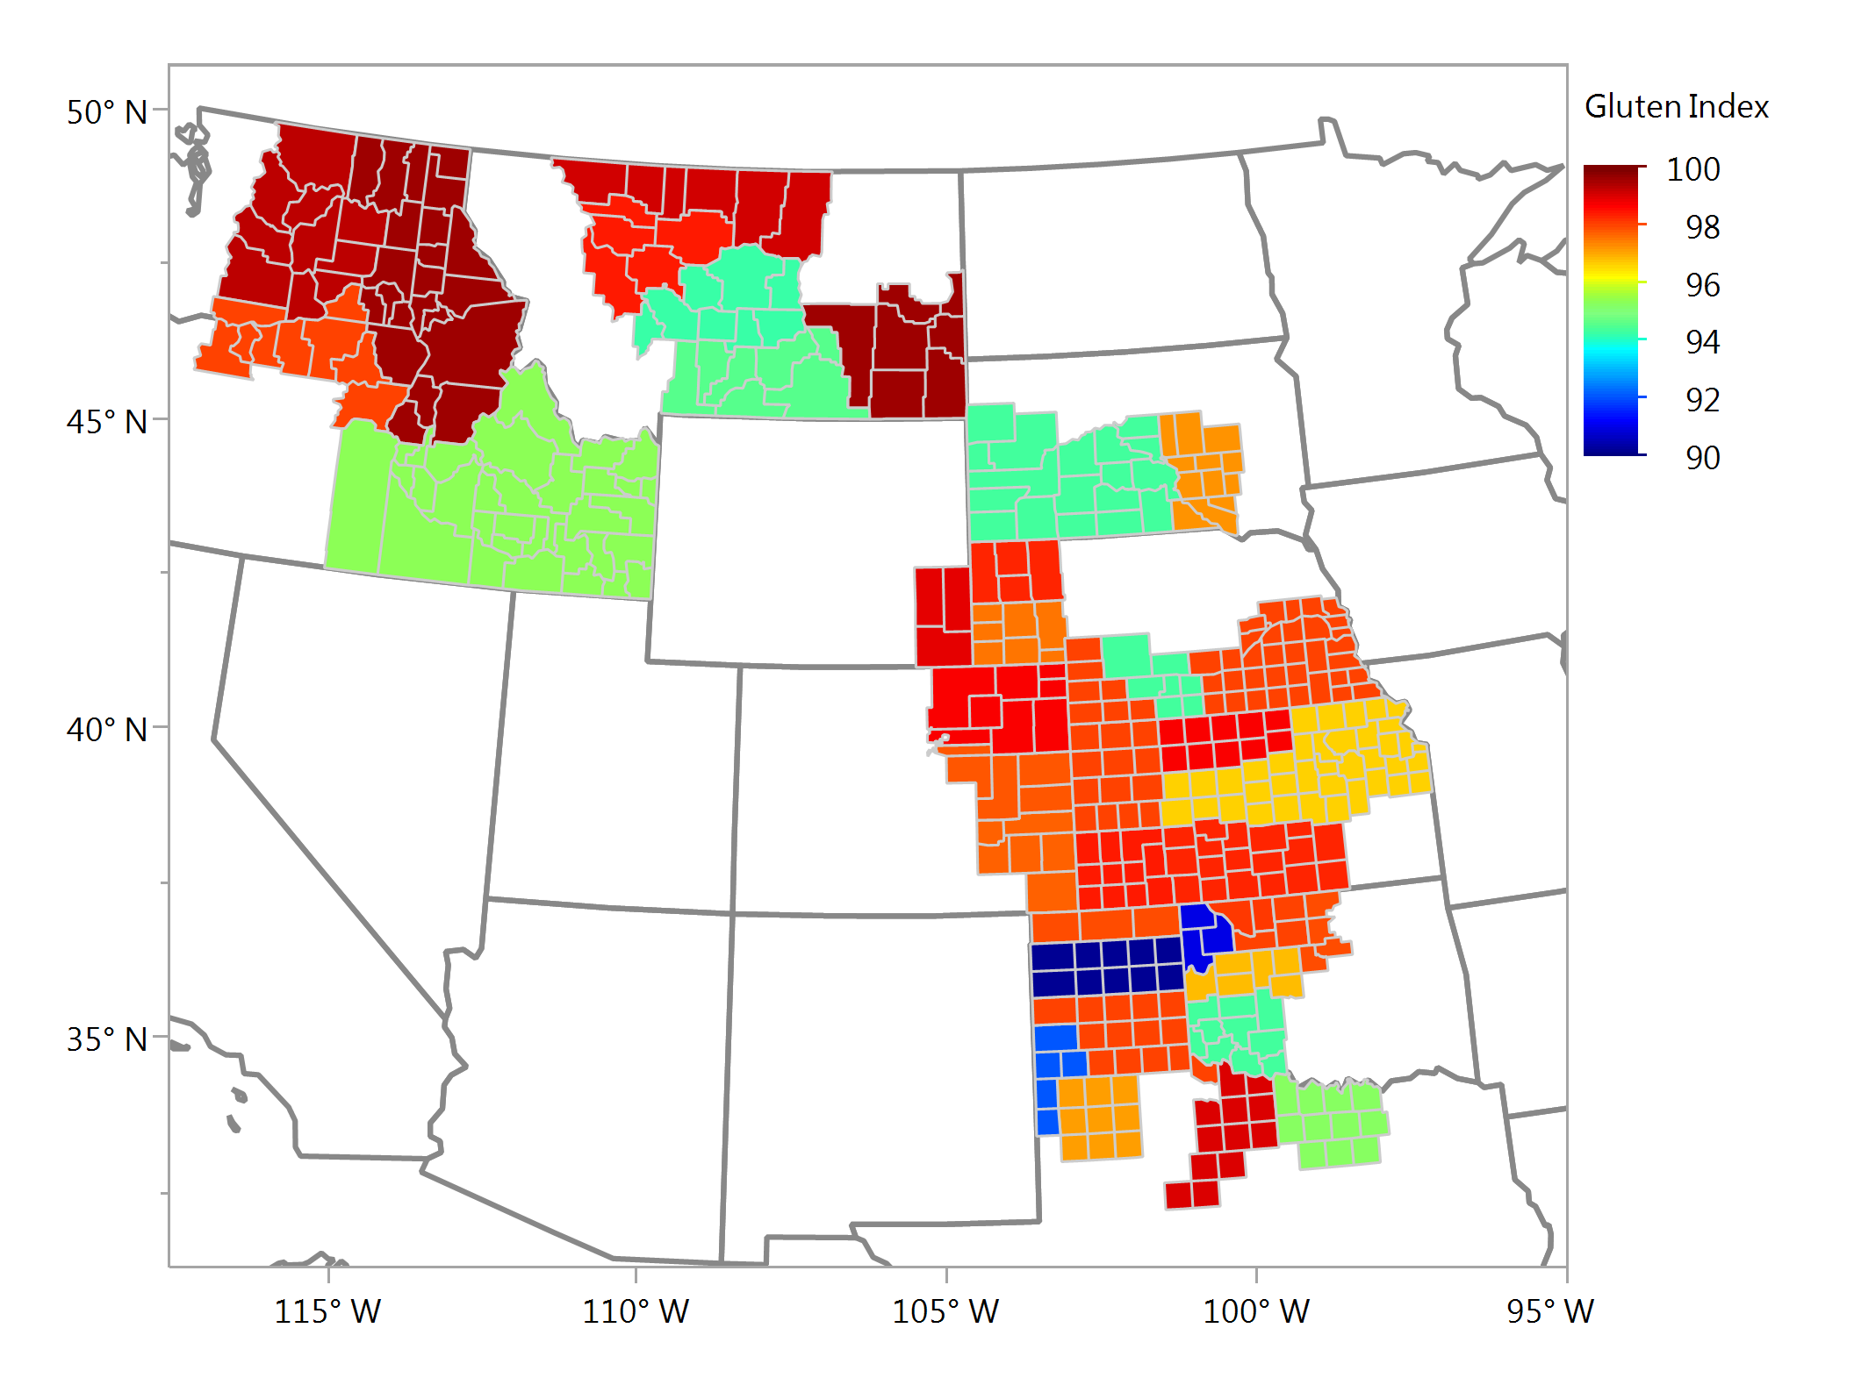
Gluten Index Composite Samples

Slide 16
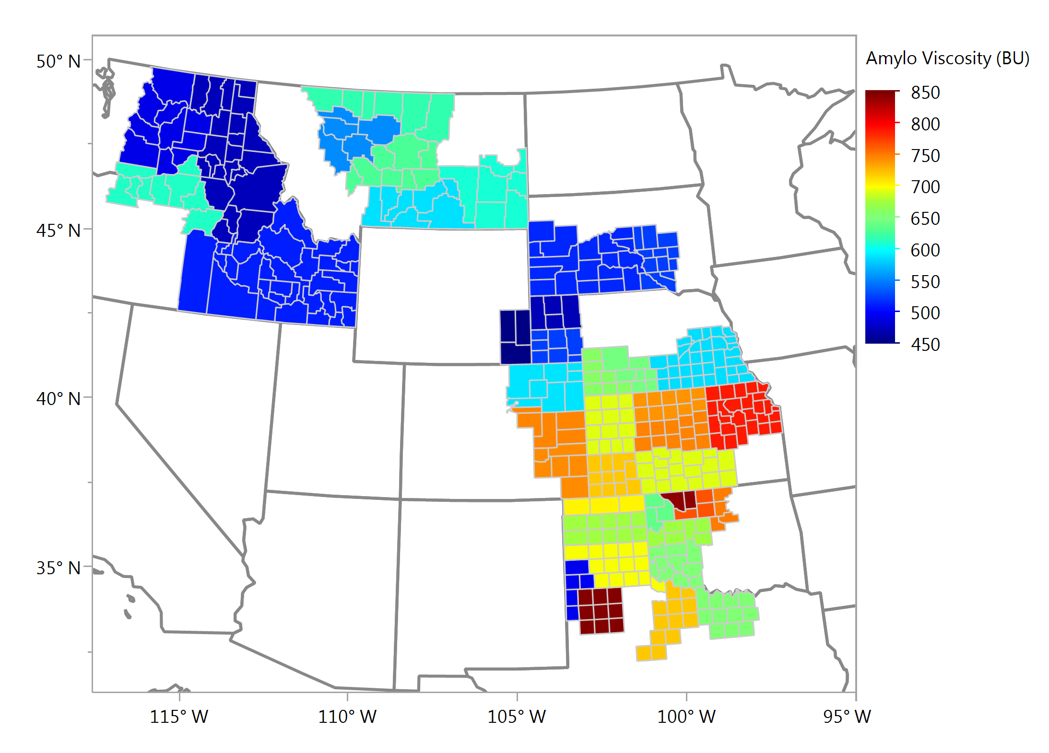
Amylograph Viscosity, BU Composite Samples

Slide 17
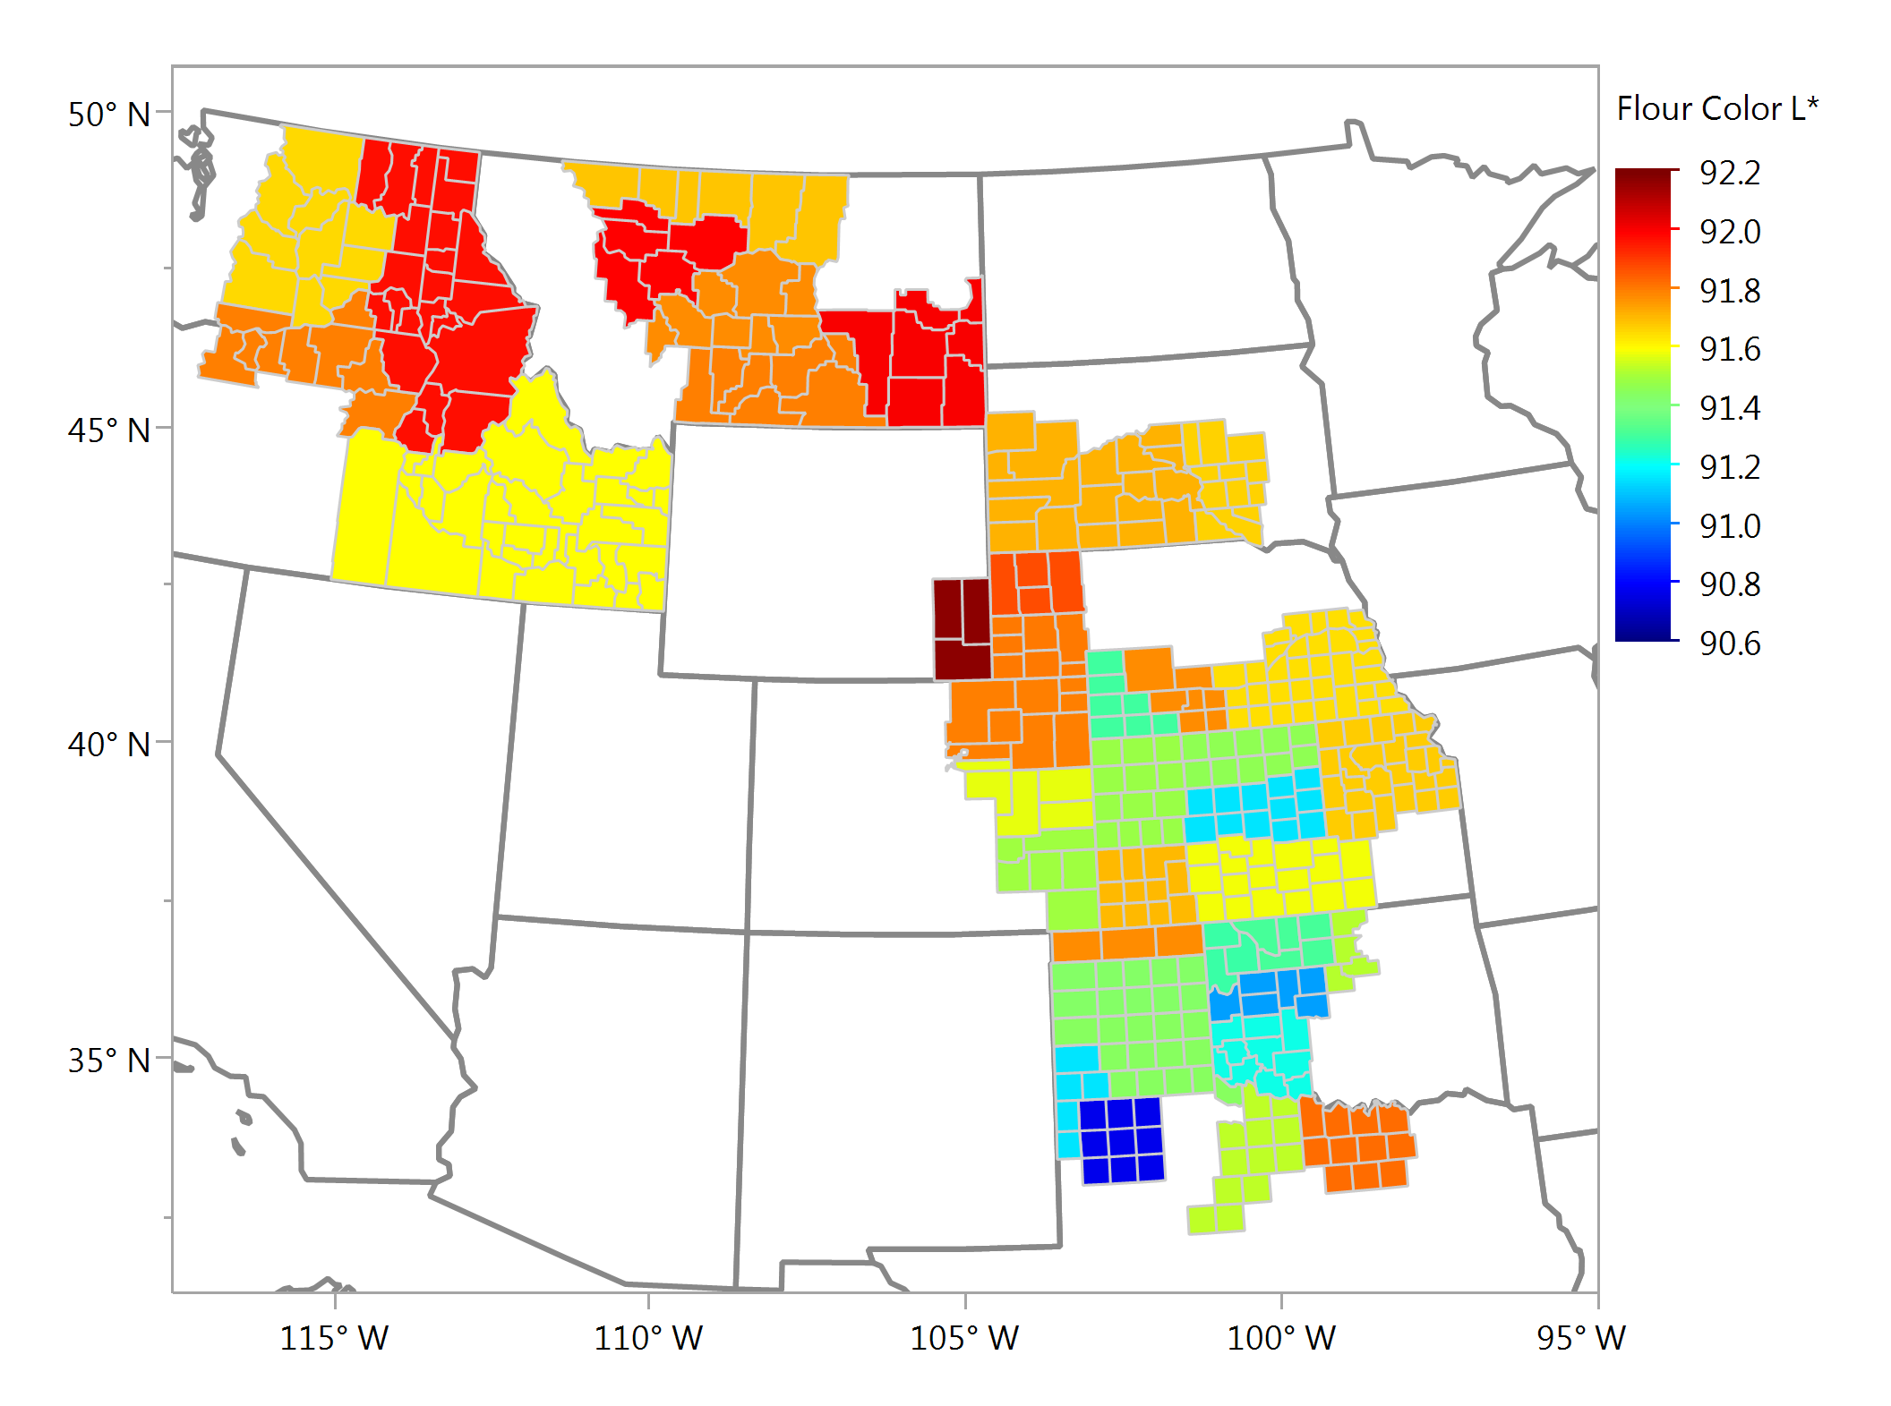
Flour Color – L Composite Samples

Slide 18
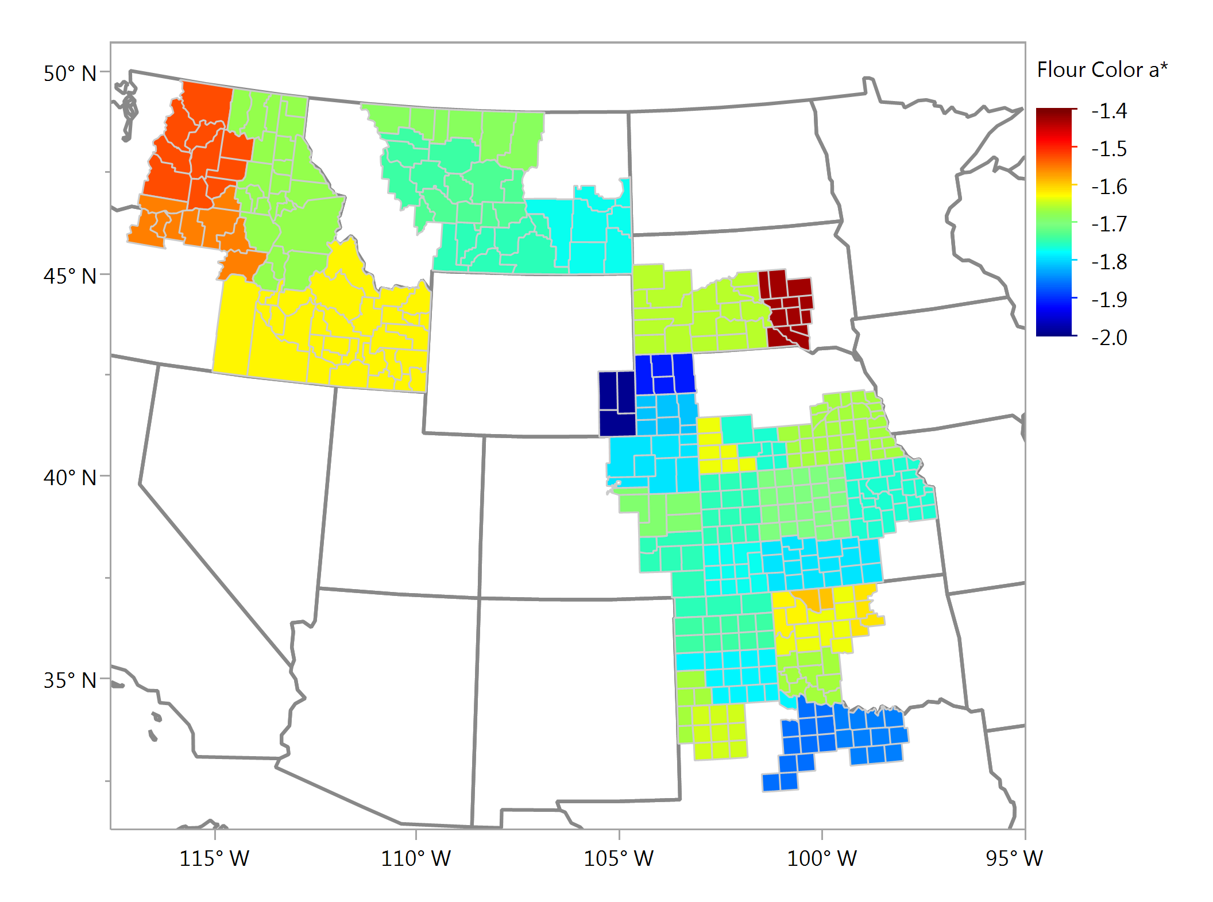
Flour Color – a Composite Samples

Slide 19
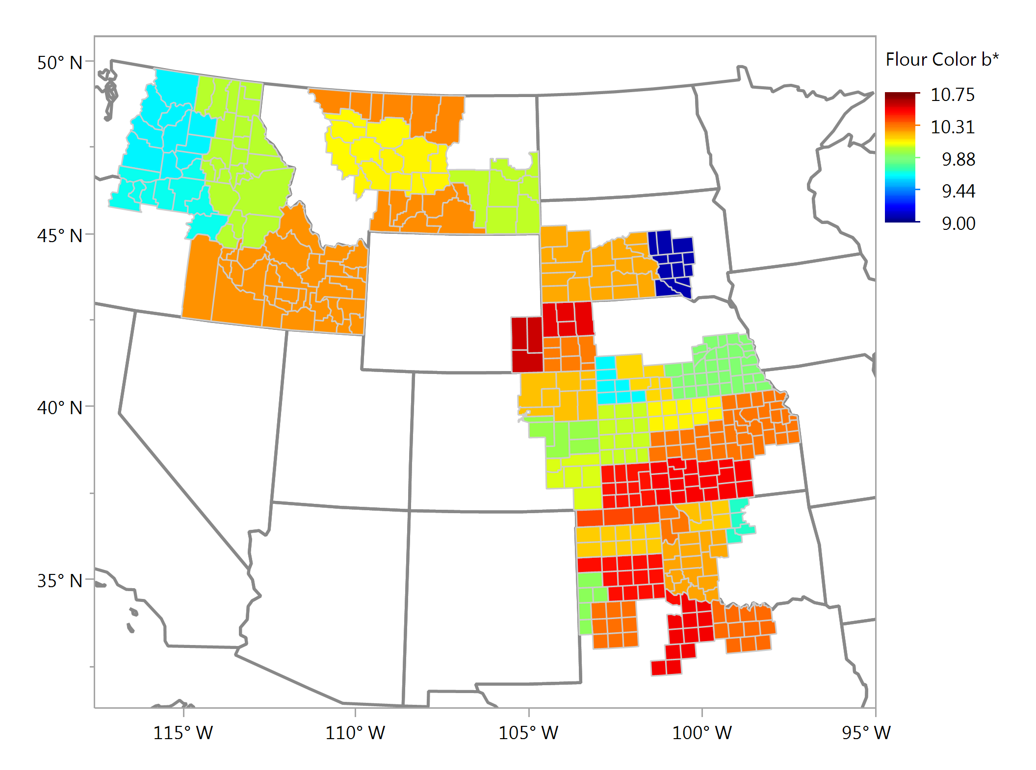
Flour Color – b Composite Samples

Slide 20
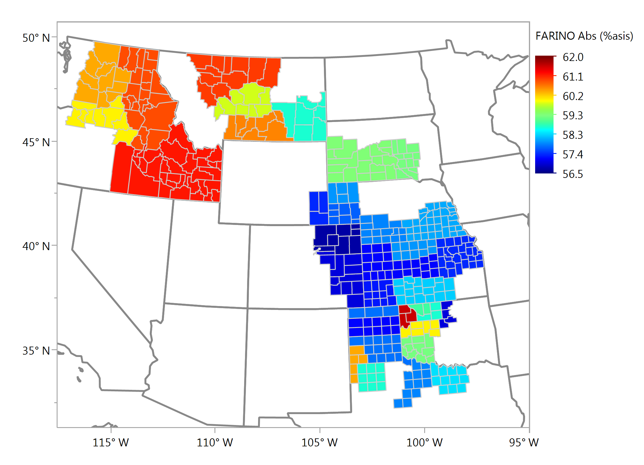
Farinograph Absorption (As Is), % Composite Samples

Slide 21
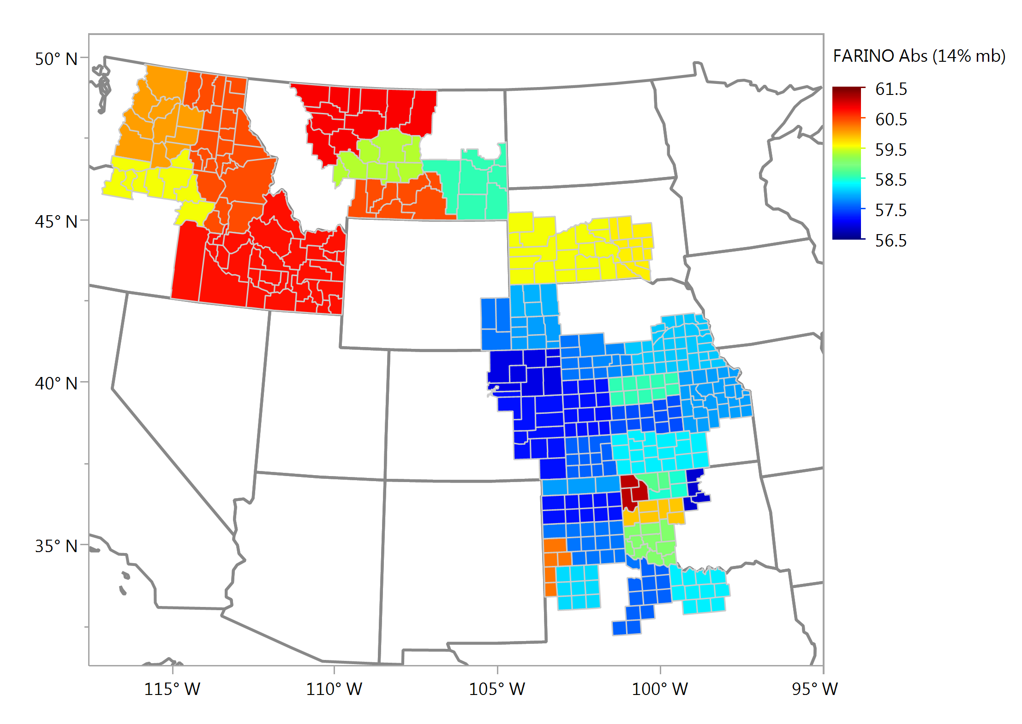
Farinograph Absorption (14% mb), % Composite Samples

Slide 22
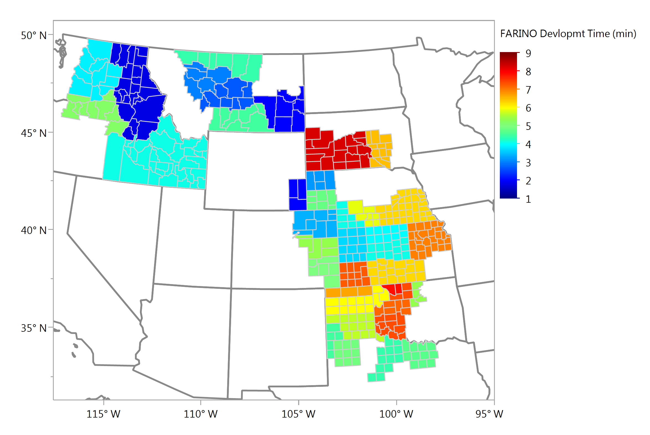
Farinograph Development, min Composite Samples

Slide 23
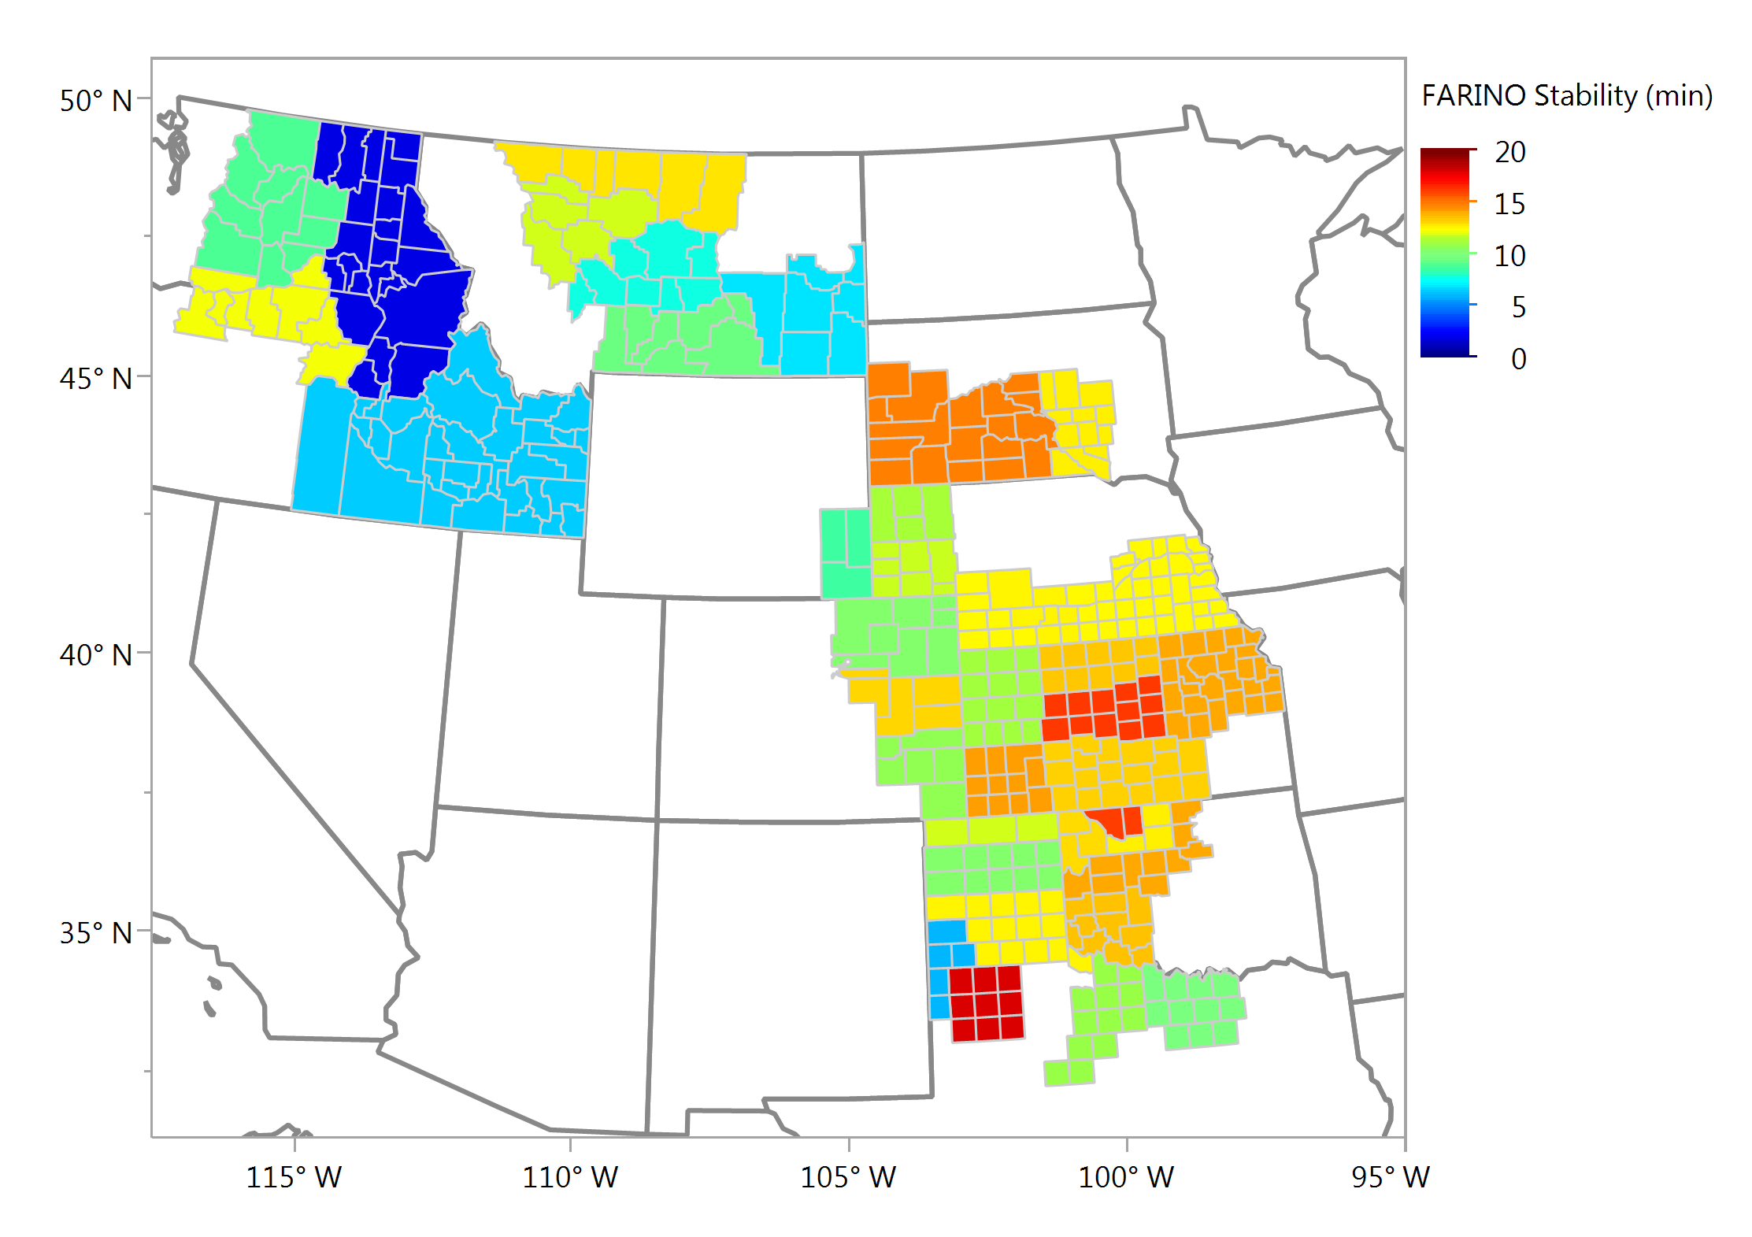
Farinograph Stability, min Composite Samples

Slide 24
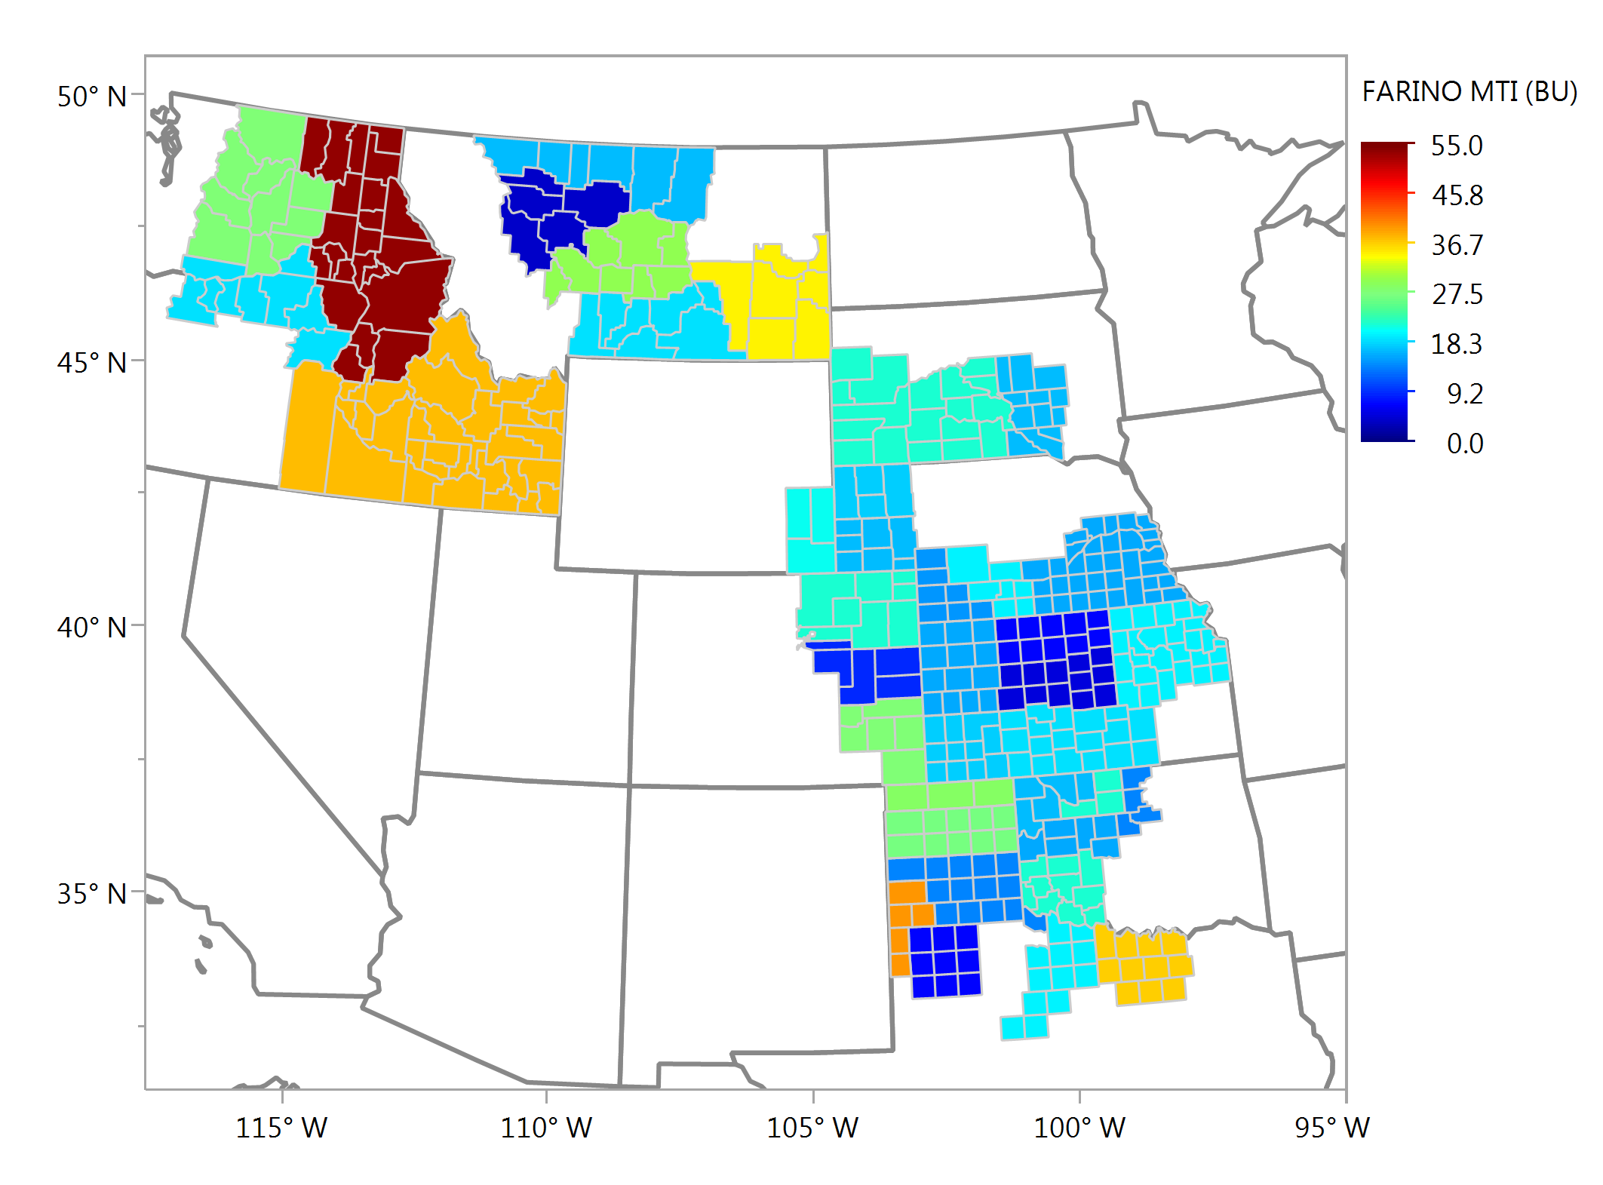
Farinograph MTI, BU Composite Samples

Slide 25
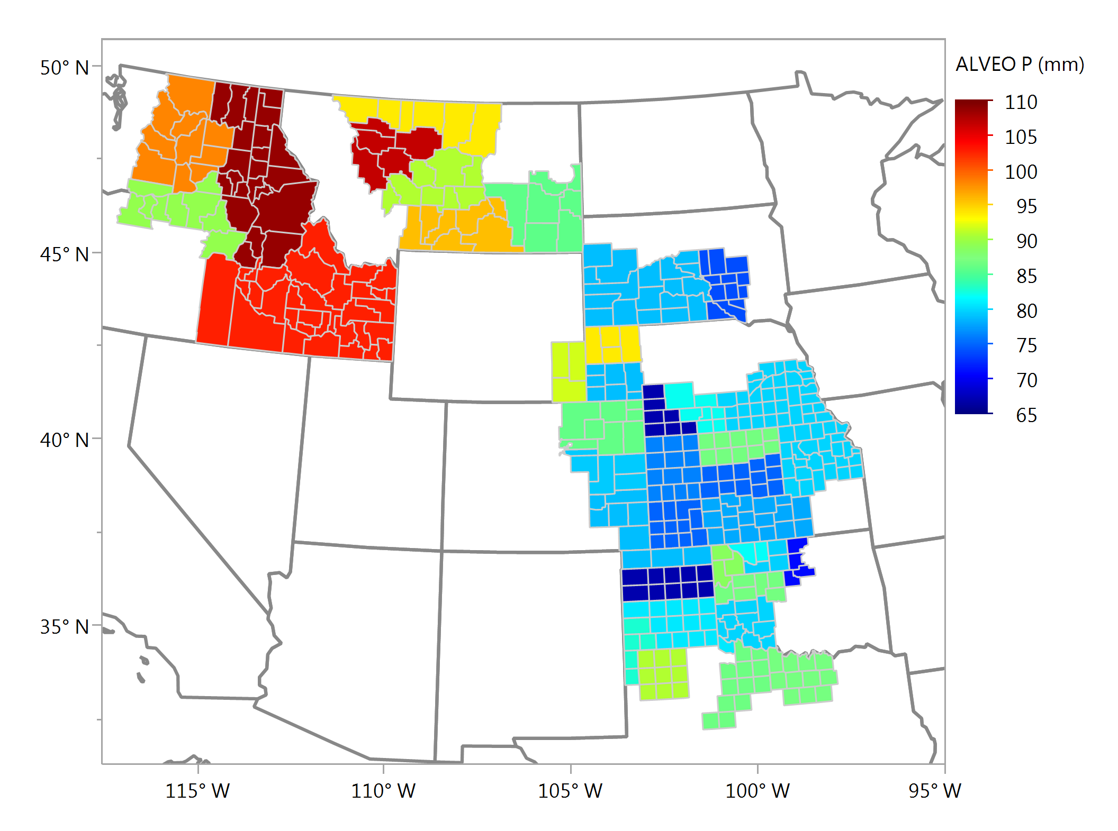
Alveograph P, mm Composite Samples

Slide 26
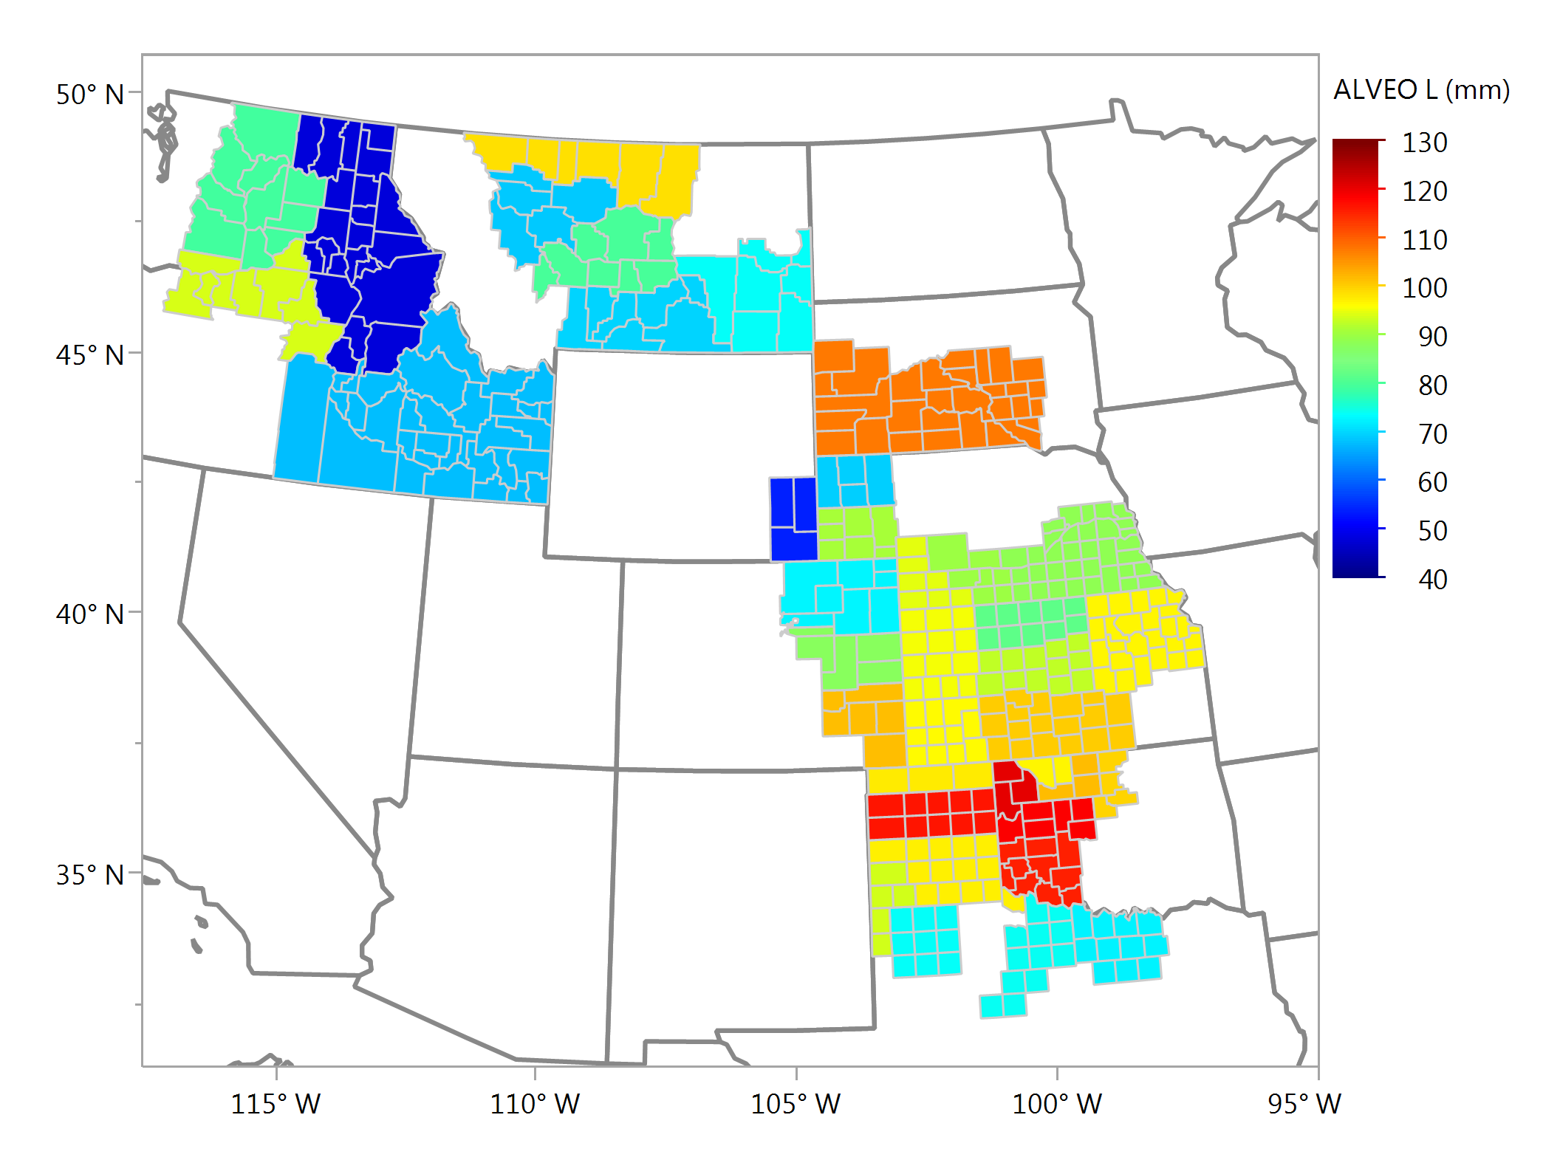
Alveograph L, mm Composite Samples

Slide 27
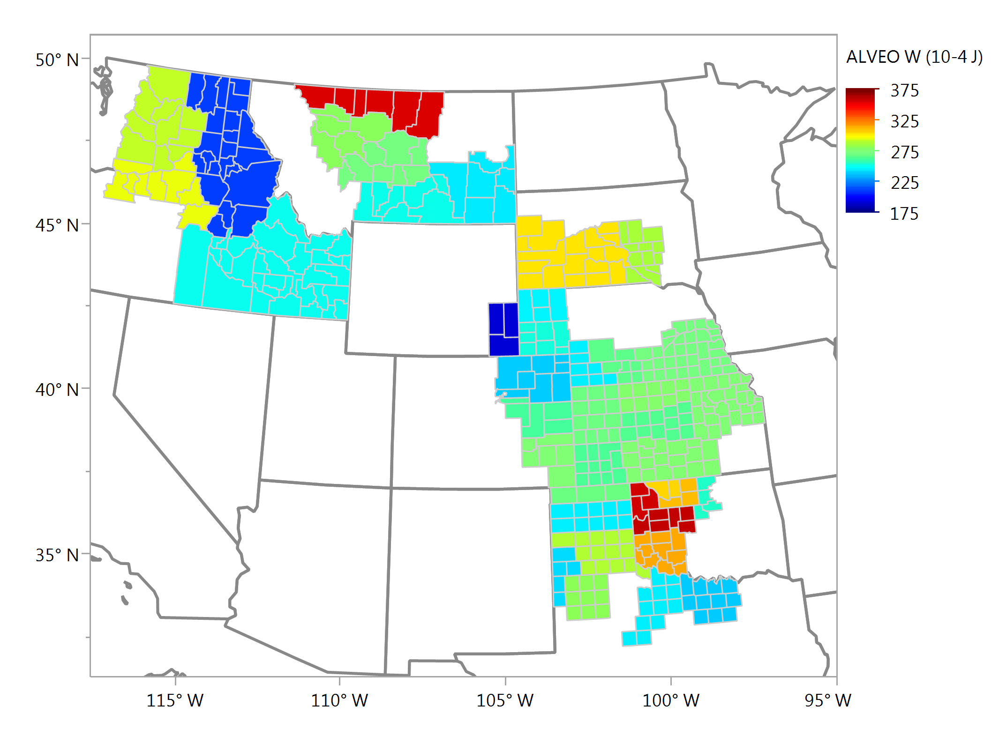
Alveograph W, 10⁻⁴ j Composite Samples

Slide 28
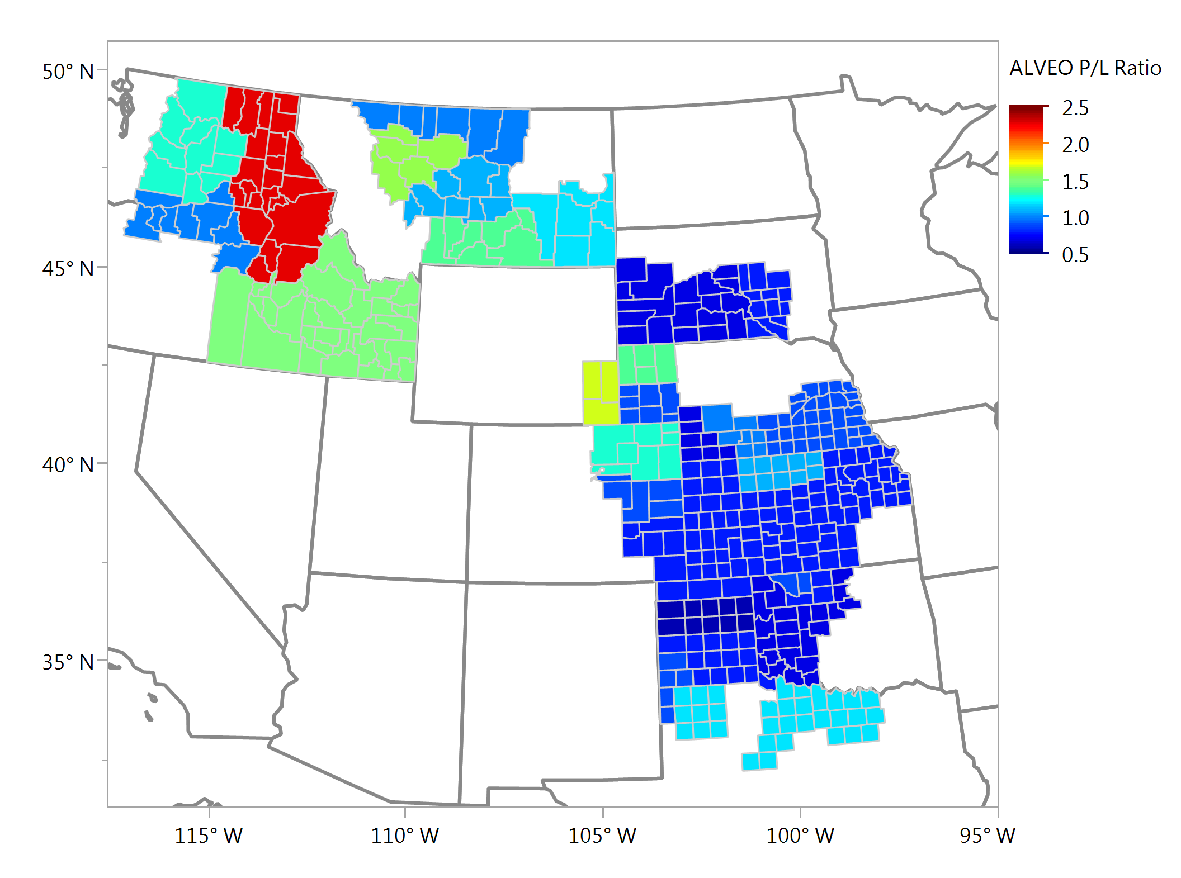
Alveograph P/L Ratio Composite Samples

Slide 29
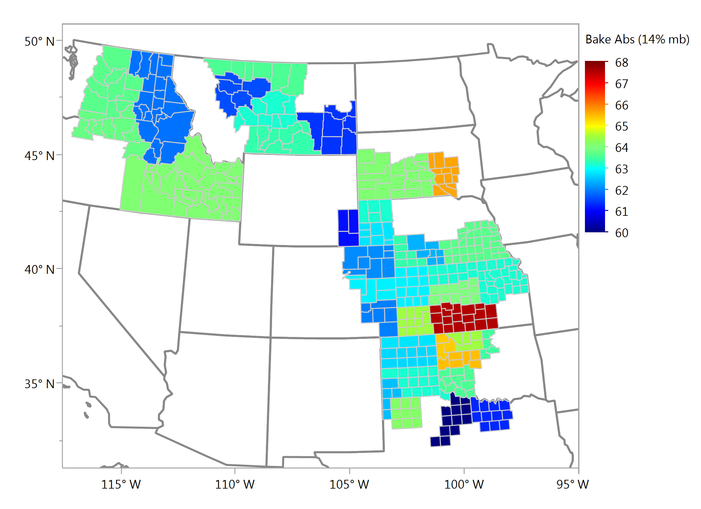
Bake Absorption (14%), % Composite Samples

Slide 30
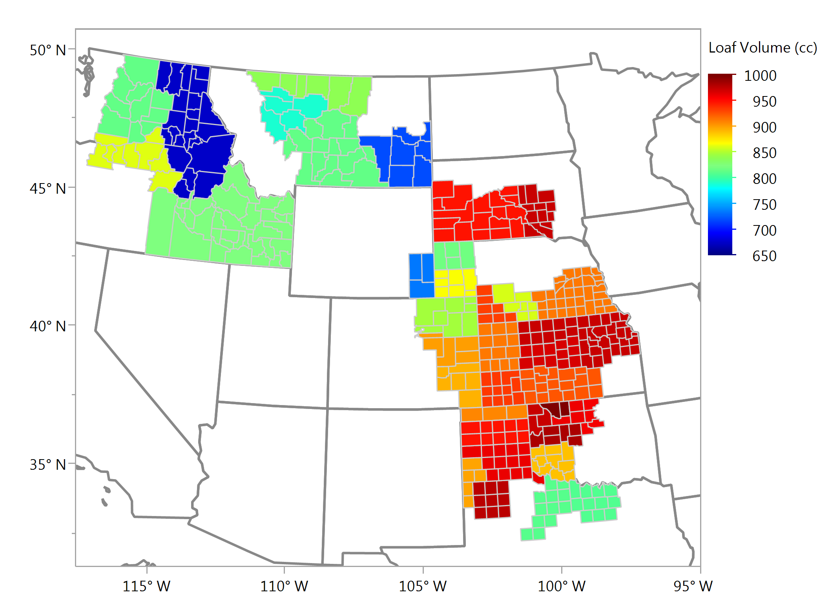
Loaf Volume, cc Composite Samples

