Slide 1
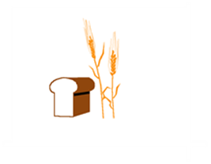
Hard Red Winter Wheat Quality Maps Based on Crop Survey by Plains Grains, Inc. Kernel Data

Slide 2
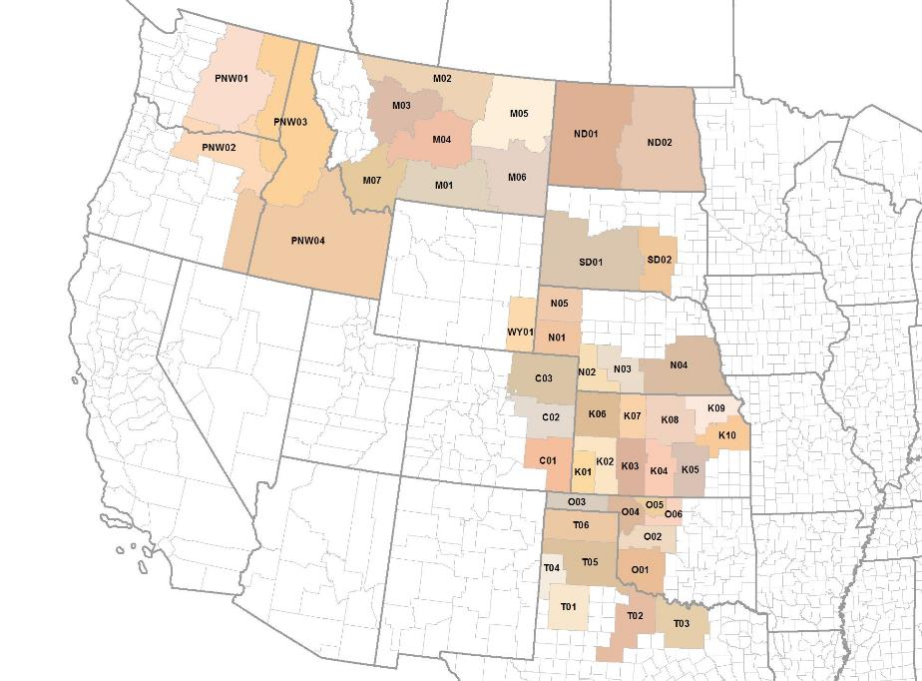
Plains Grains, Inc. Grainsheds Gulf and PNW Export Areas

Slide 3
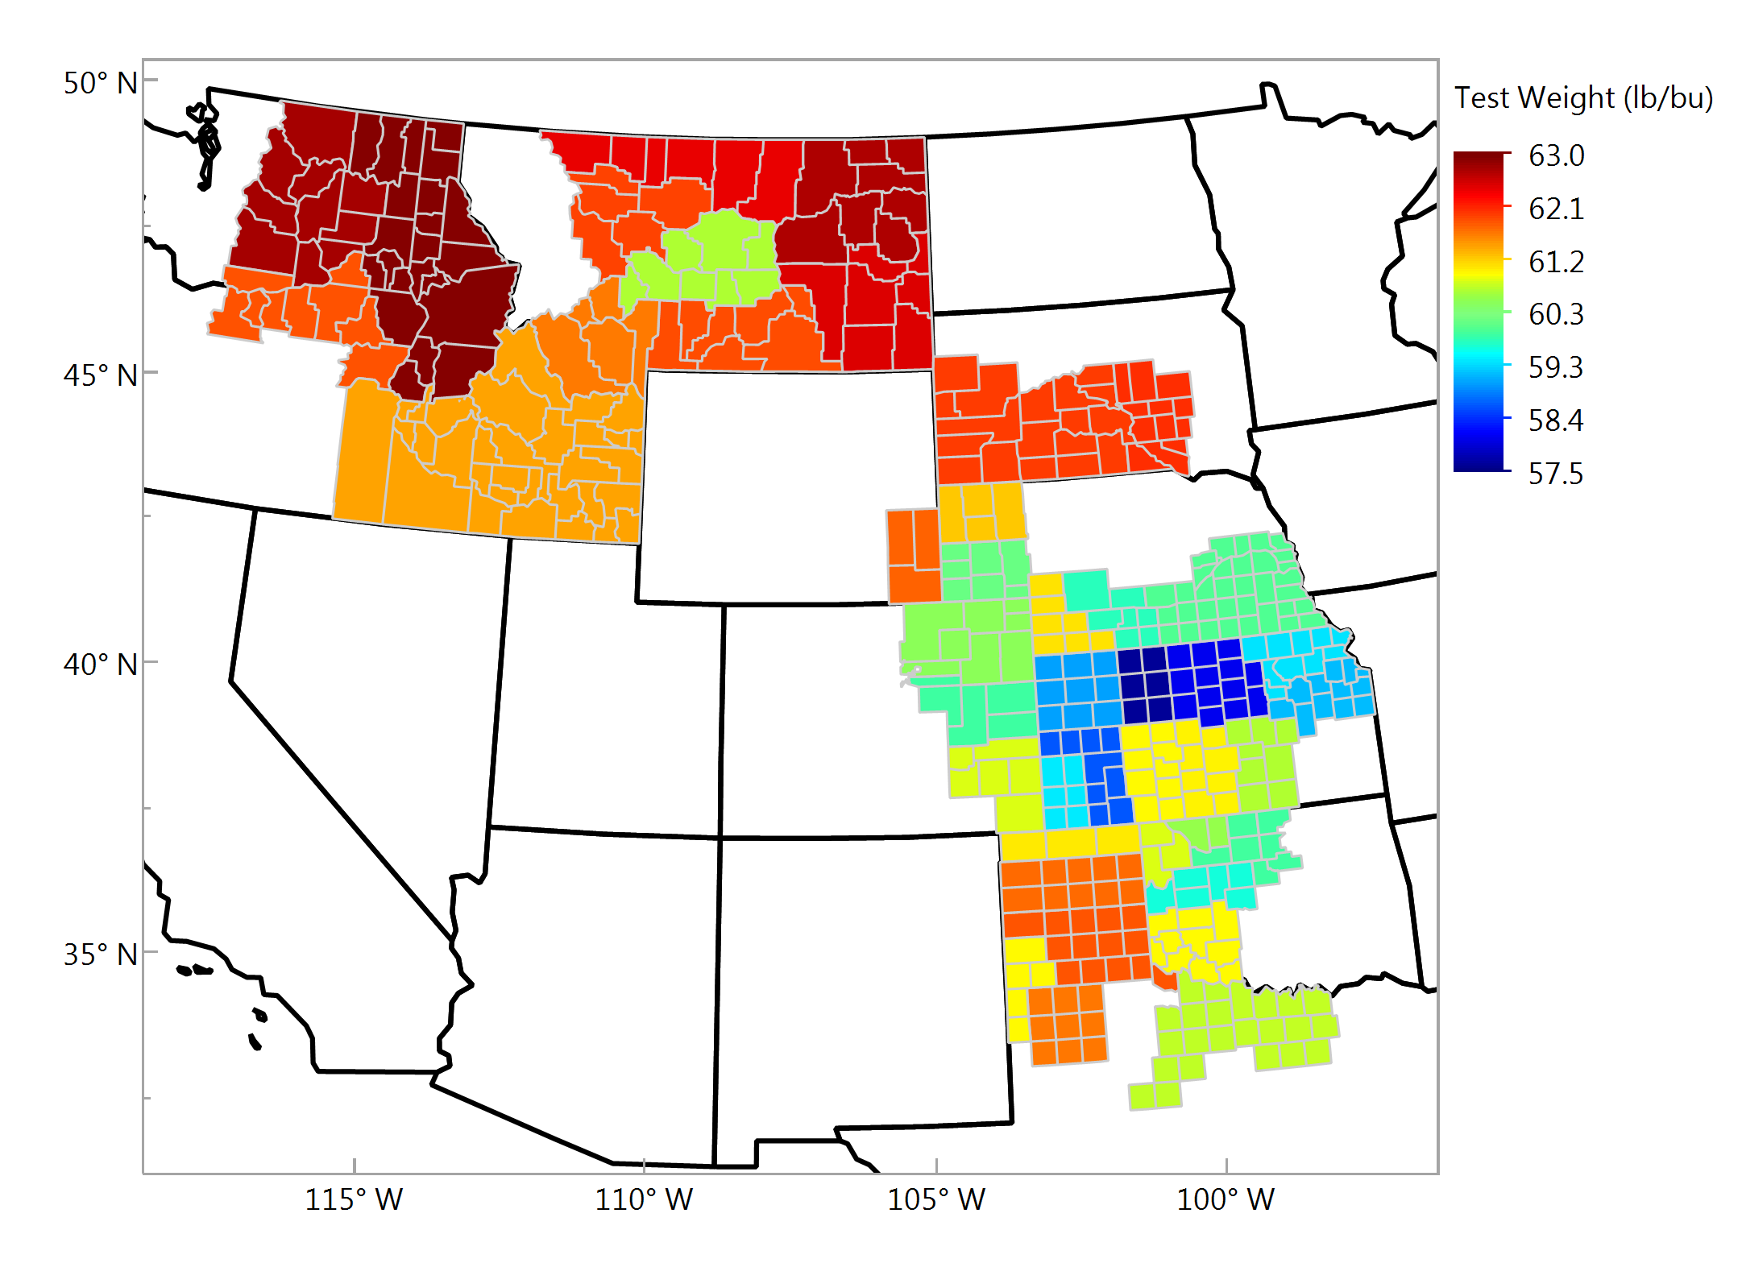
Test Weight, lbs/bu Individual Samples

Slide 4
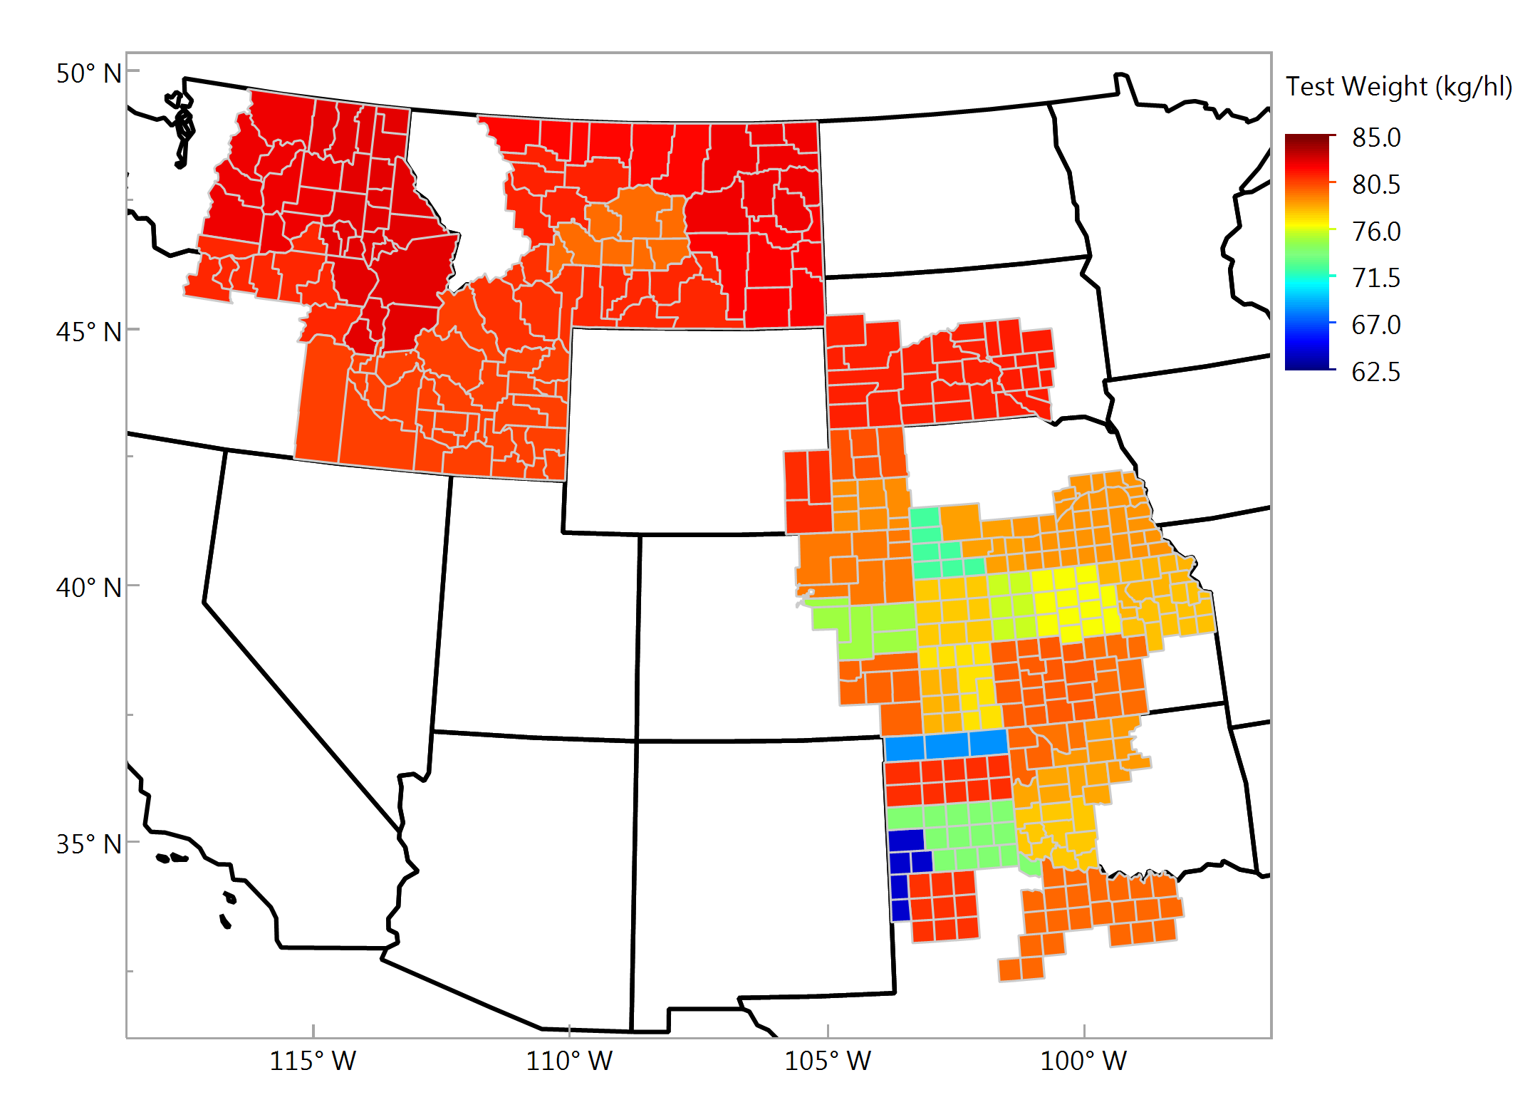
Test Weight, kg/hl Individual Samples

Slide 5
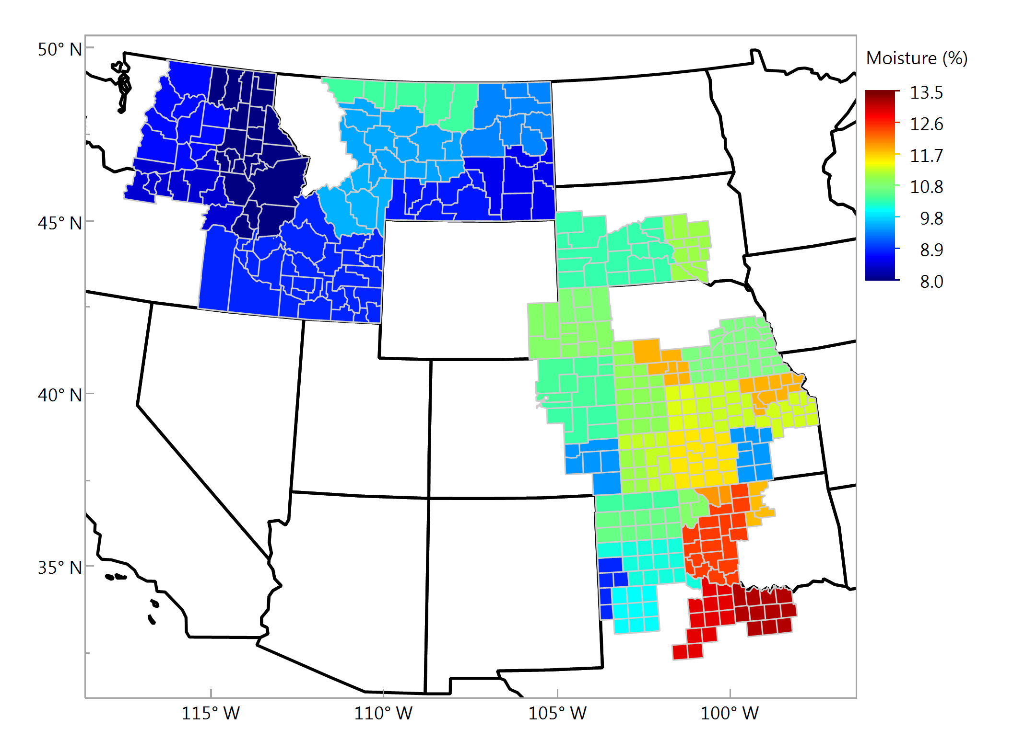
Wheat Moisture, % Individual Samples

Slide 6
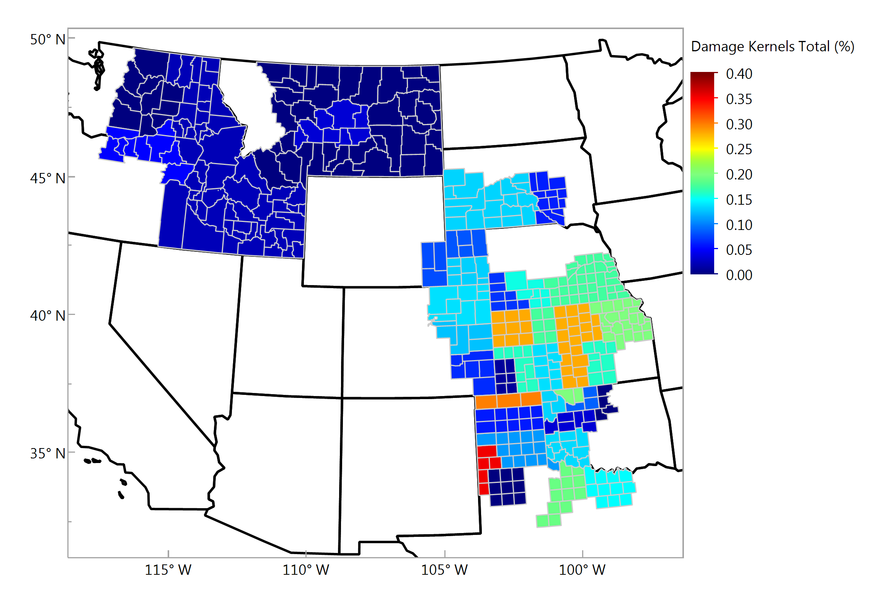
Damaged Kernels, % Individual Samples

Slide 7
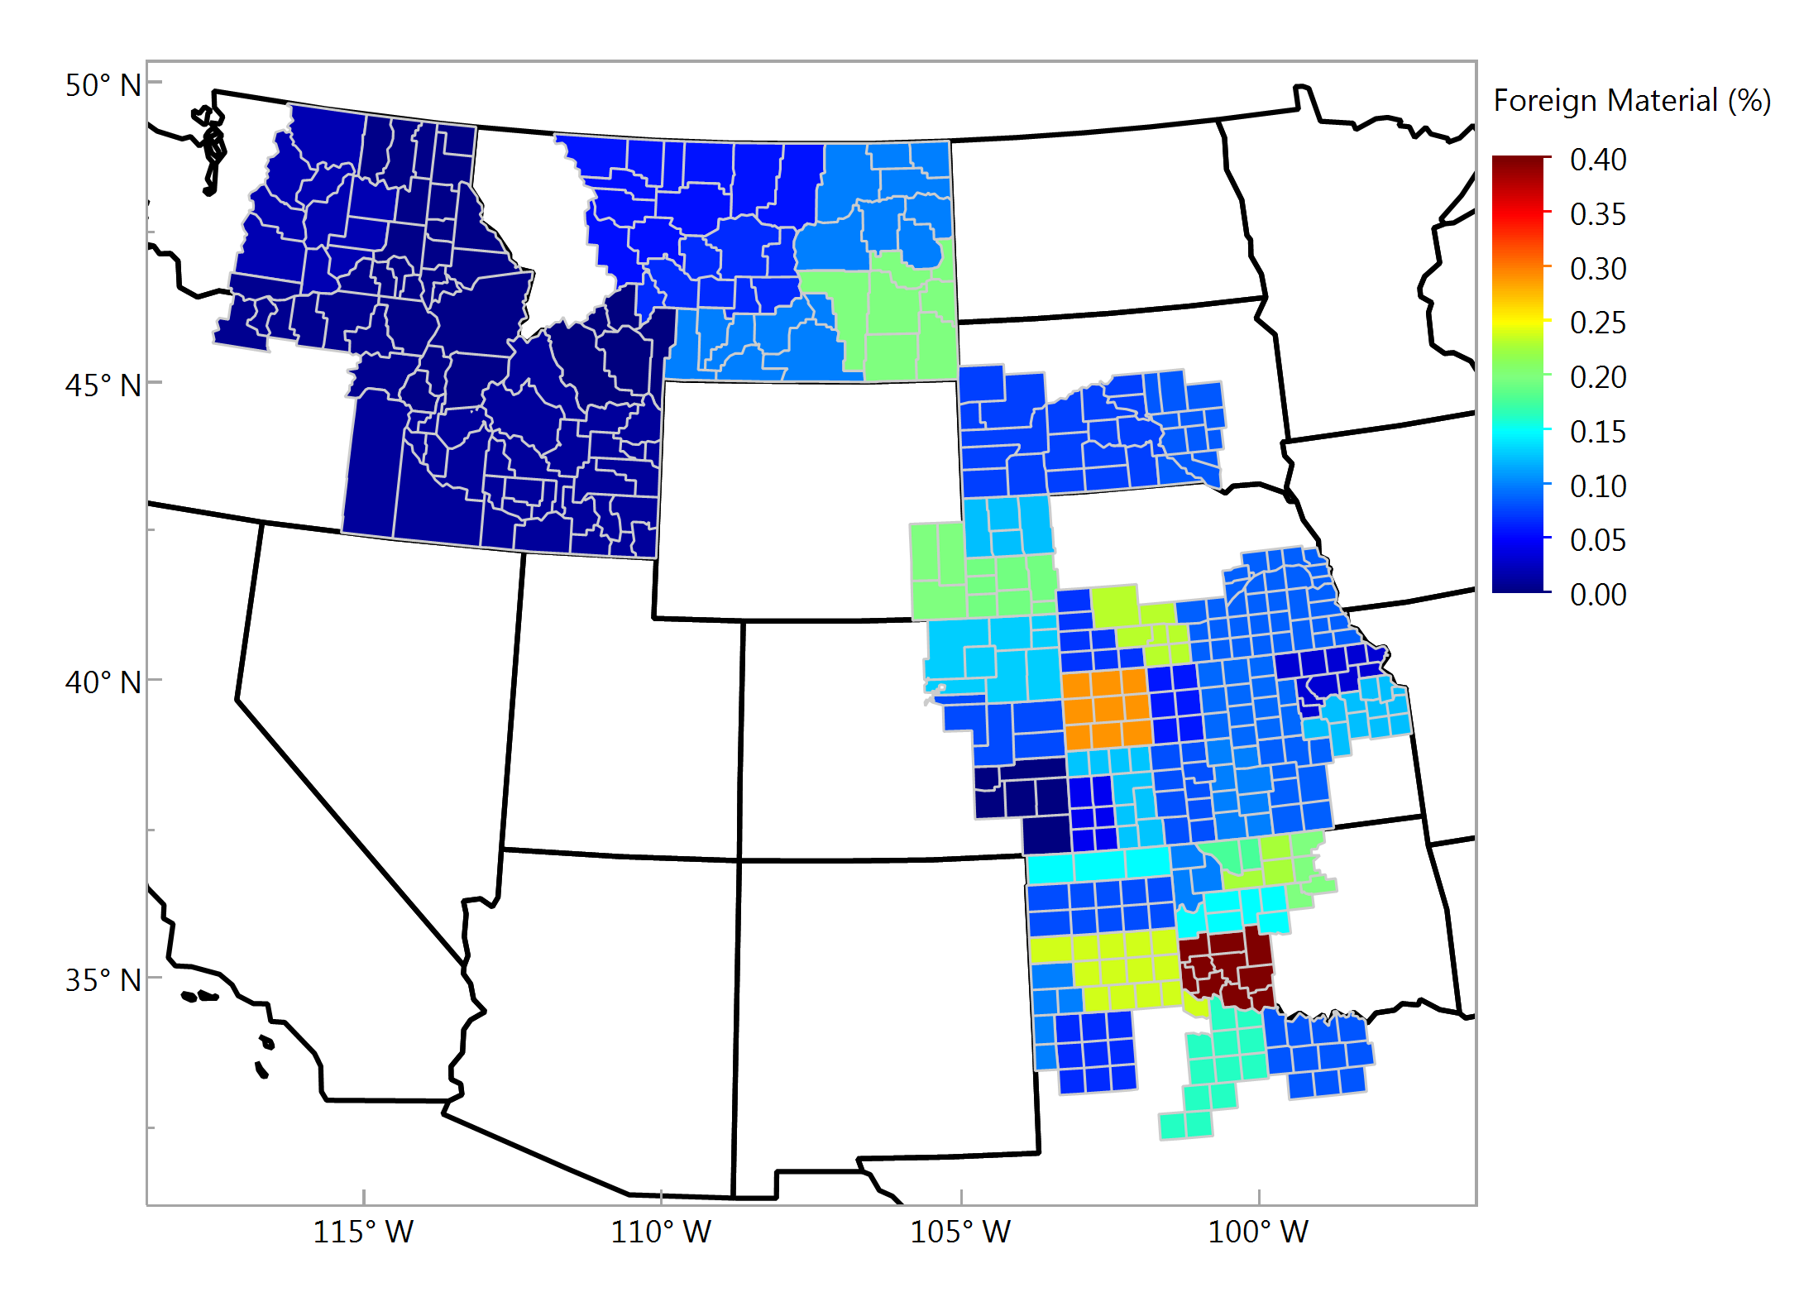
Foreign Material, % Individual Samples

Slide 8
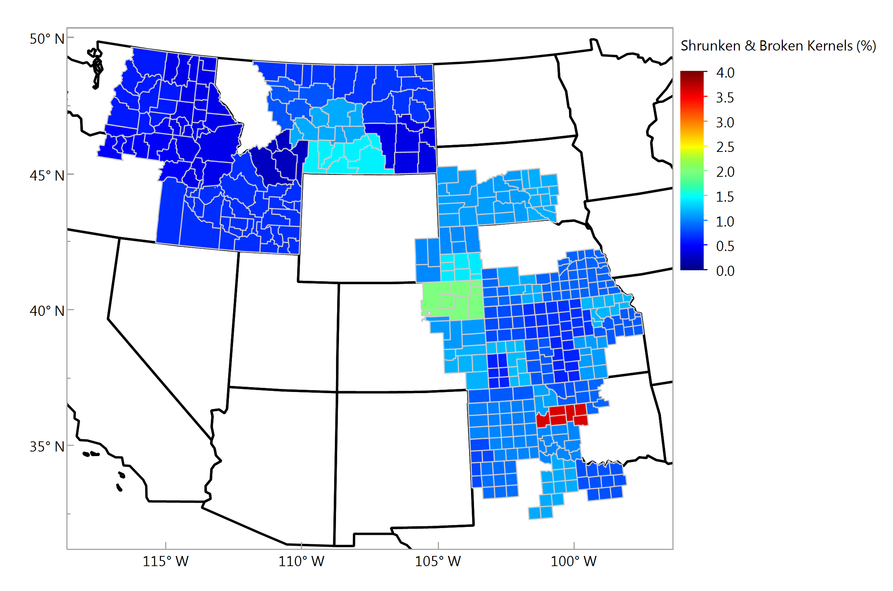
Shrunken & Broken, % Individual Samples

Slide 9
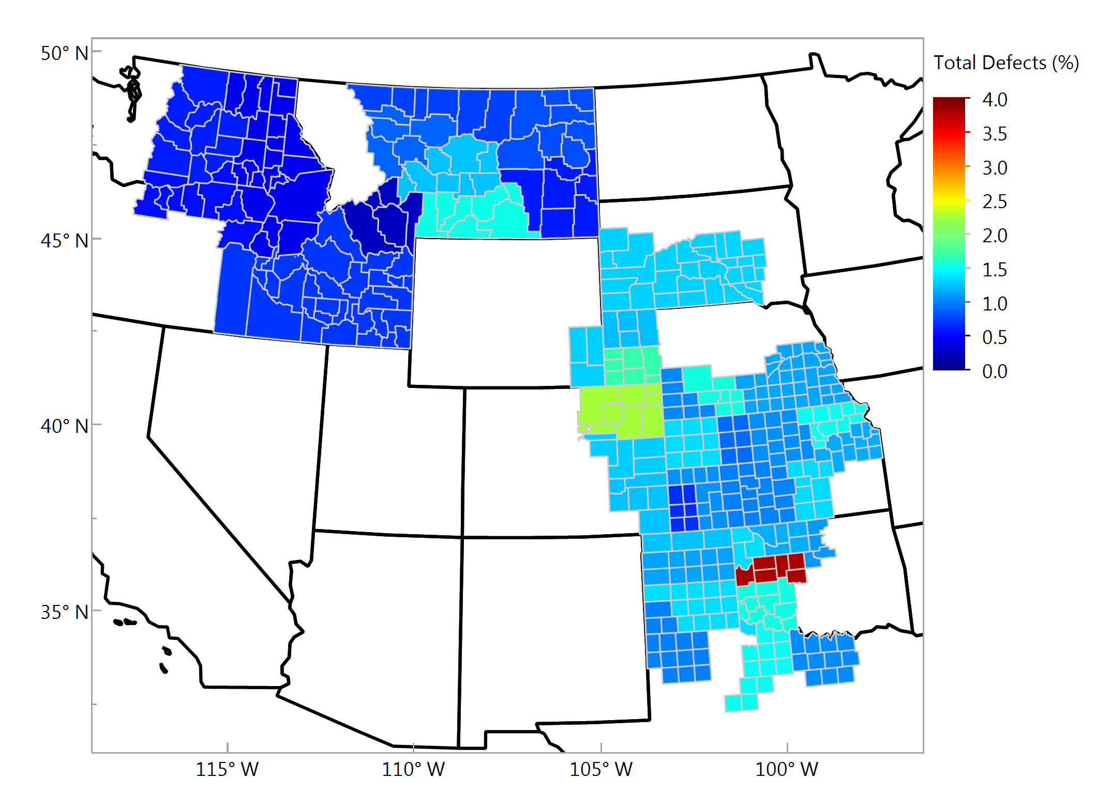
Total Defects, % Individual Samples

Slide 10
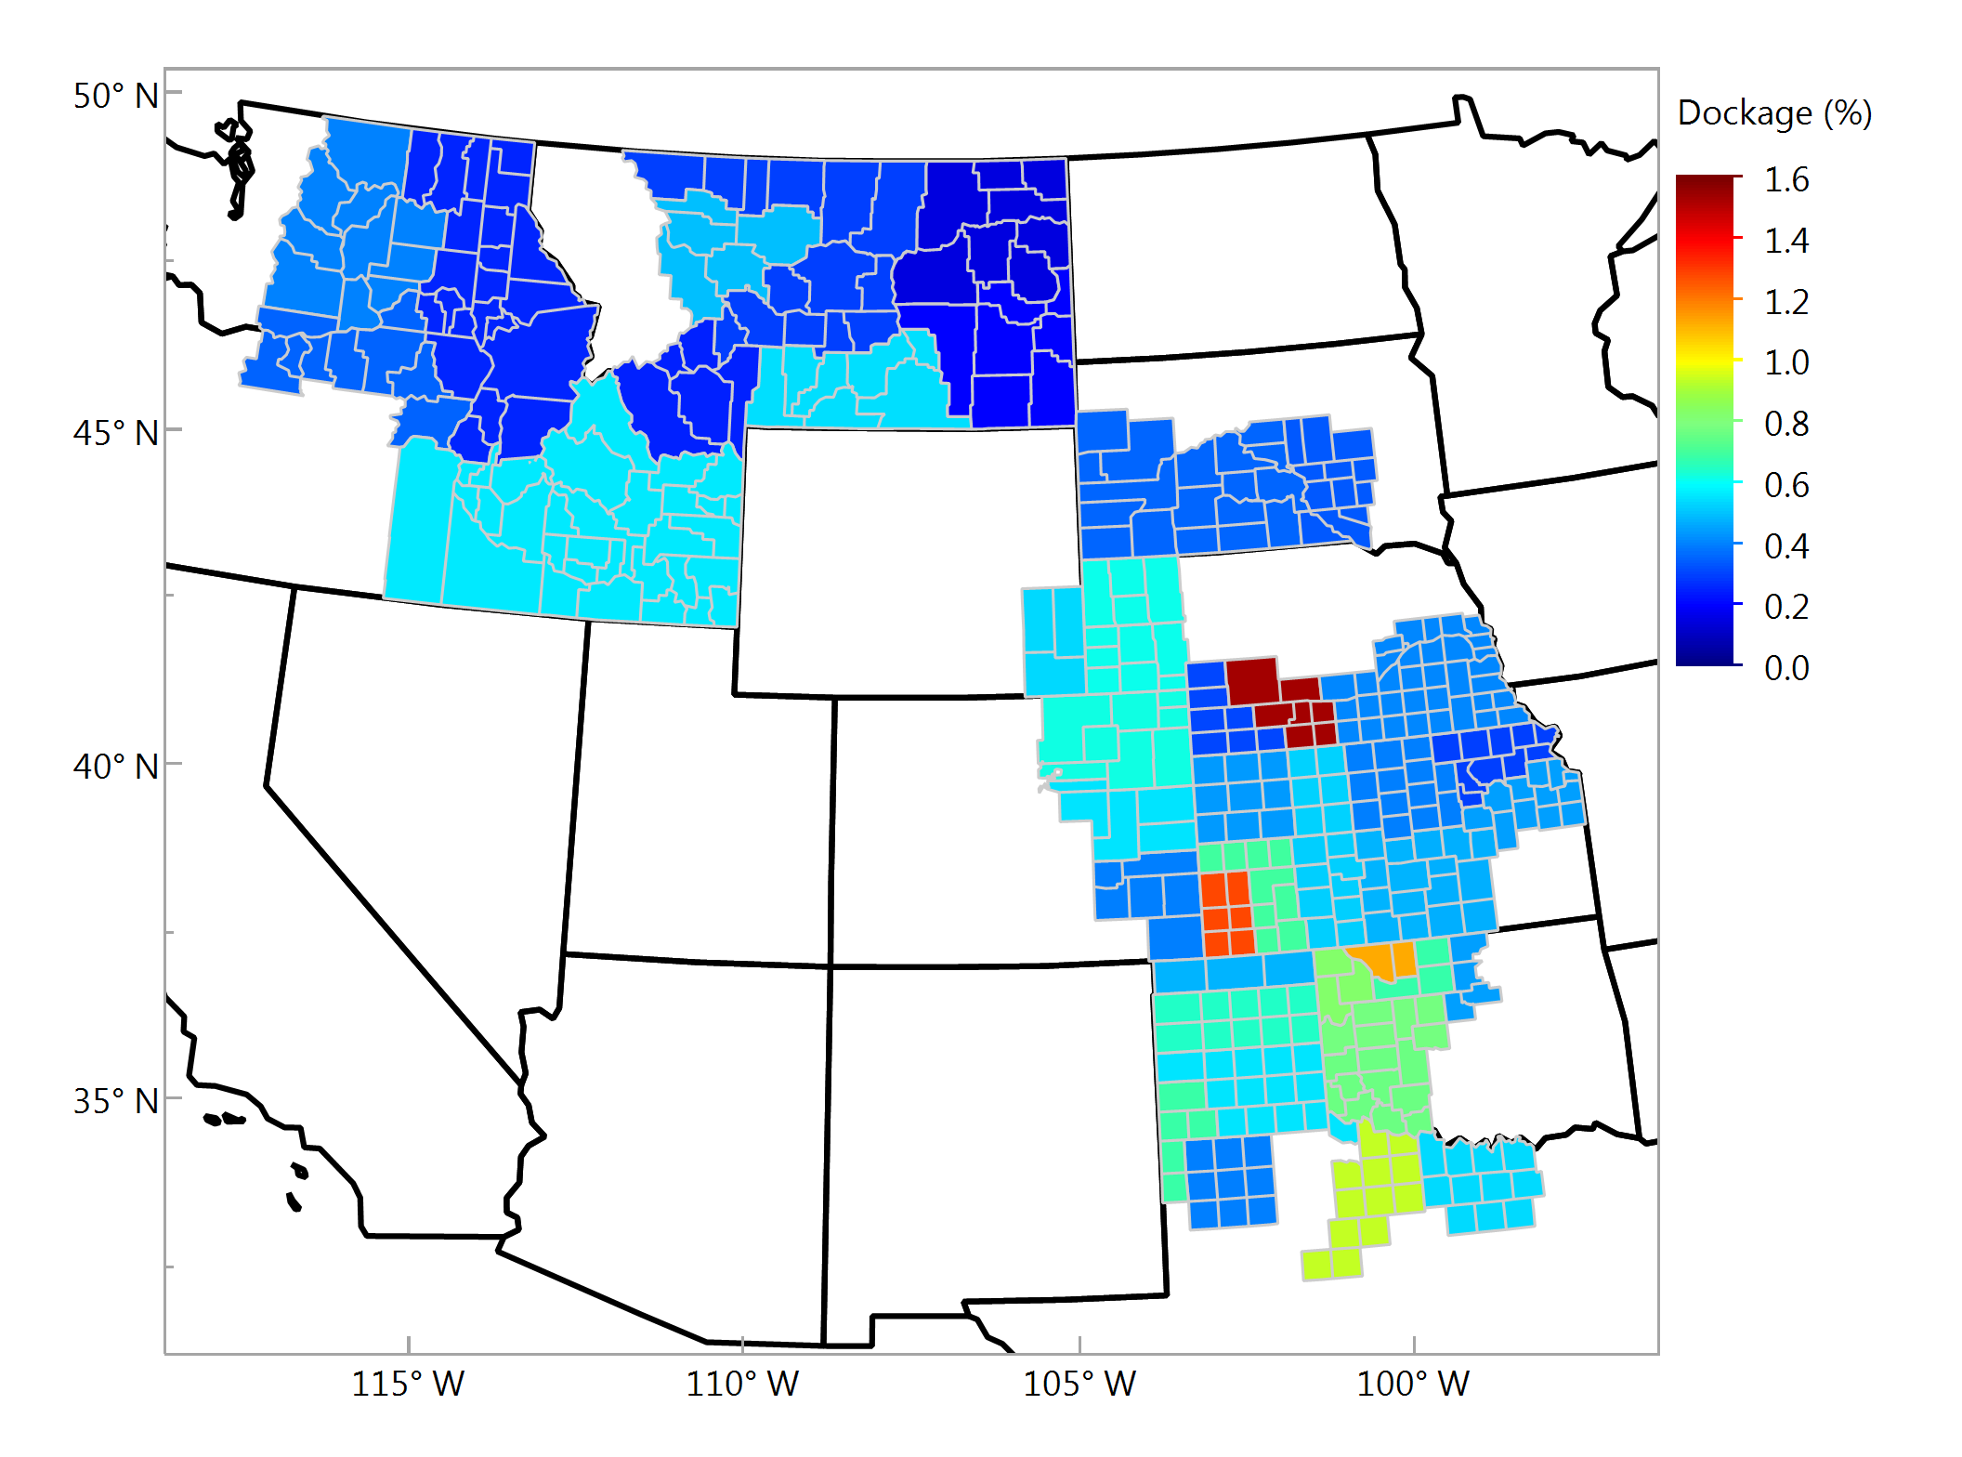
Dockage, % Individual Samples

Slide 11
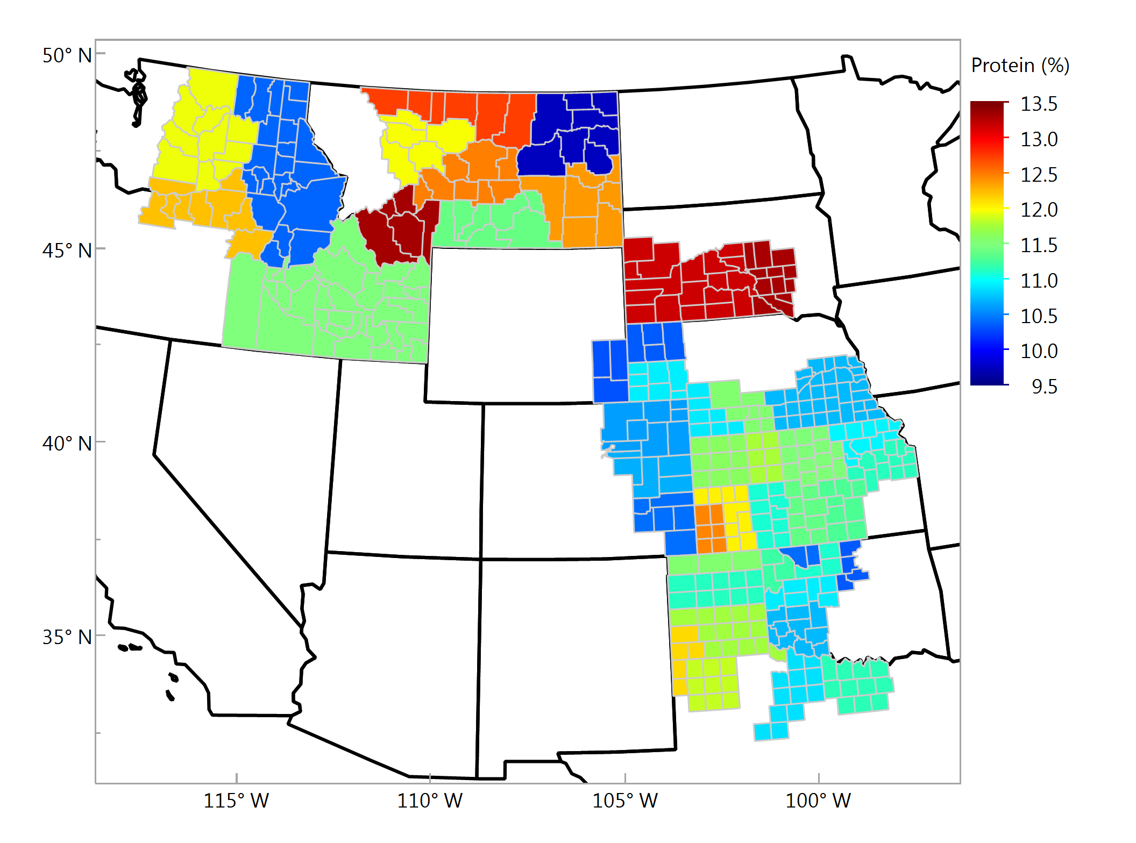
Wheat Protein, % (12%mb) Individual Samples

Slide 12
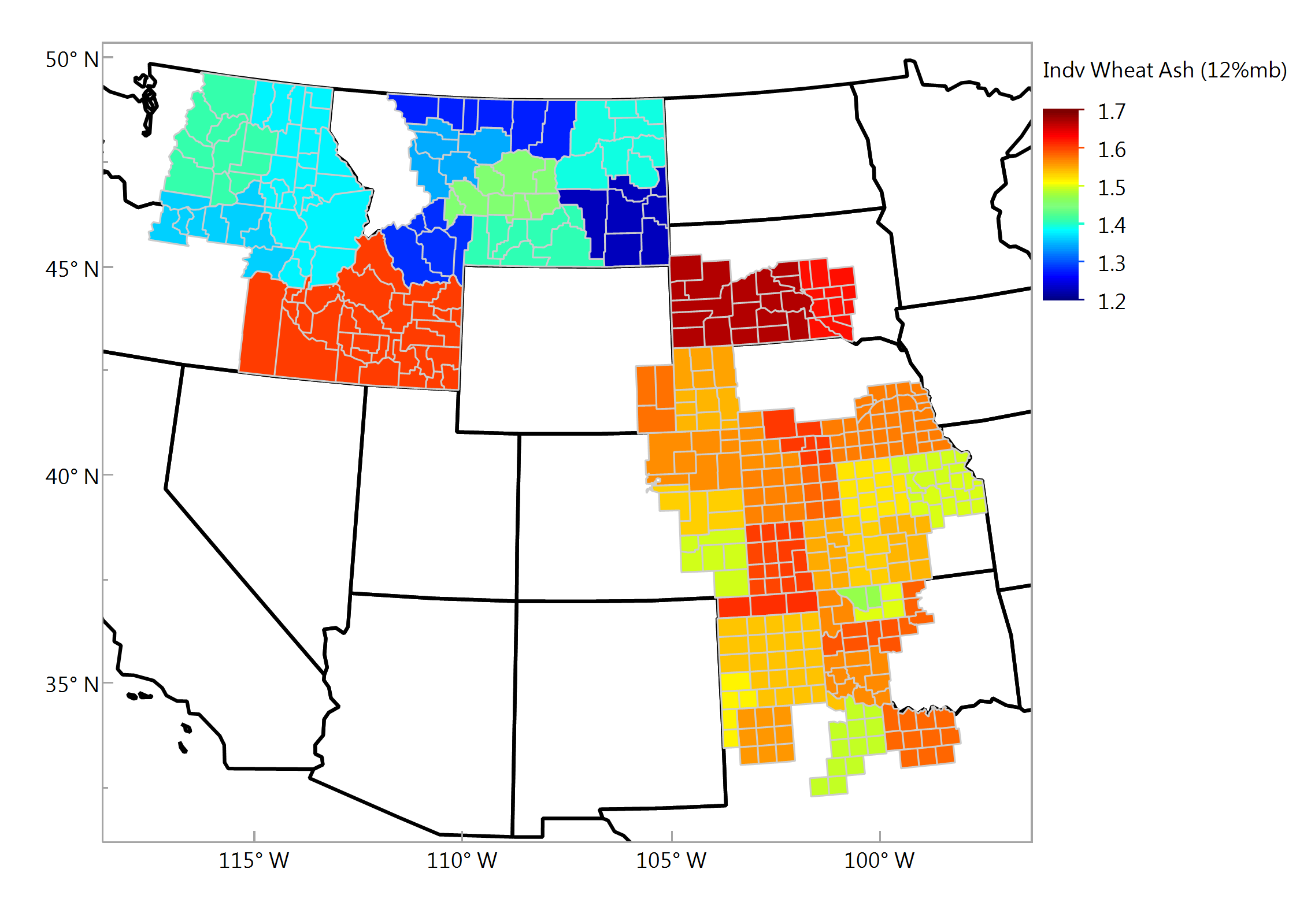
Wheat Ash (12% mb), % Individual Samples

Slide 13
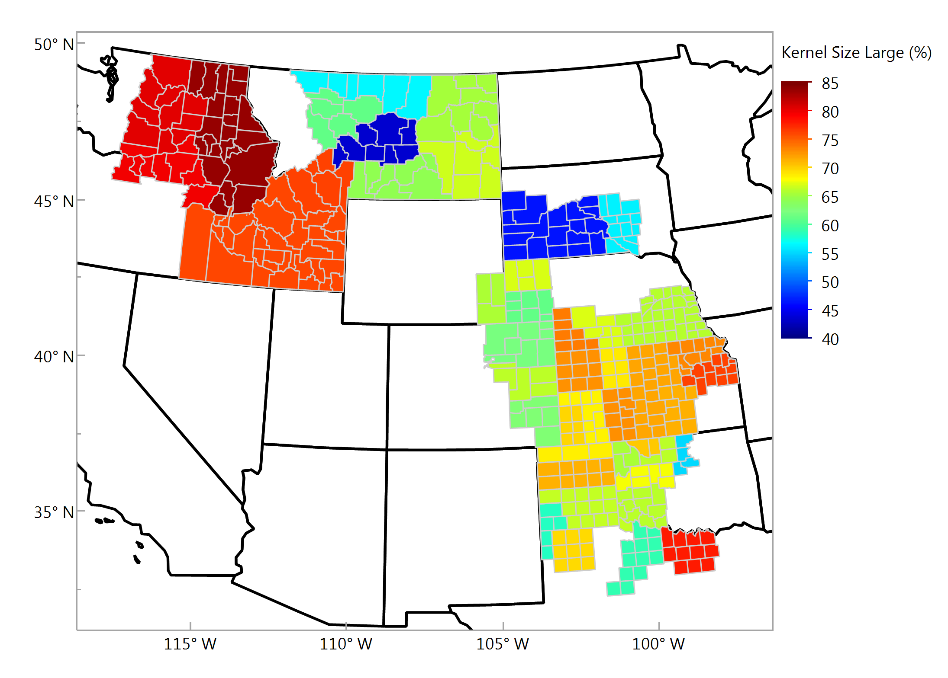
Kernel Size, Large, % Individual Samples

Slide 14
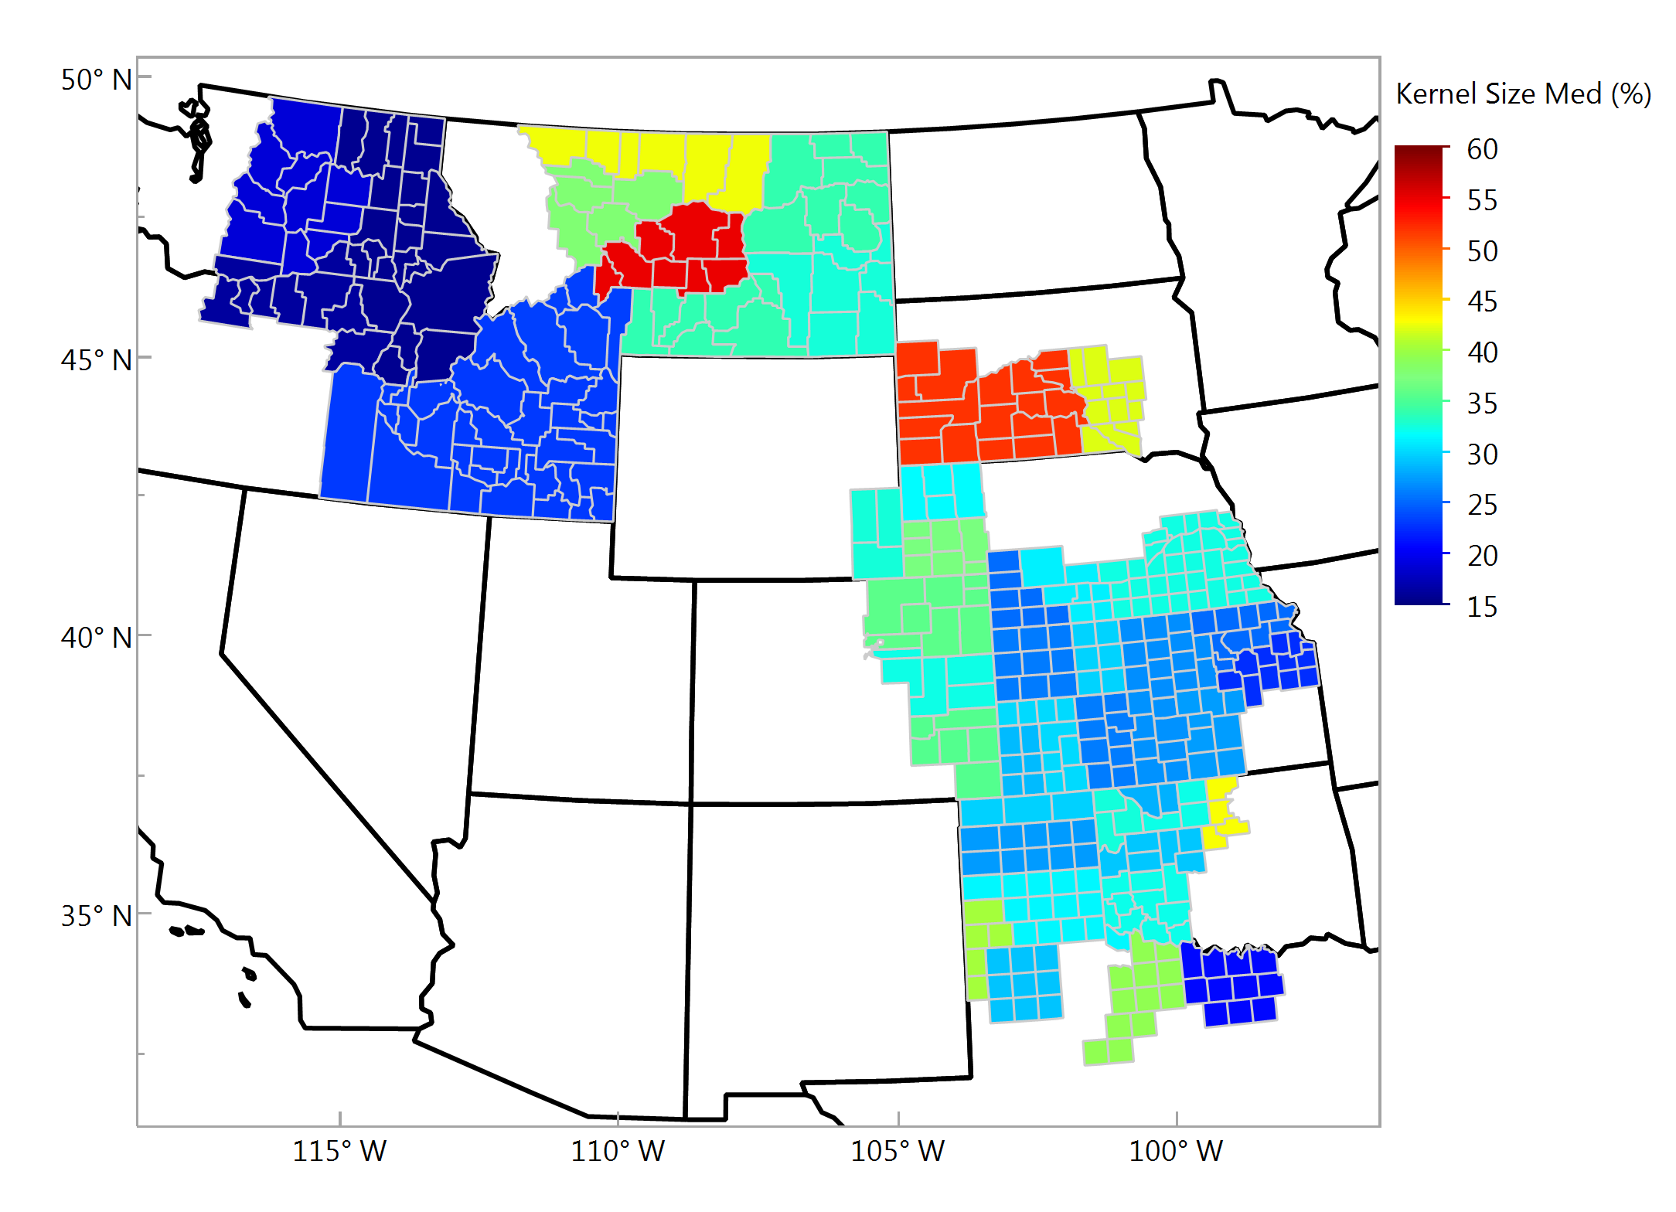
Kernel Size, Medium, % Individual Samples

Slide 15
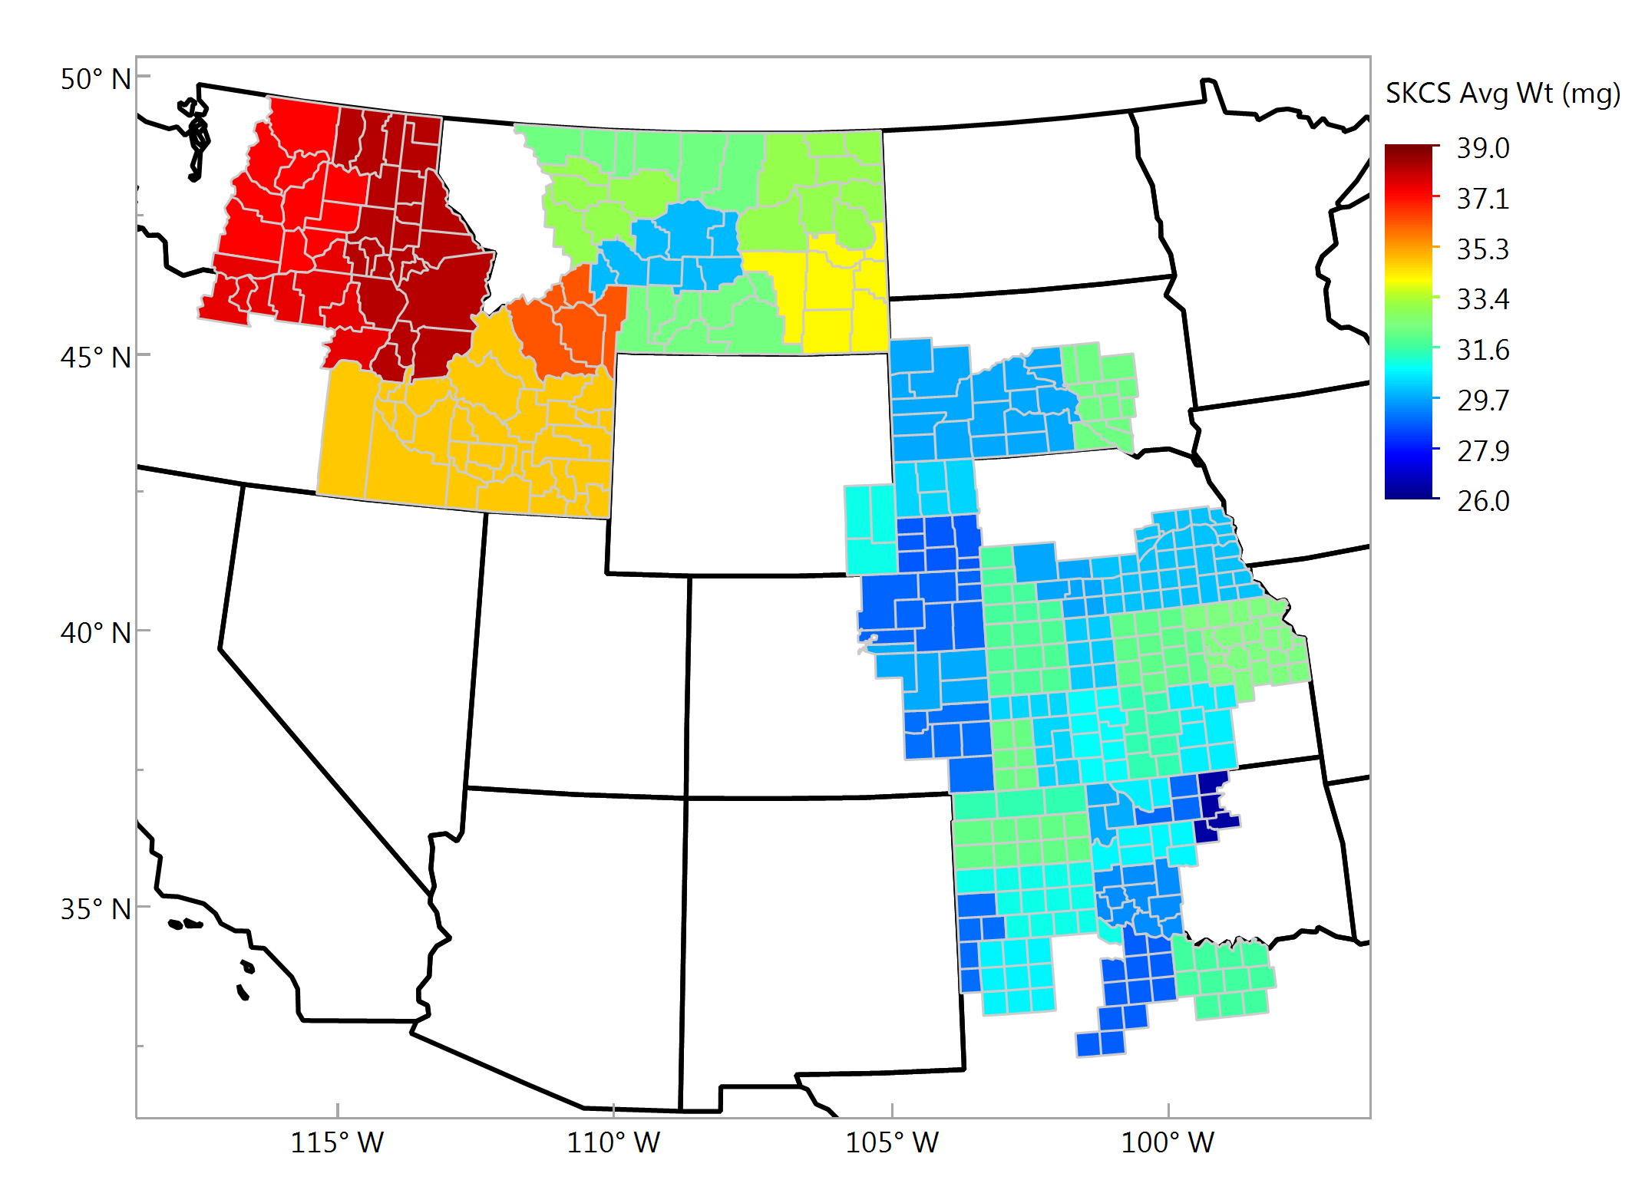
Average SKCS Kernel Weight, mg Individual Samples

Slide 16
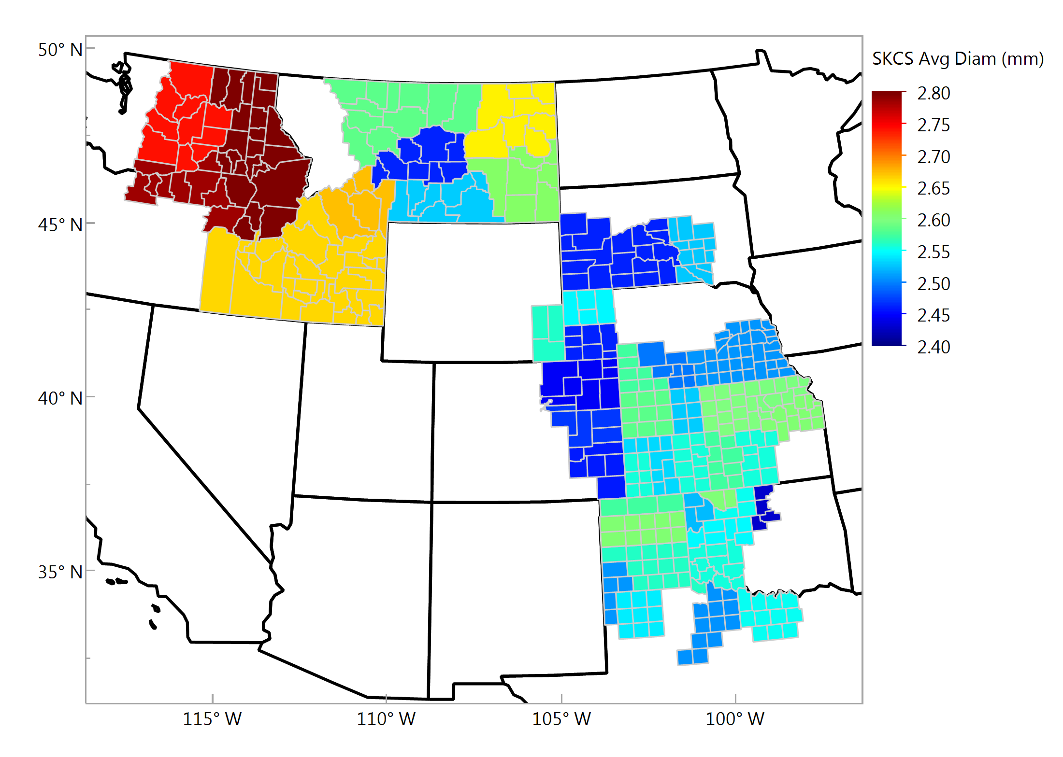
Average SKCS Kernel Diameter, mm Individual Samples

Slide 17
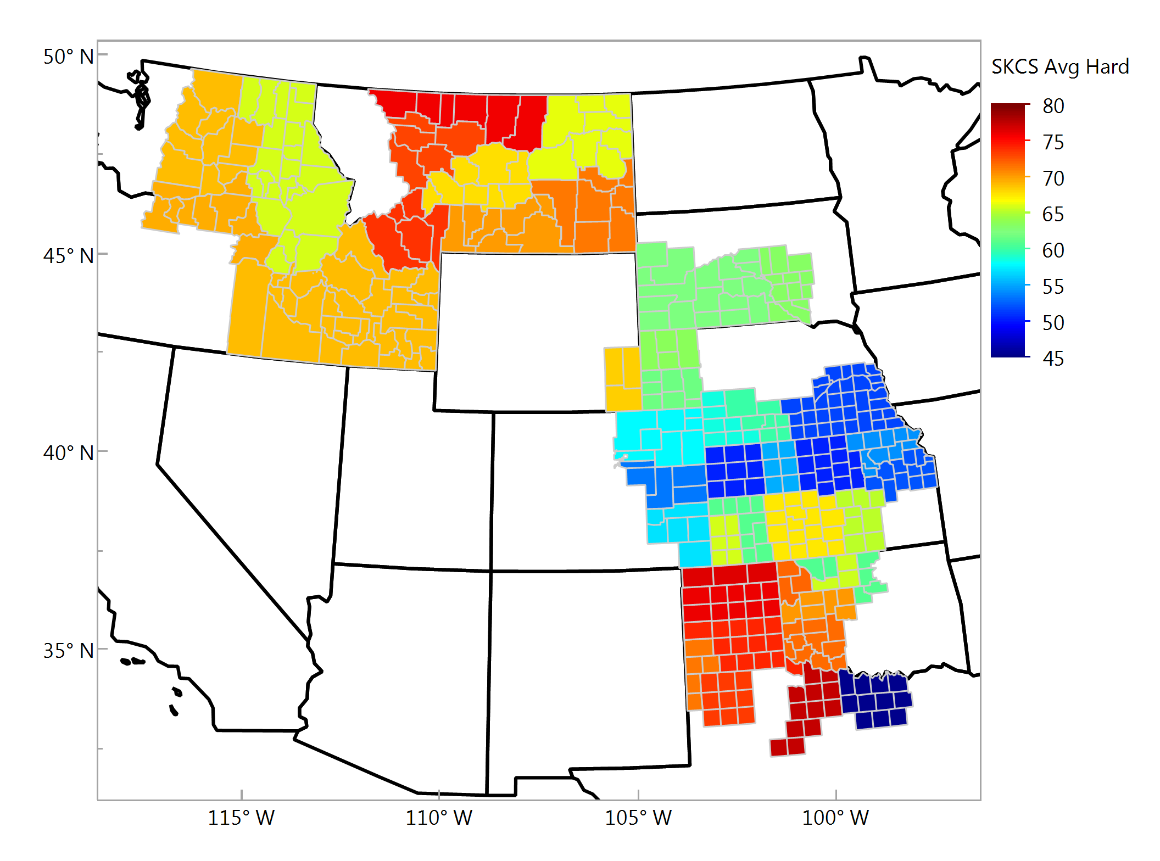
Average SKCS Kernel Hardness Individual Samples

Slide 18
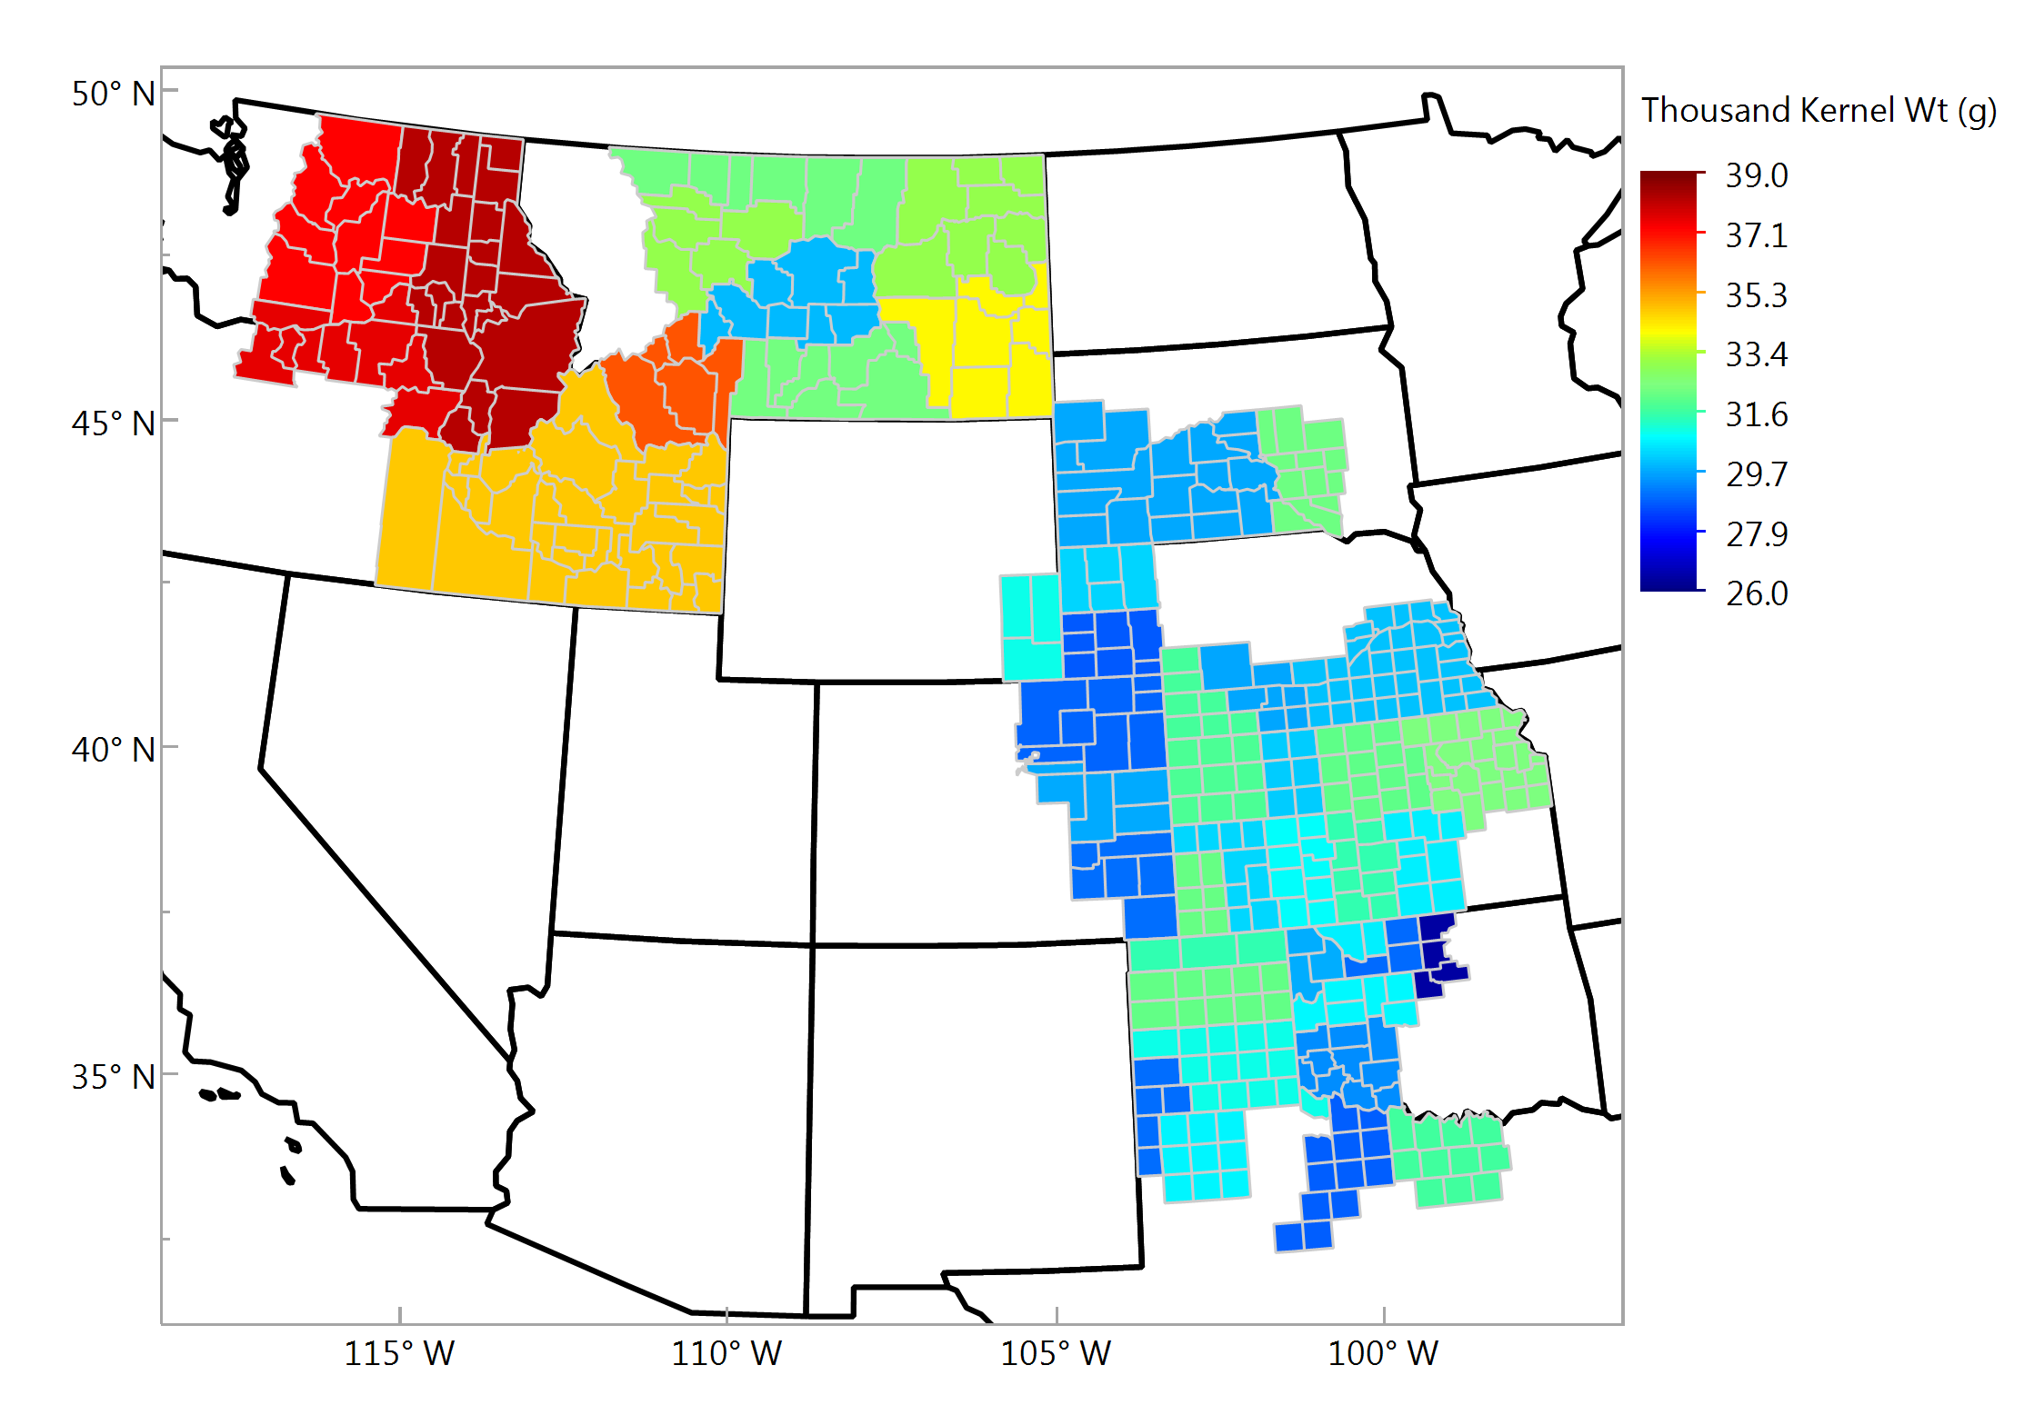
Thousand Kernel Weight, g Individual Samples

Slide 19
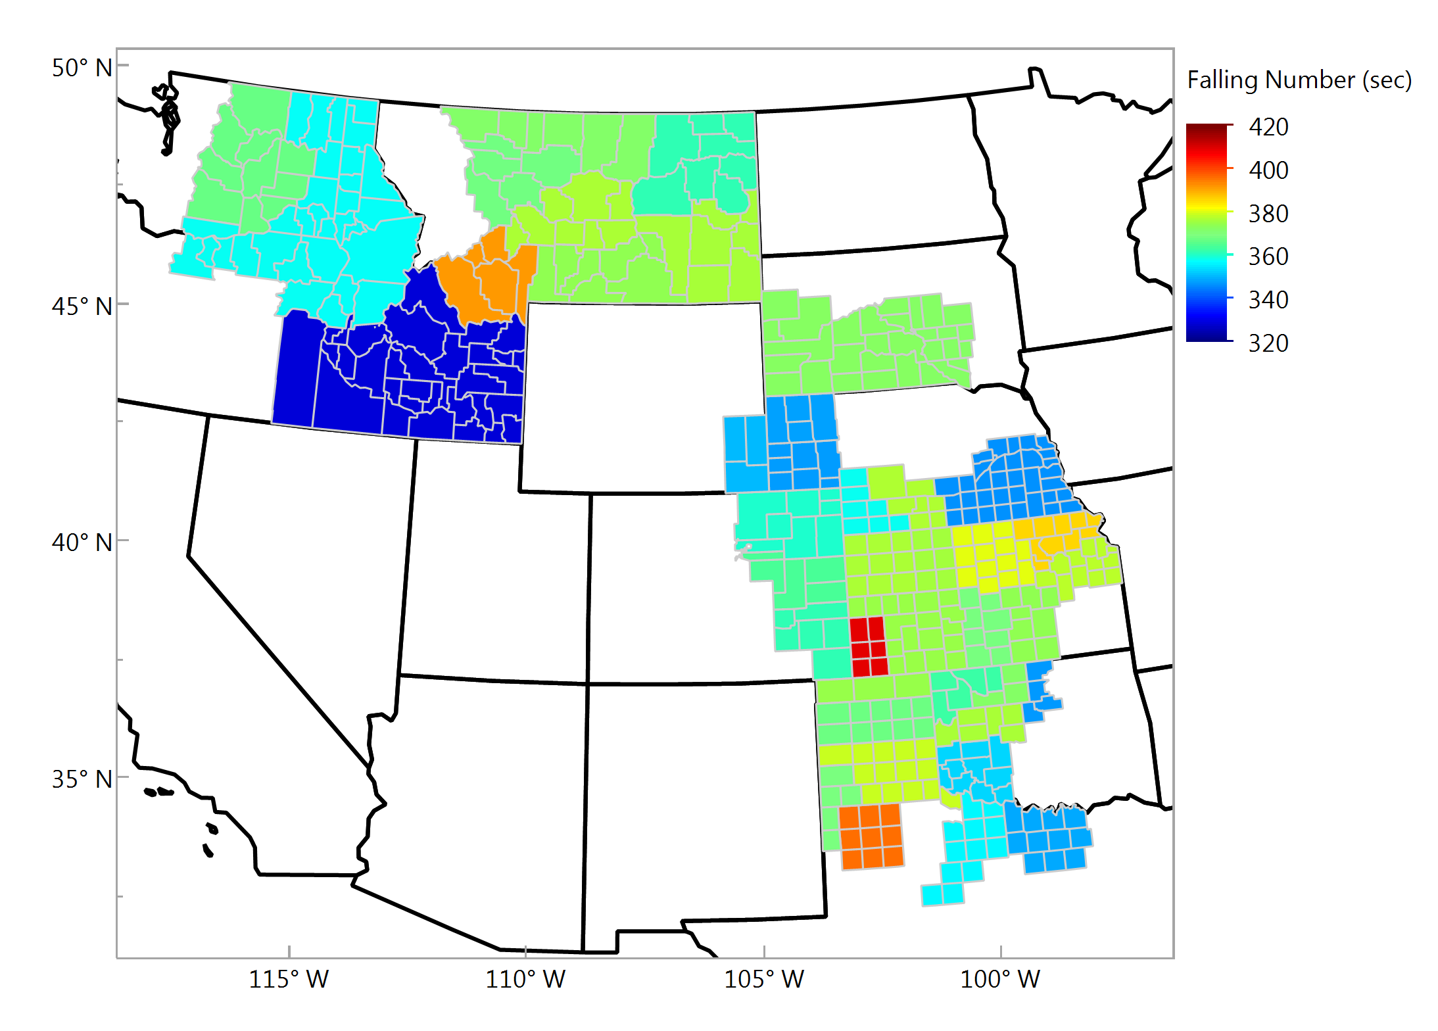
Wheat Falling Number, sec Individual Samples

