Slide 1
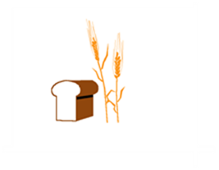
Hard Red Winter Wheat Quality Maps Based on Crop Survey by Plains Grains, Inc.
Flour and Dough

Slide 2
Plains Grains, Inc. Grainsheds

Slide 3
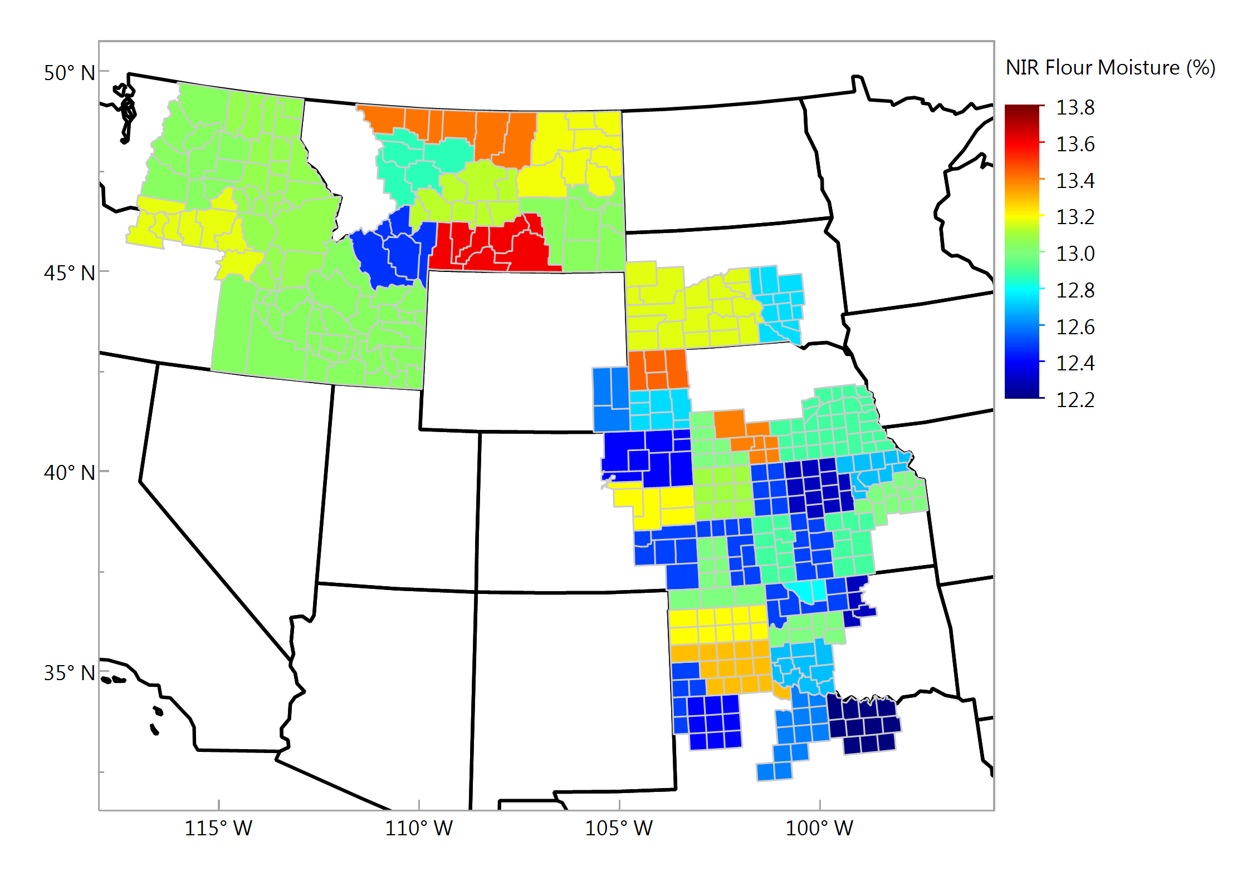
Flour Moisture (NIR), % Composite Samples

Slide 4
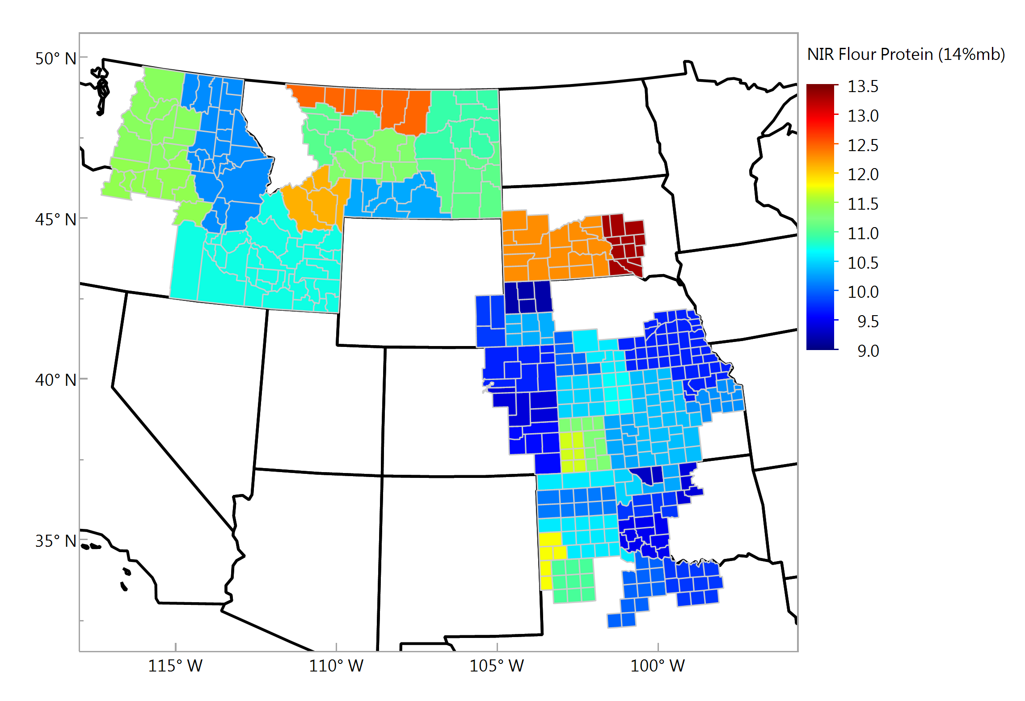
Flour Protein (NIR, 14% mb), % Composite Samples

Slide 5
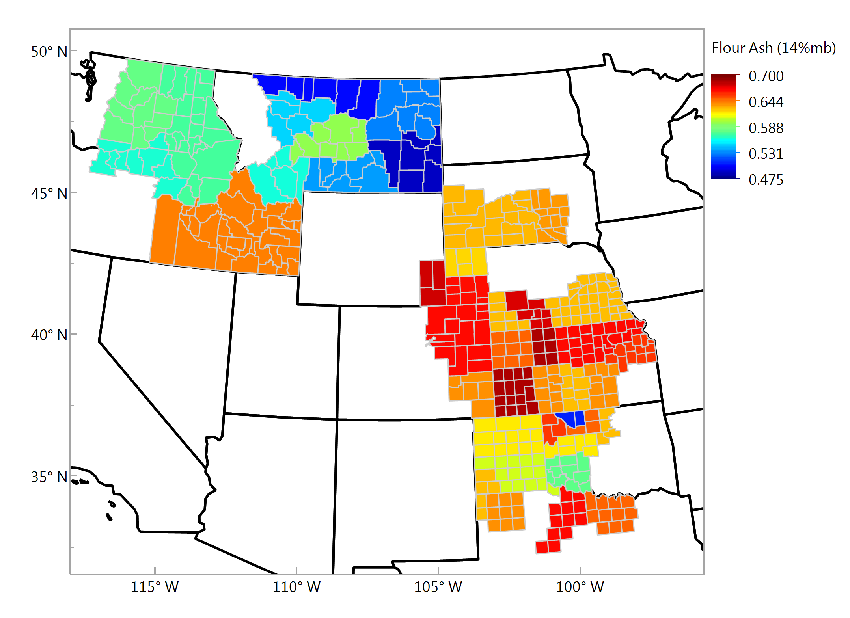
Flour Ash (14% mb), % Composite Samples

Slide 6
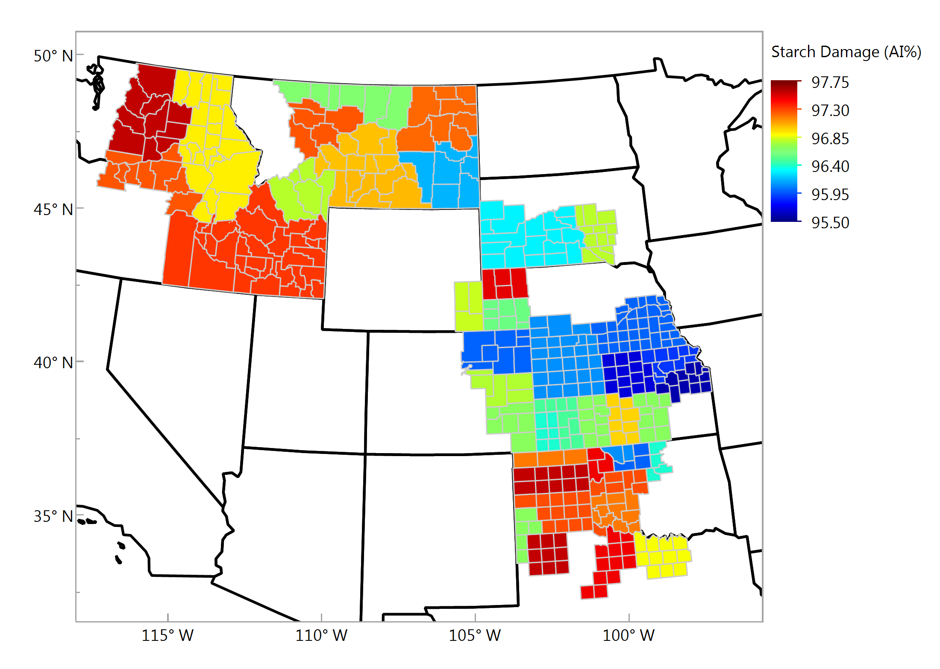
Starch Damage, % Composite Samples

Slide 7
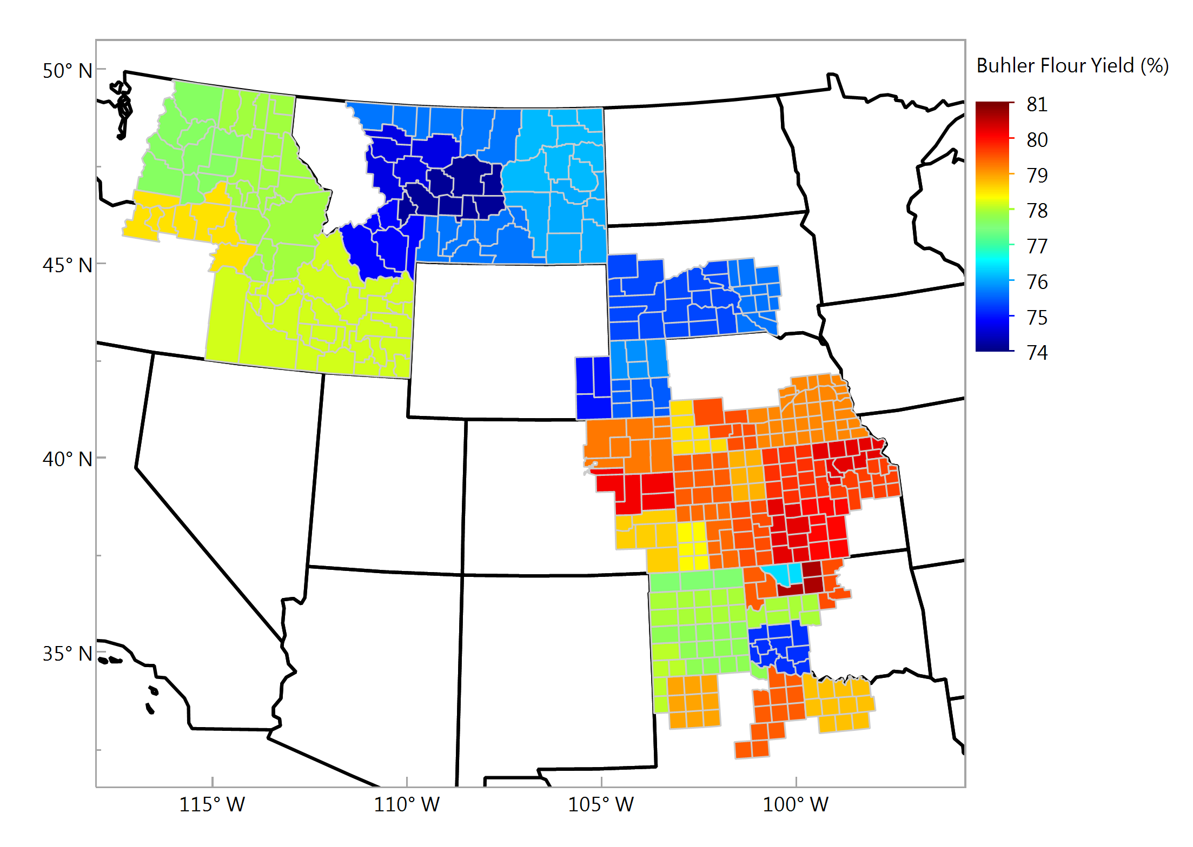
Buhler Flour Yield, % Composite Samples

Slide 8
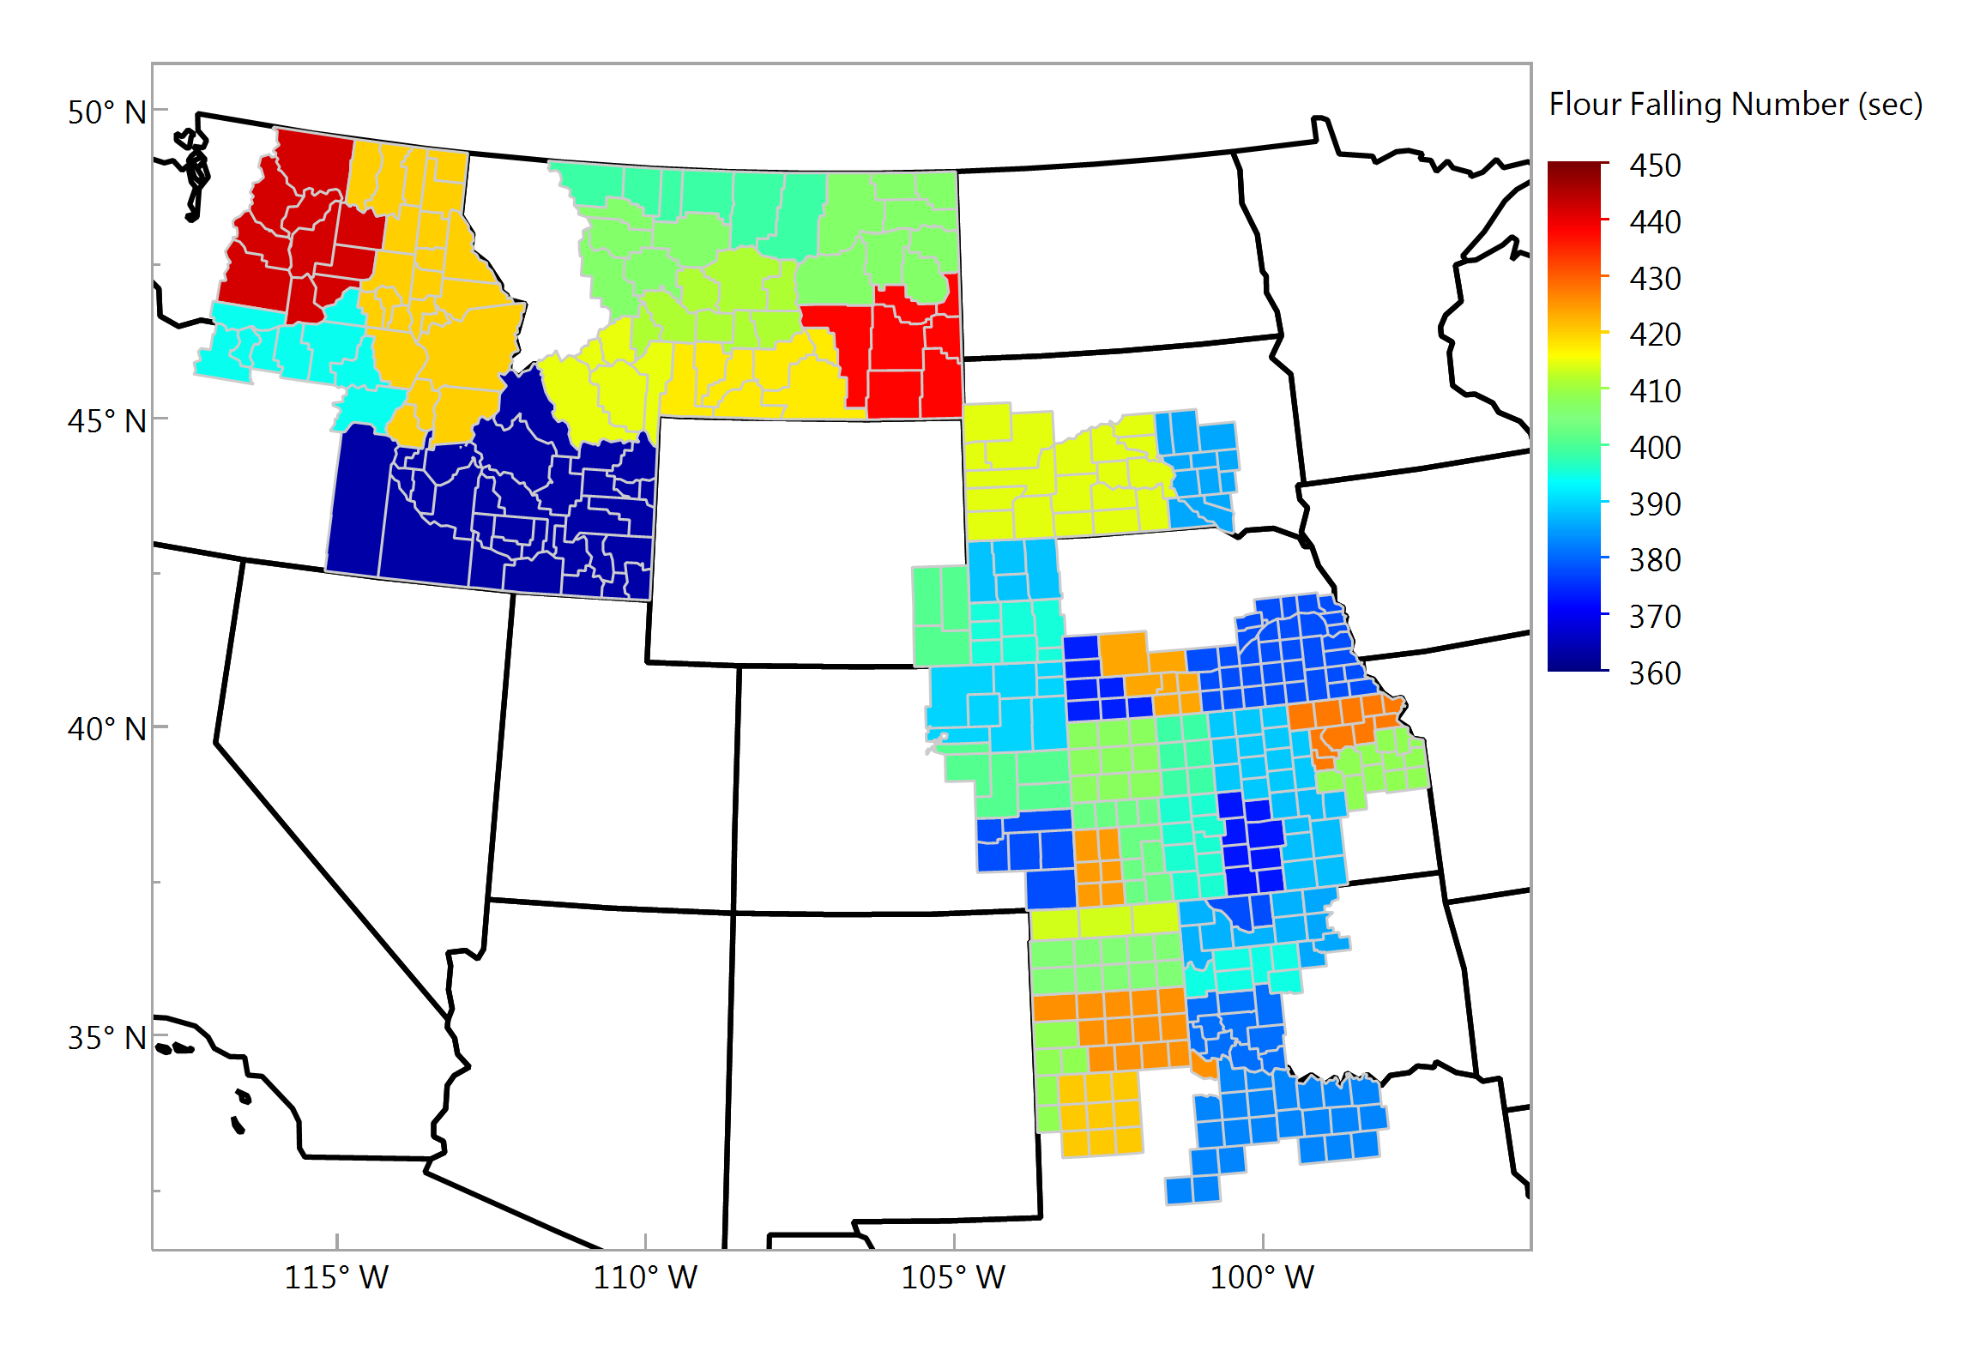
Flour Falling Number (sec) Composite Samples

Slide 9
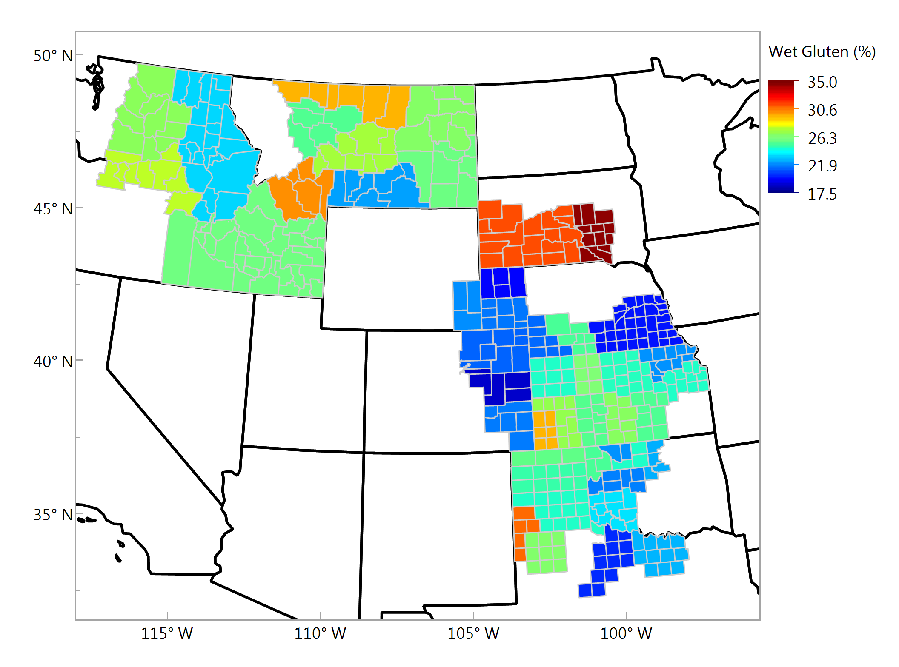
Wet Gluten, % Composite Samples

Slide 10
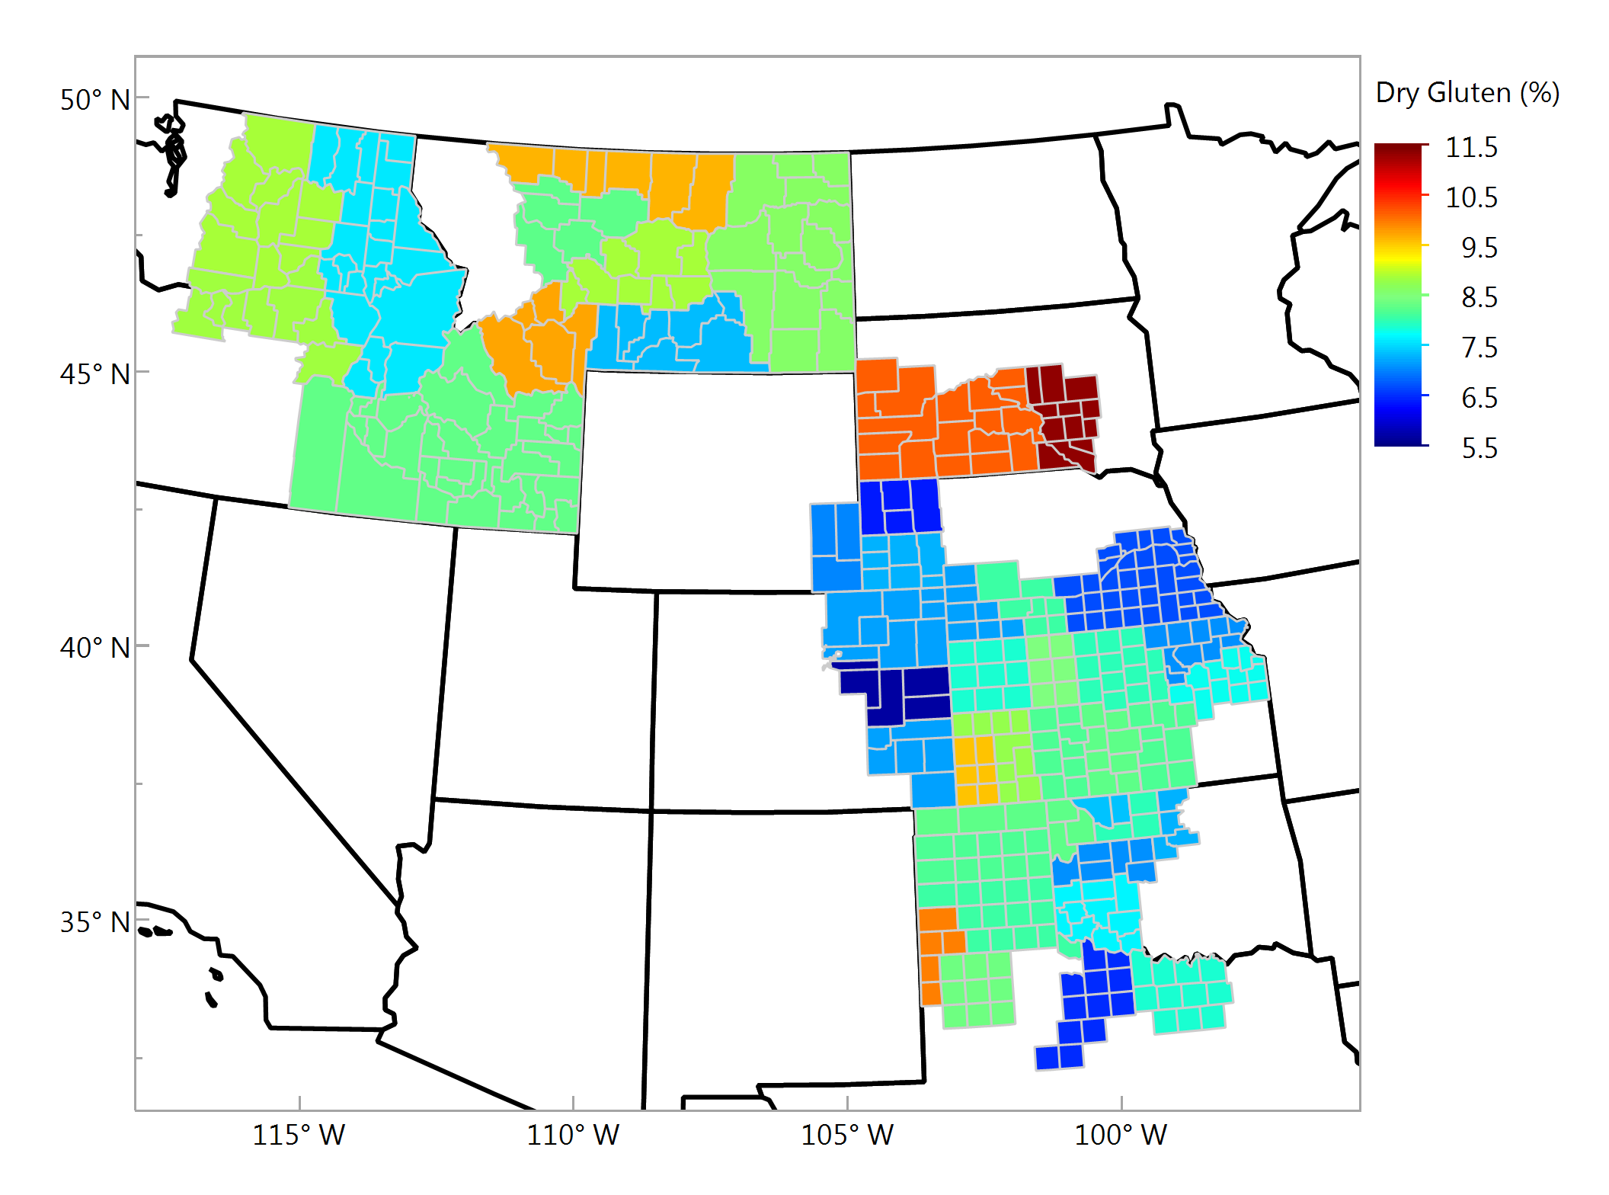
Dry Gluten, % Composite Samples

Slide 11
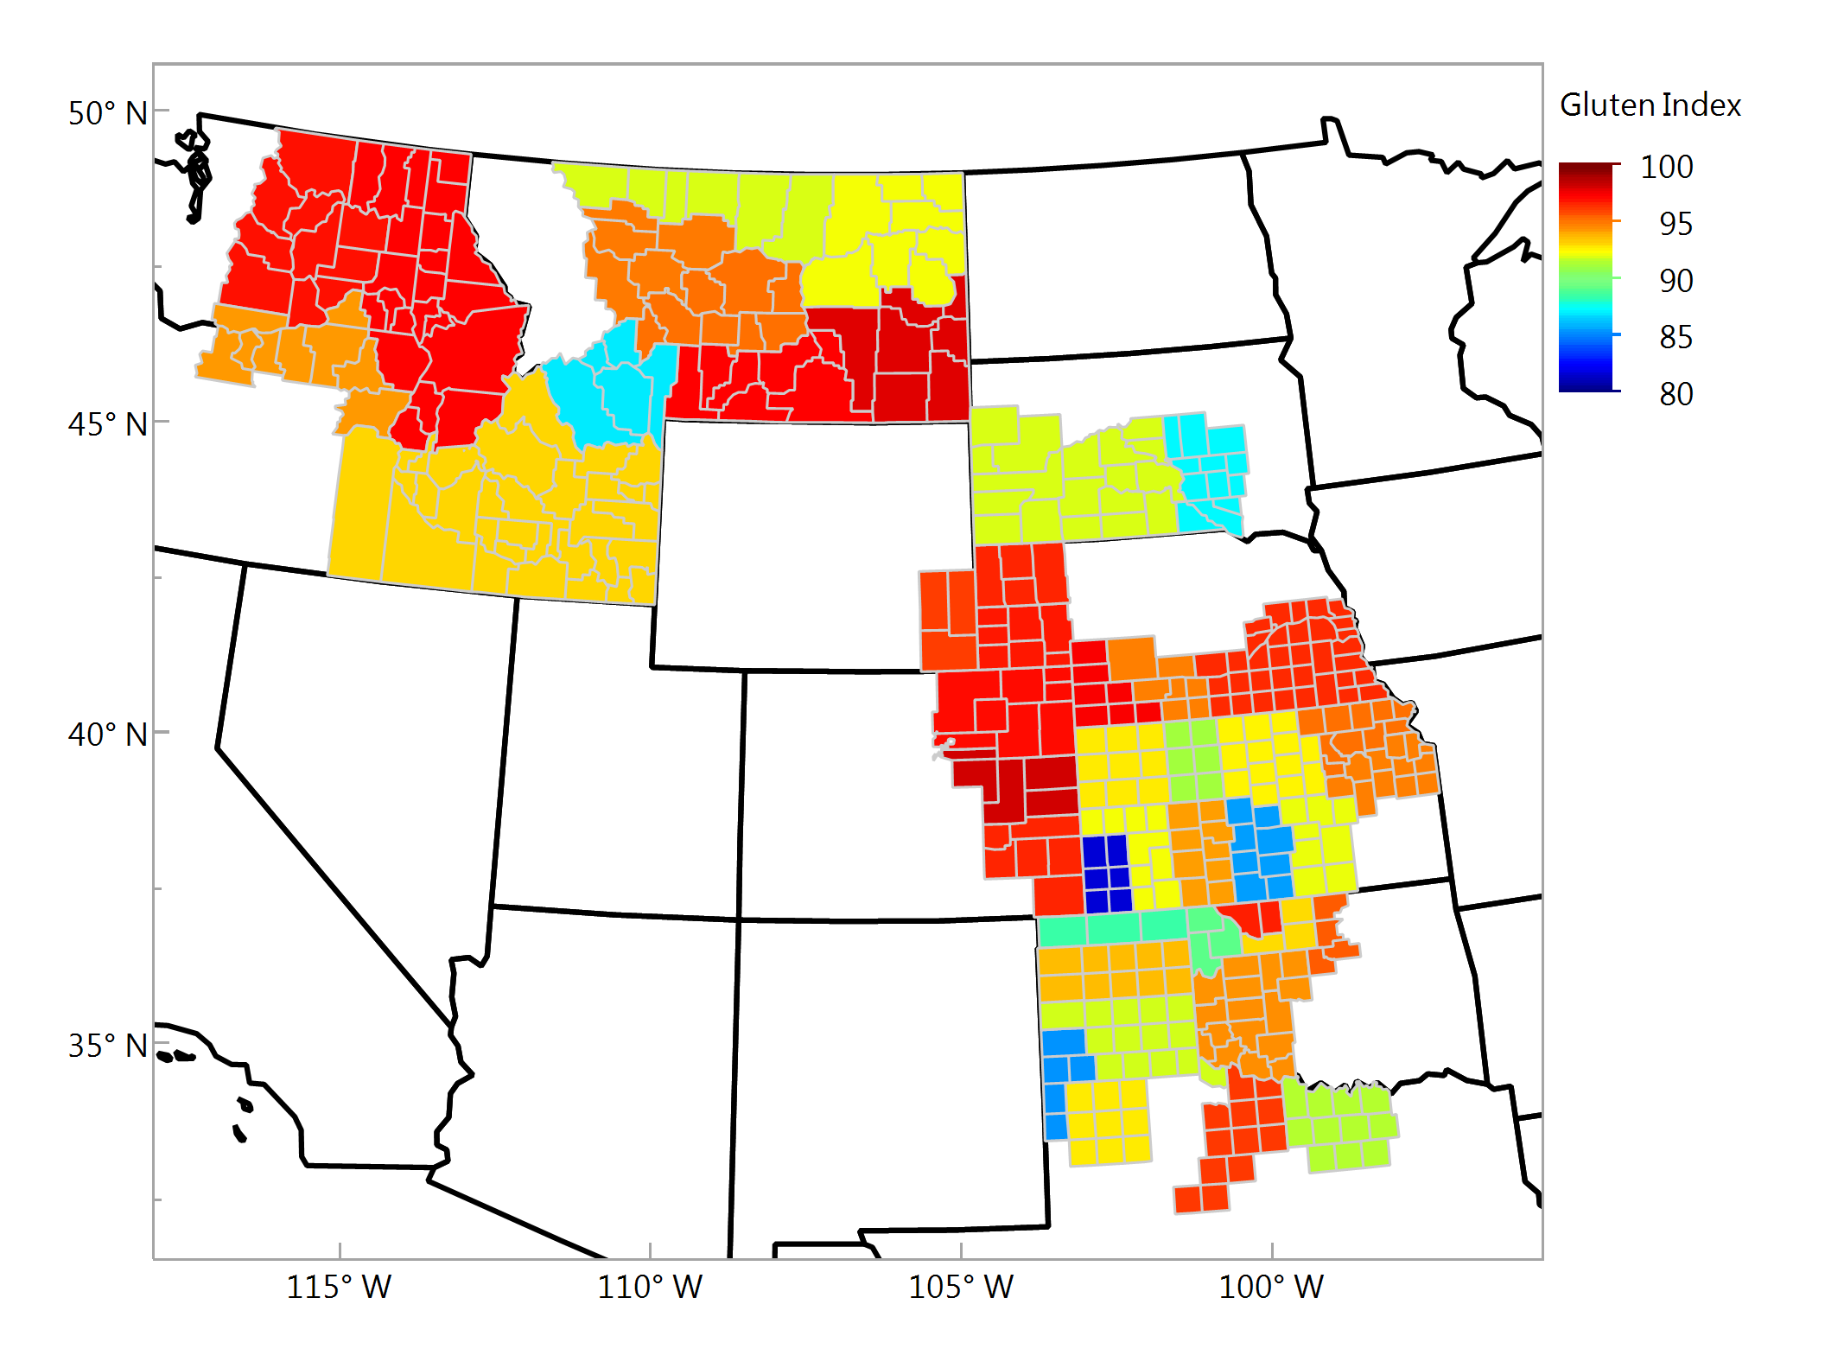
Gluten Index Composite Samples

Slide 12
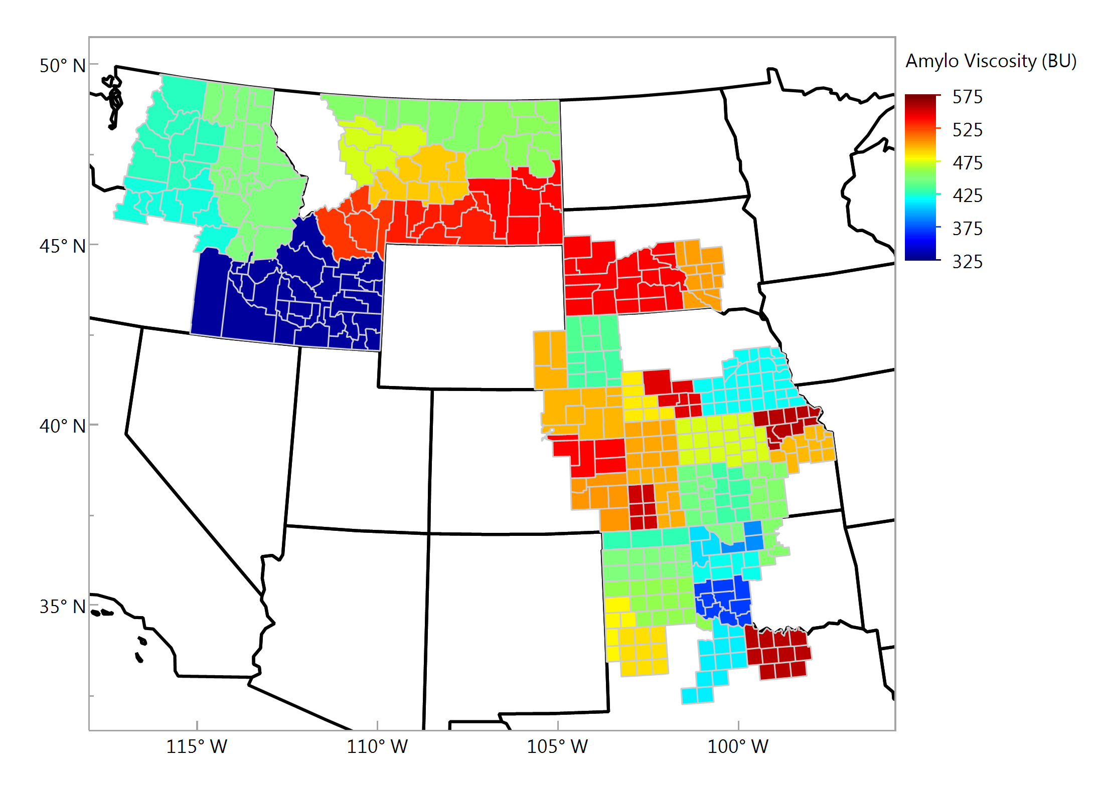
Amylograph Viscosity, BU Composite Samples

Slide 13
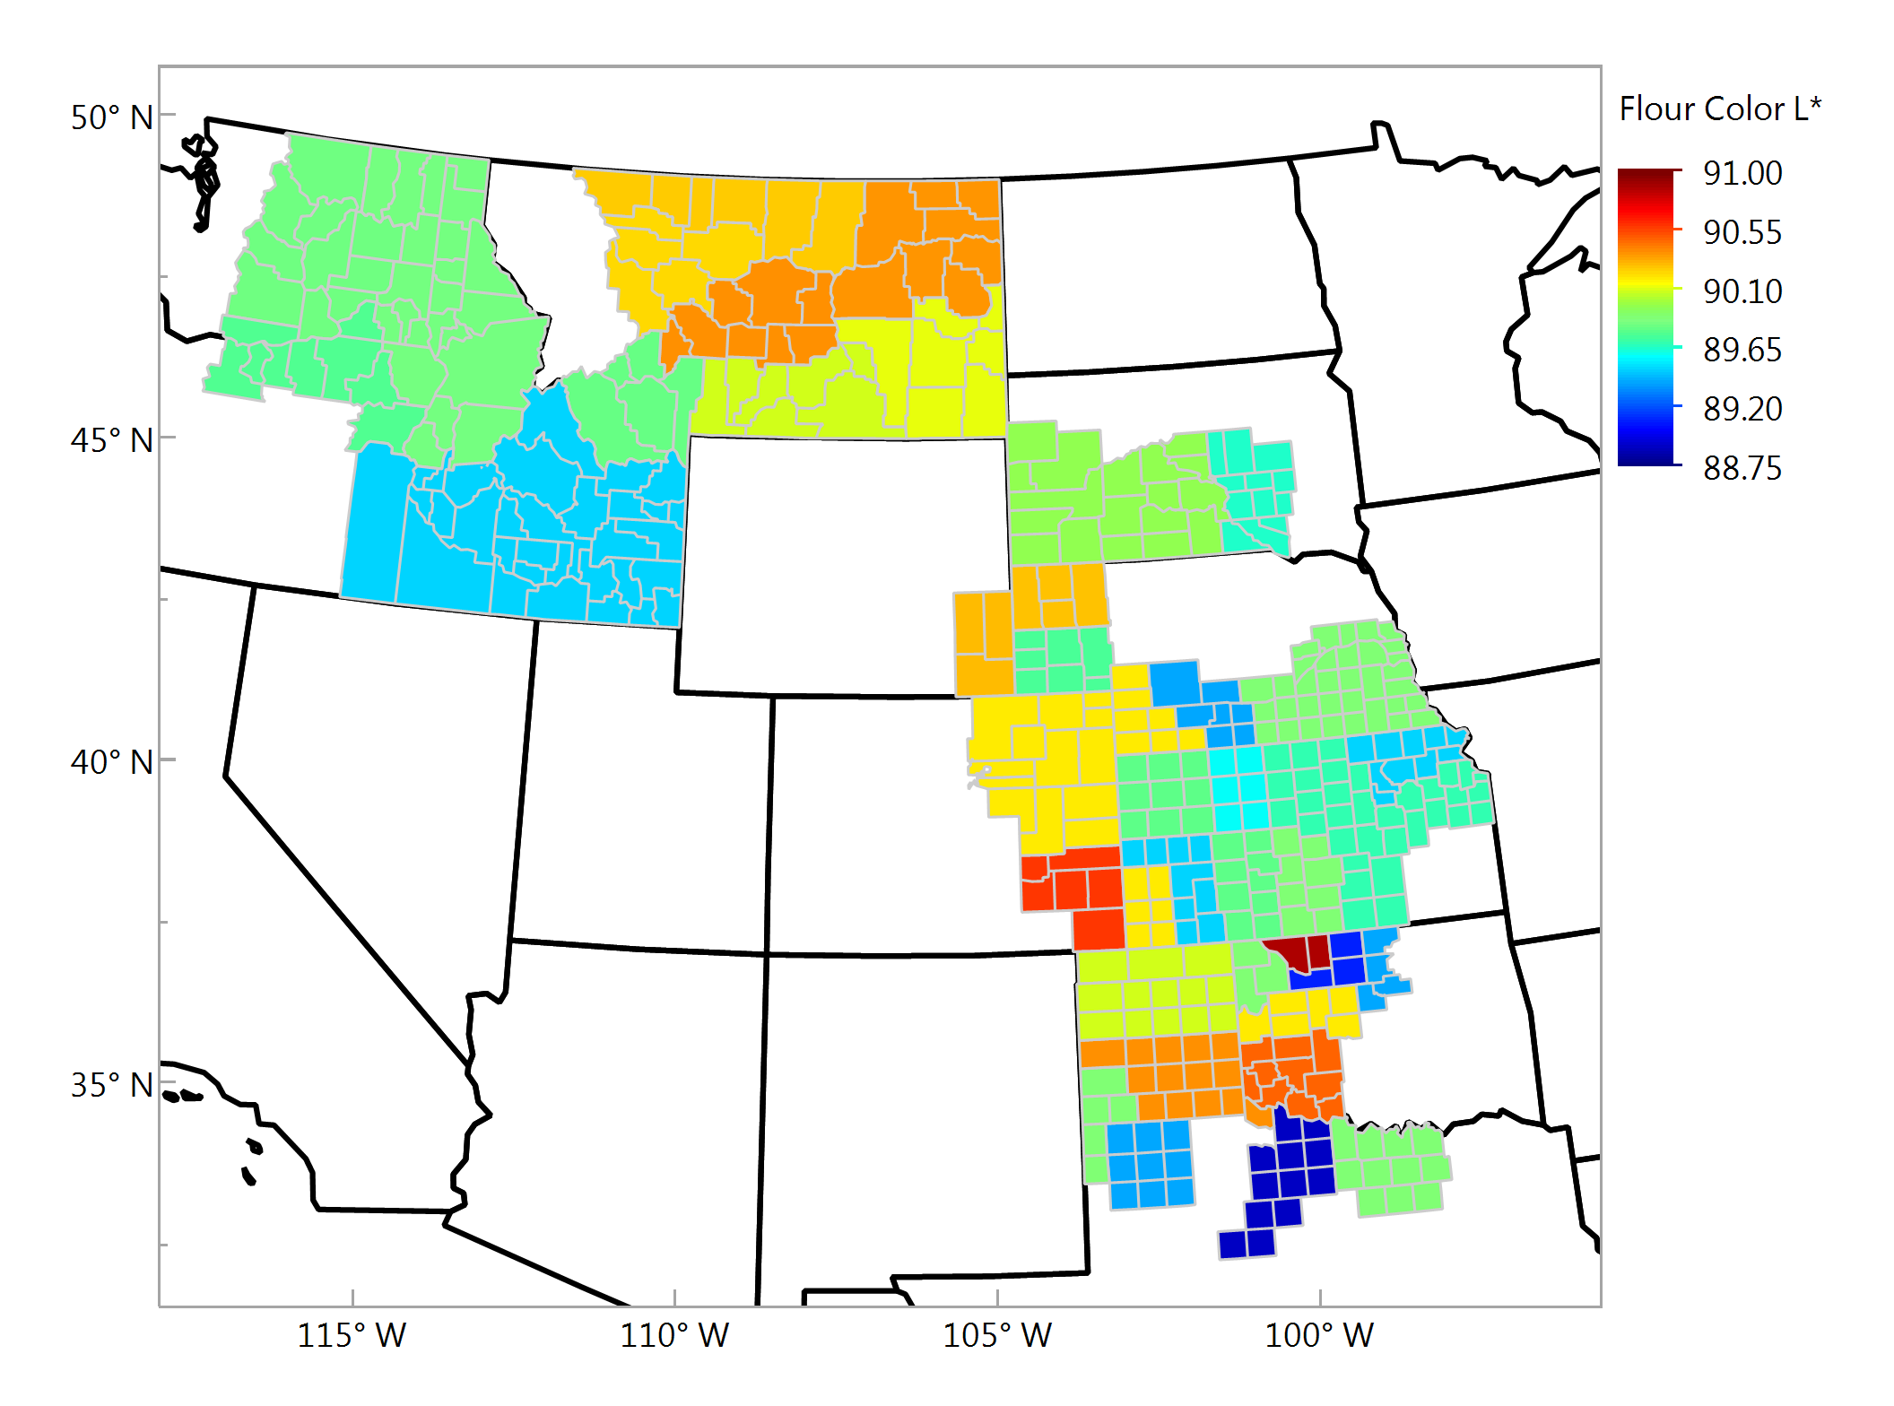
Flour Color - L Composite Samples

Slide 14
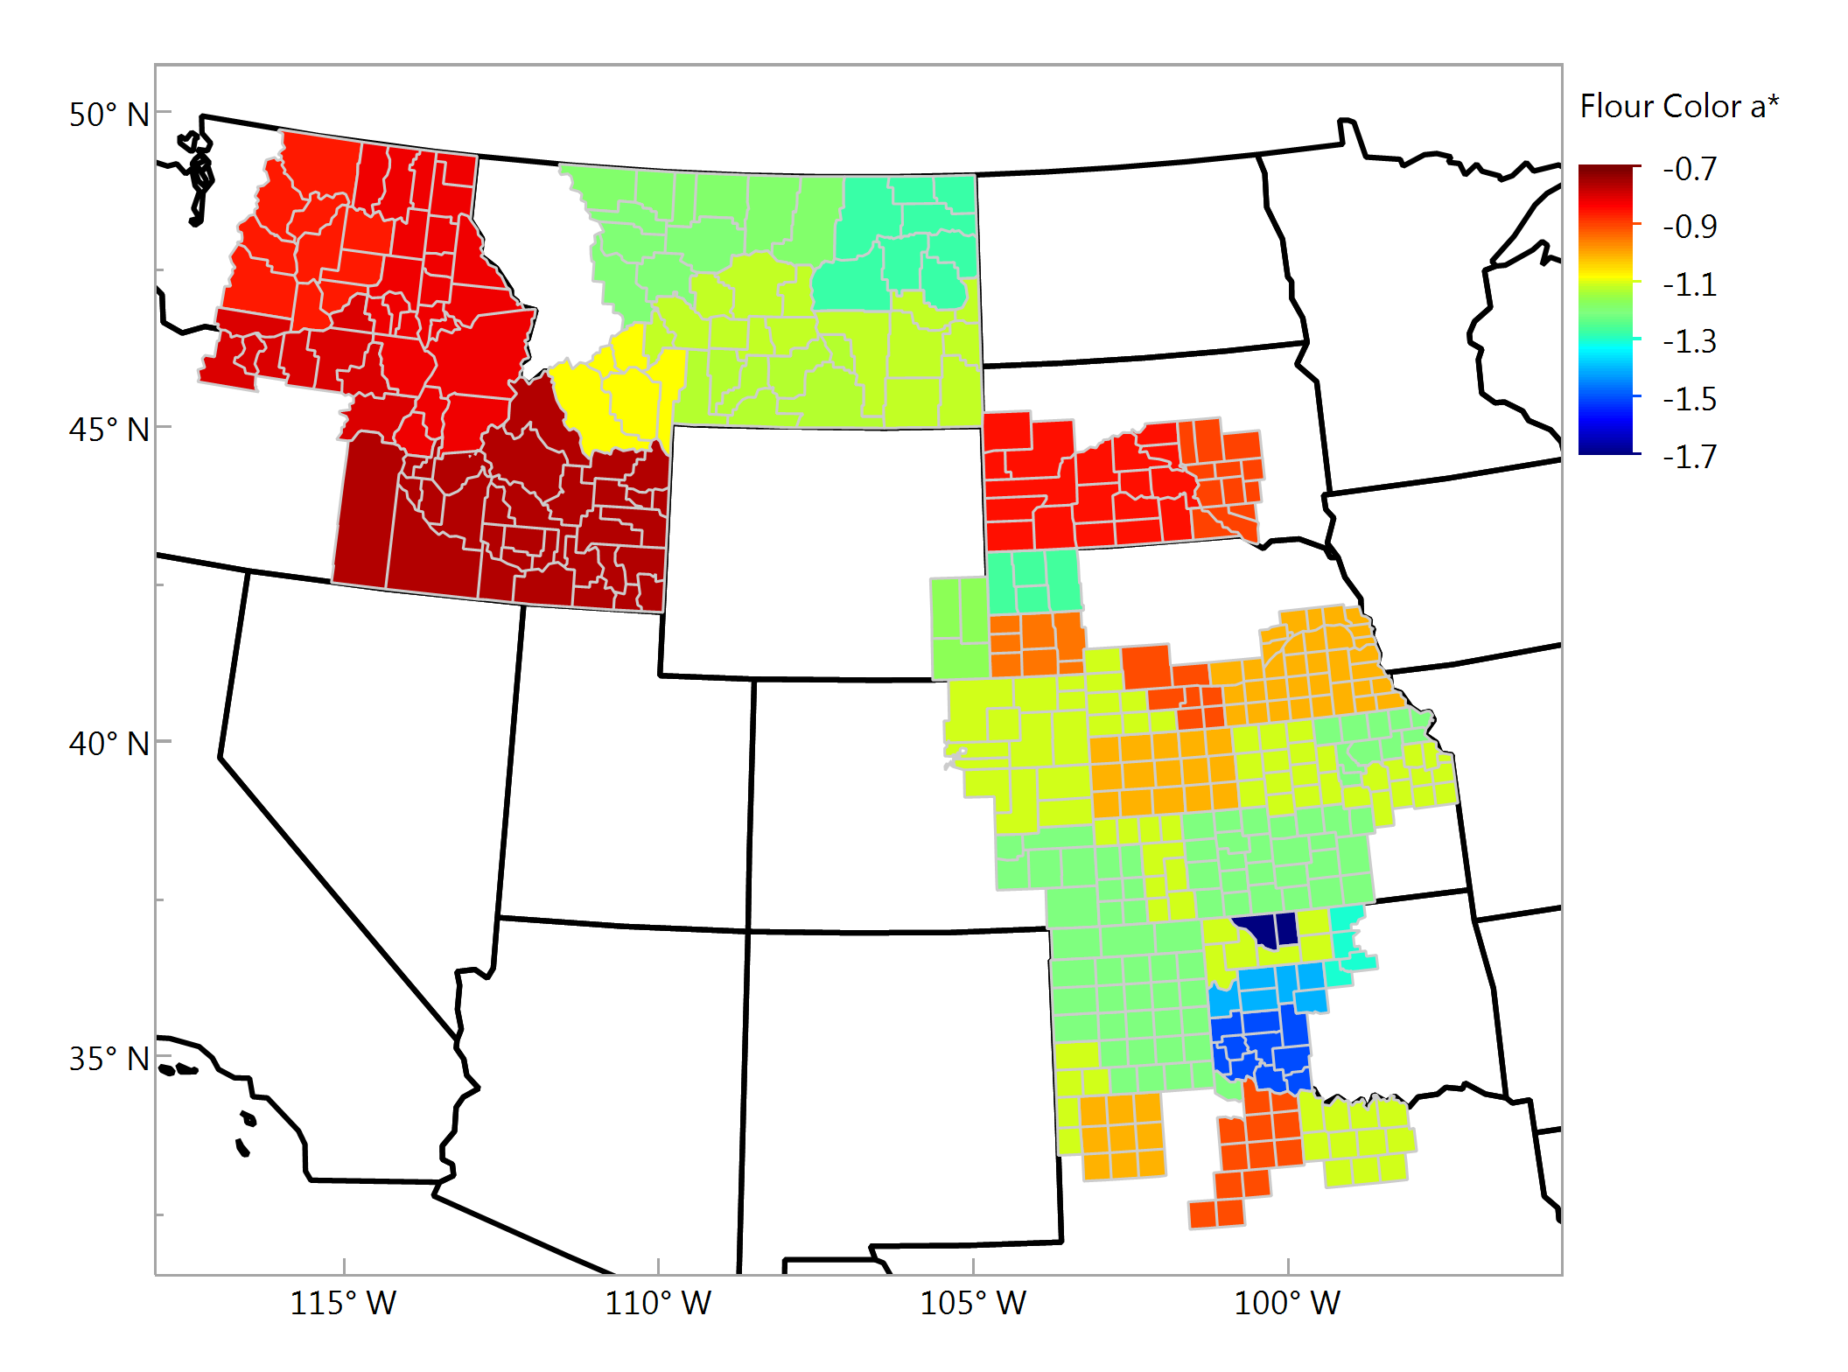
Flour Color - a Composite Samples

Slide 15
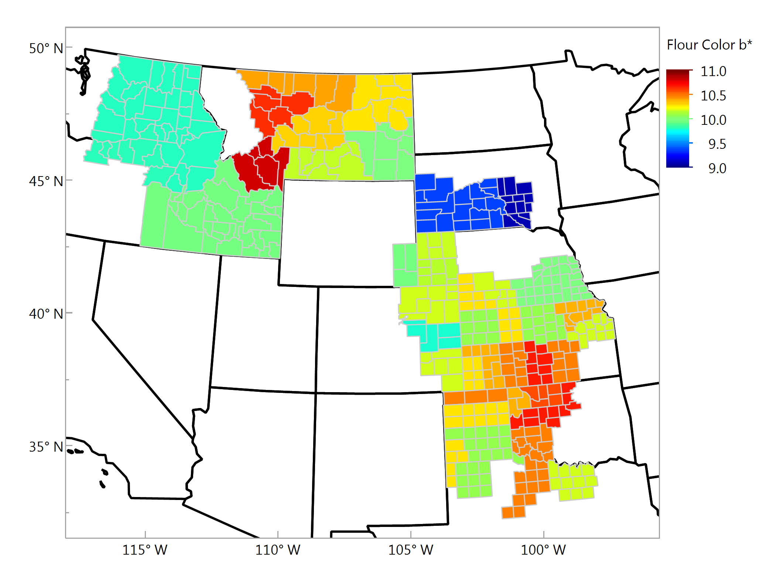
Flour Color - b Composite Samples

Slide 16
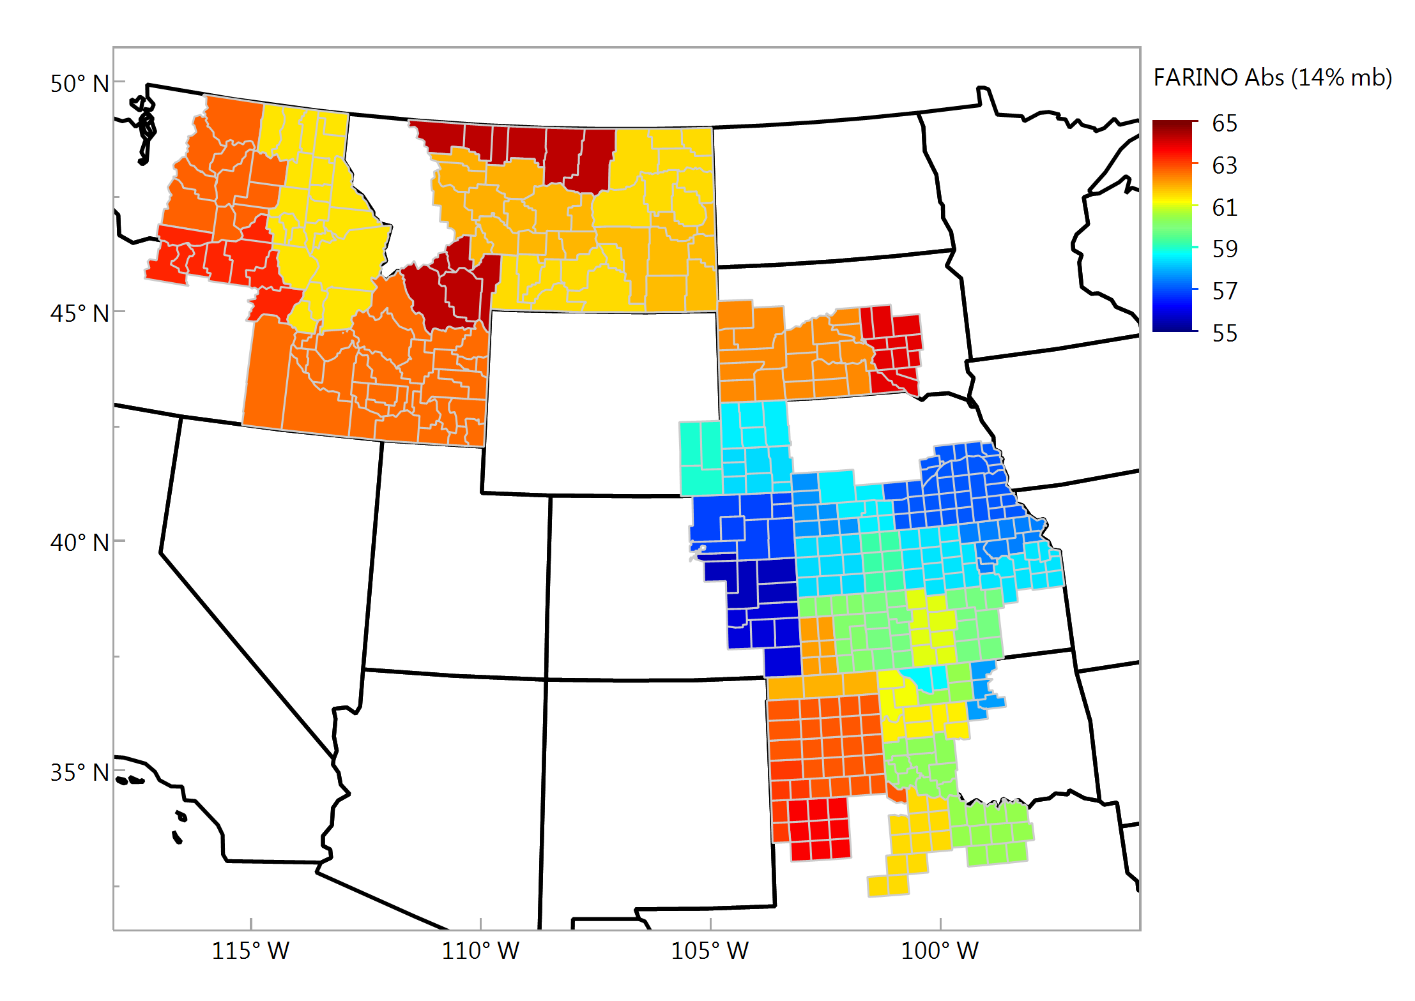
Farinograph Absorption (14% mb), % Composite Samples

Slide 17
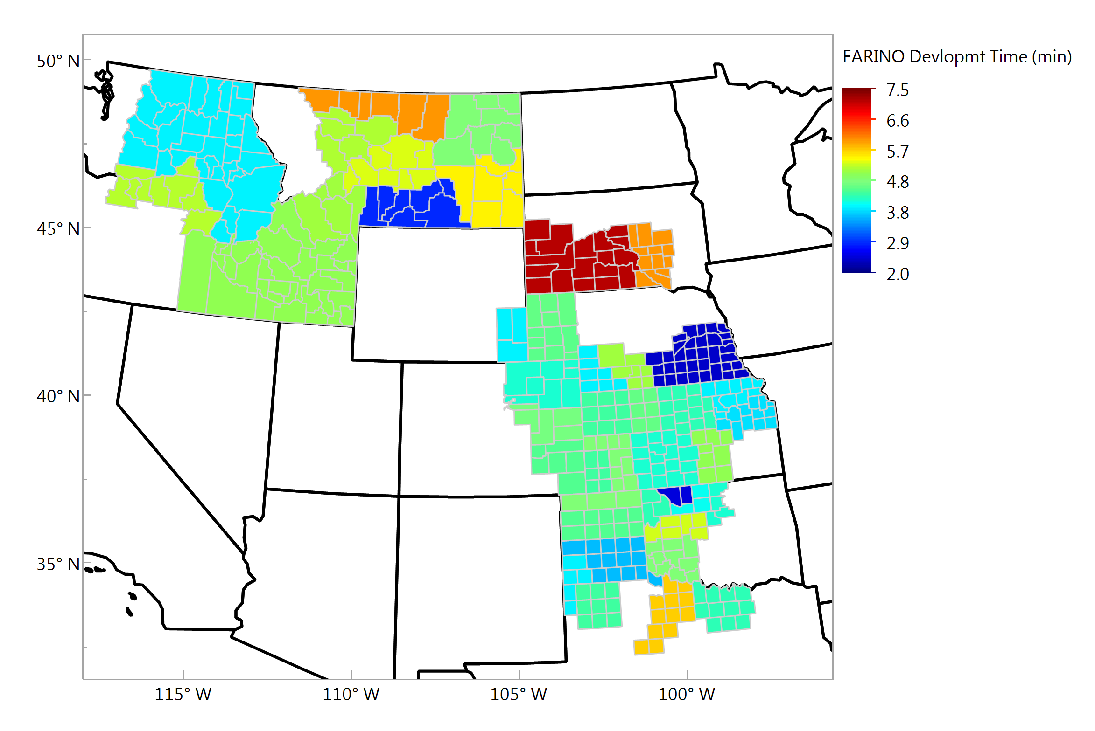
Farinograph Development, min Composite Samples

Slide 18
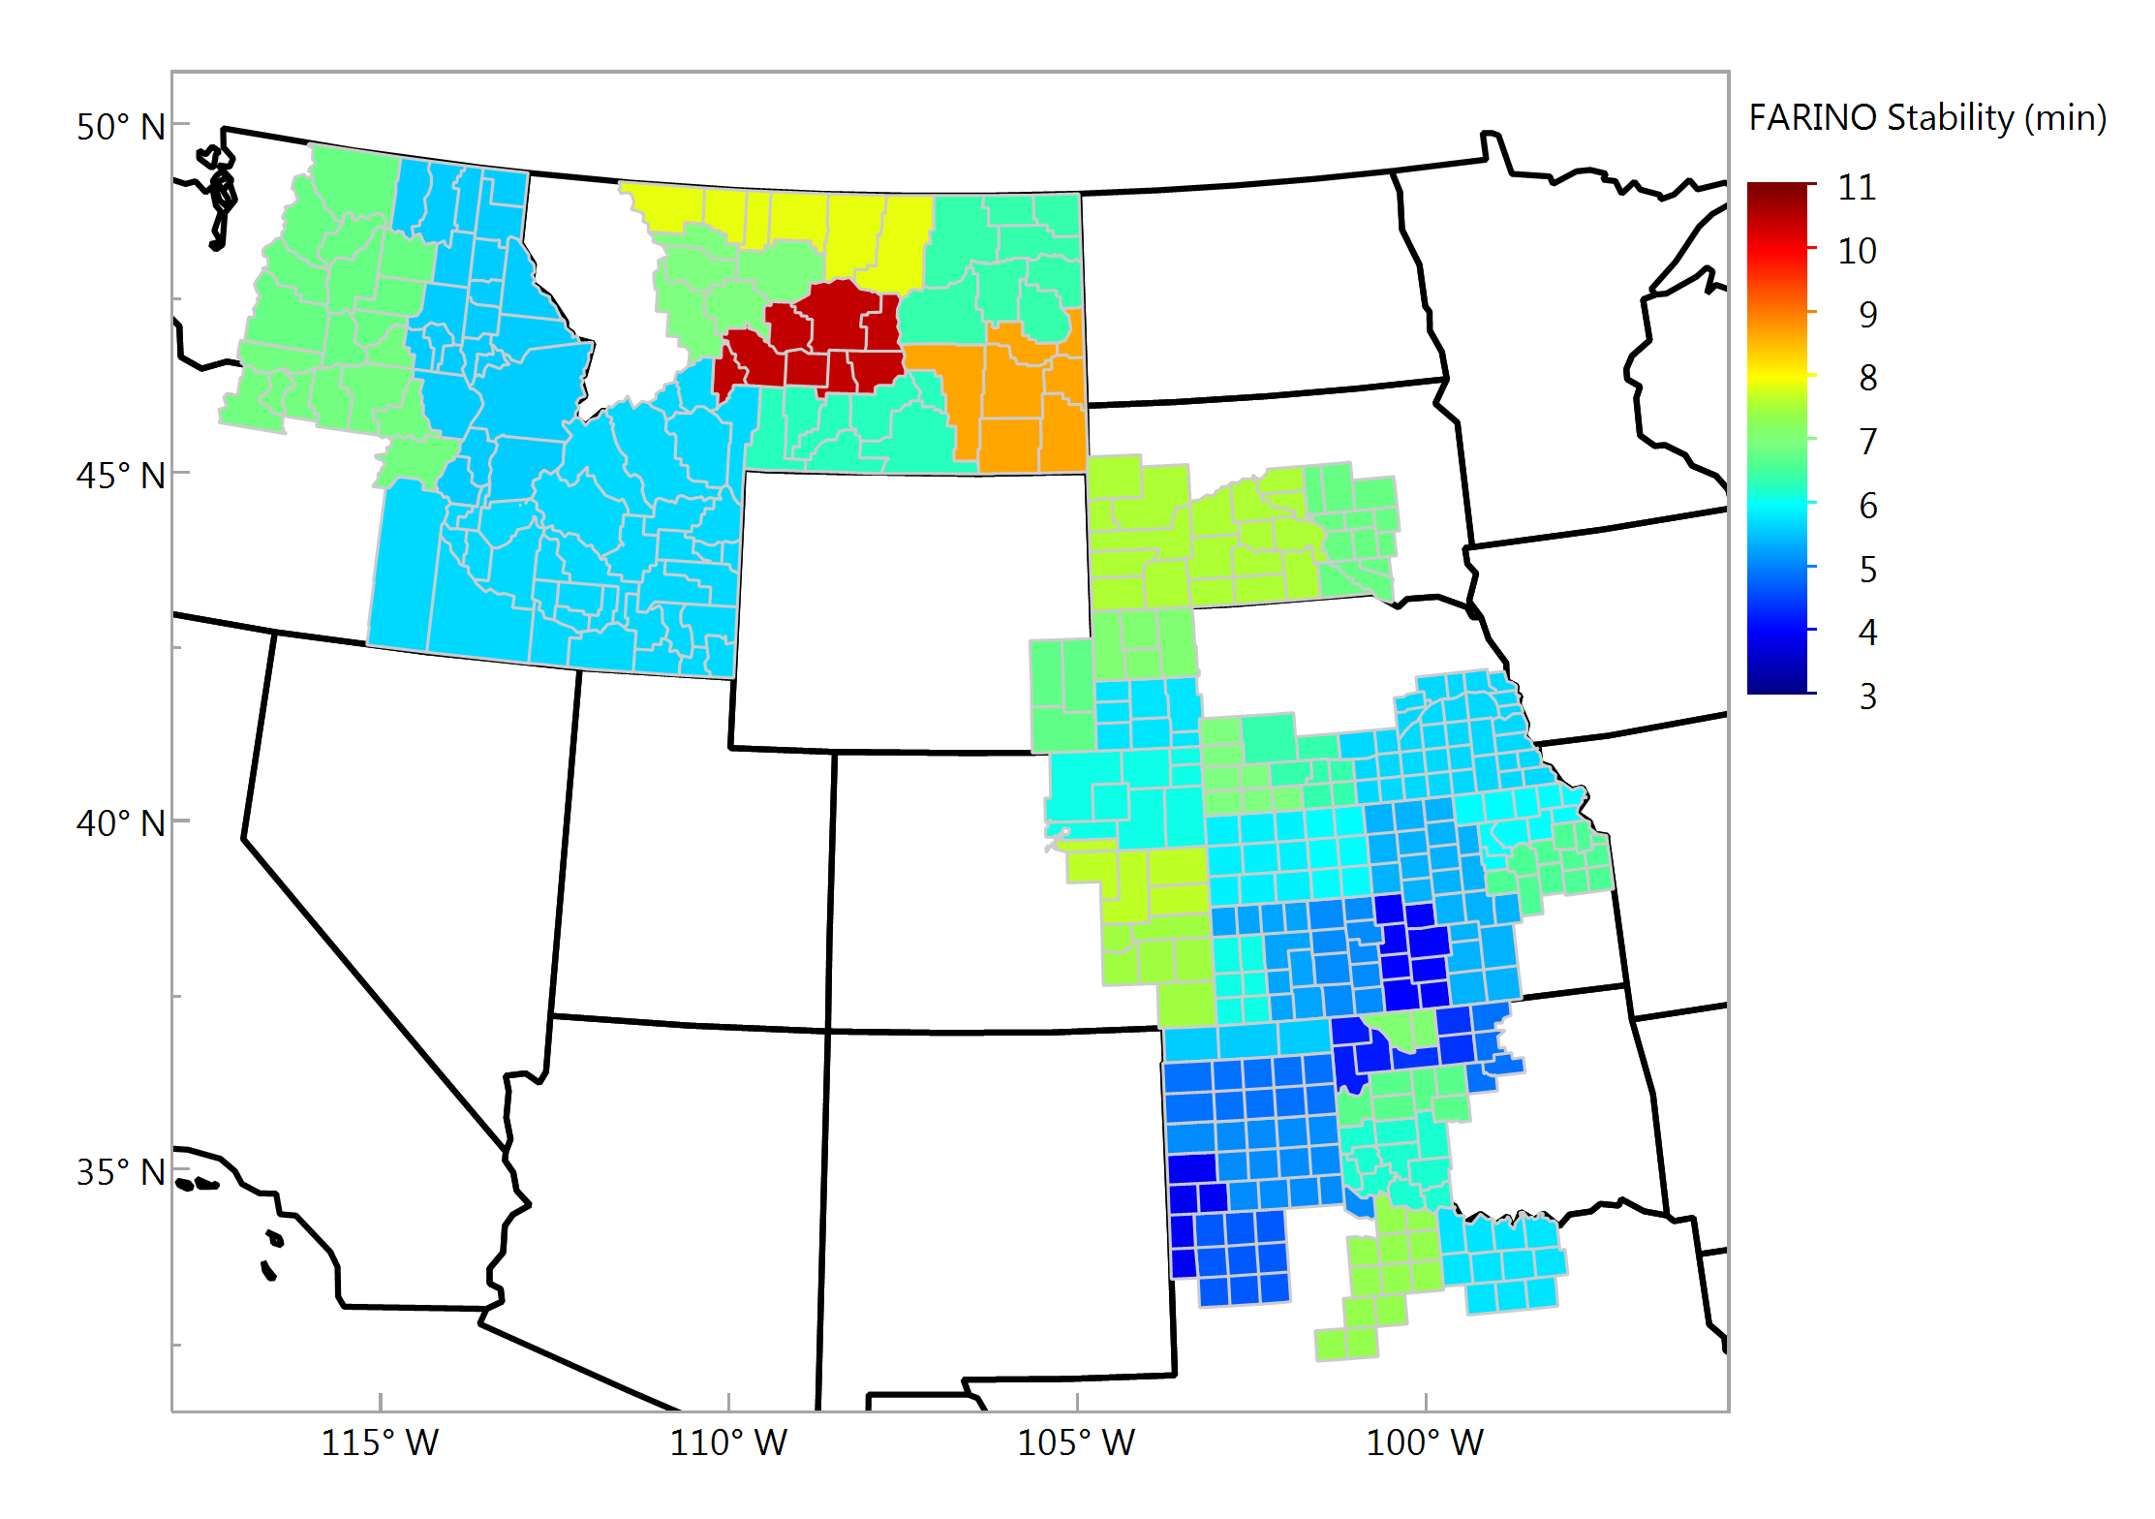
Farinograph Stability, min Composite Samples

Slide 19
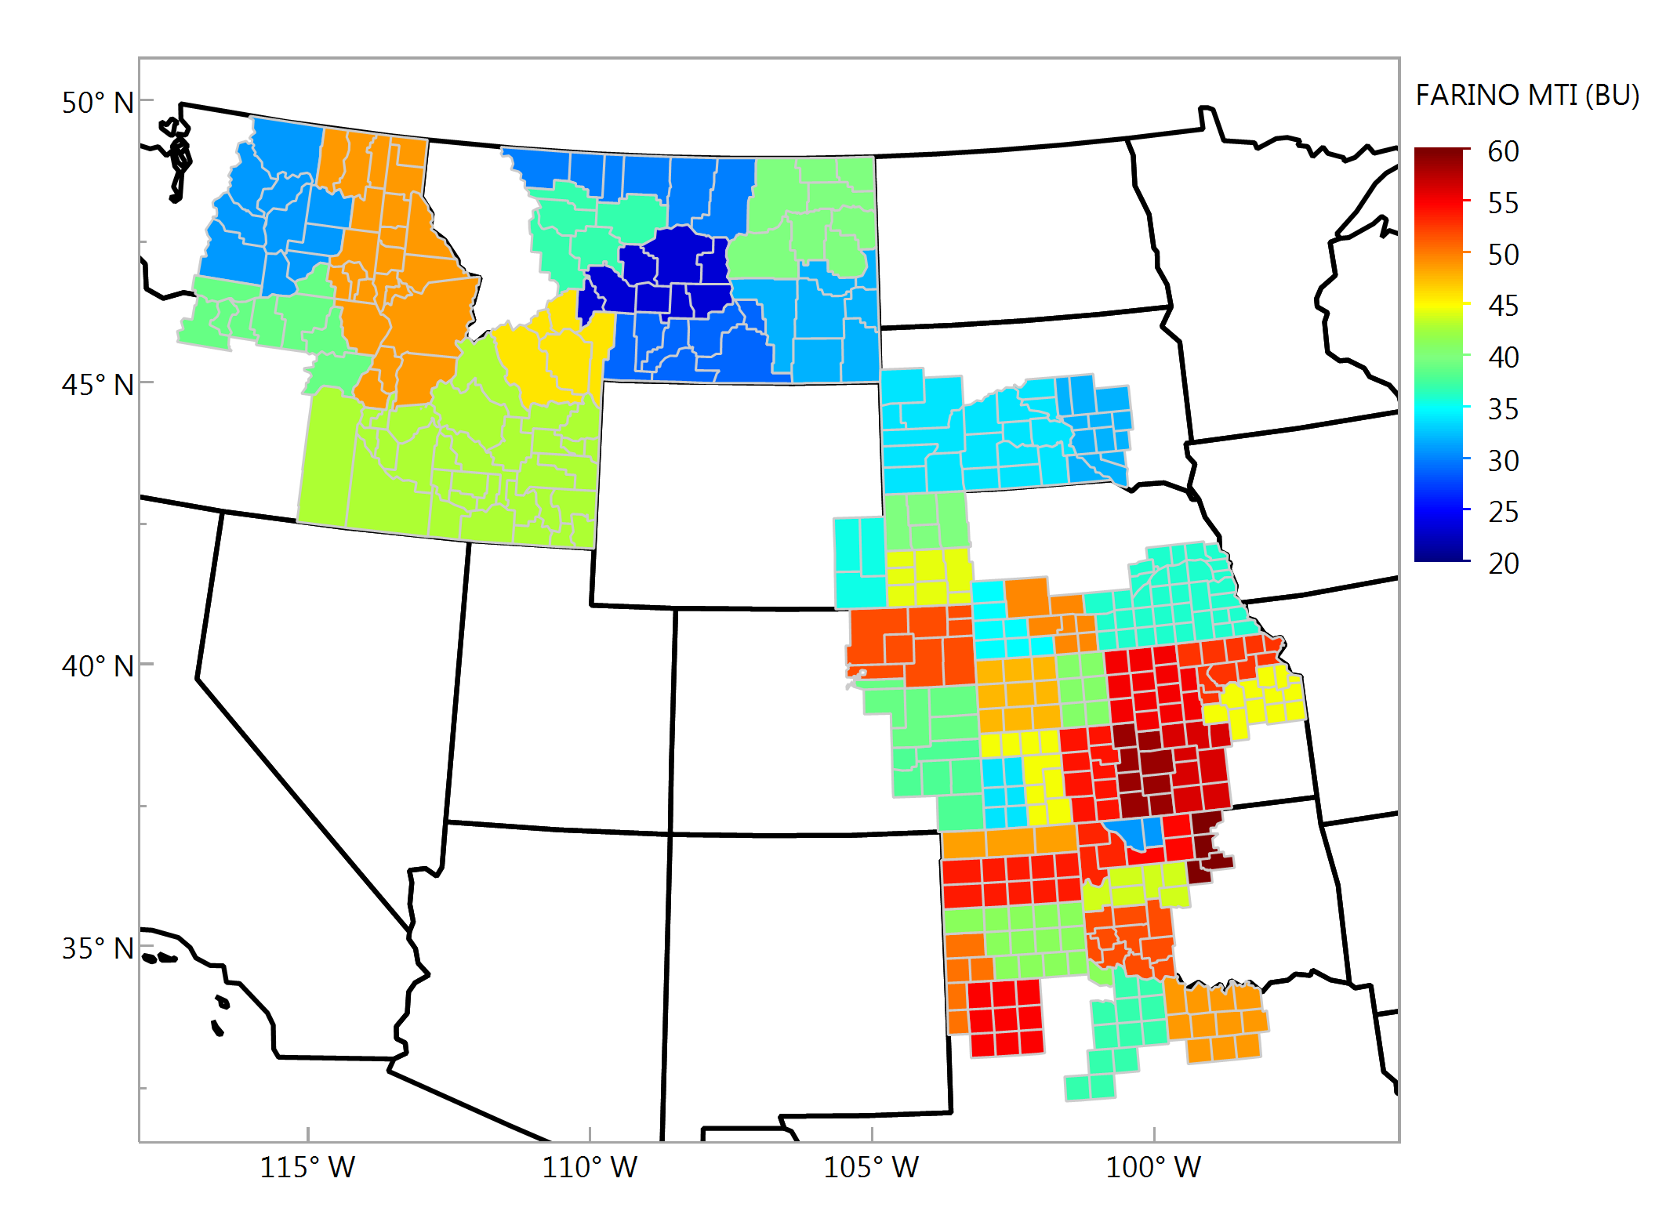
Farinograph MTI, BU Composite Samples

Slide 20
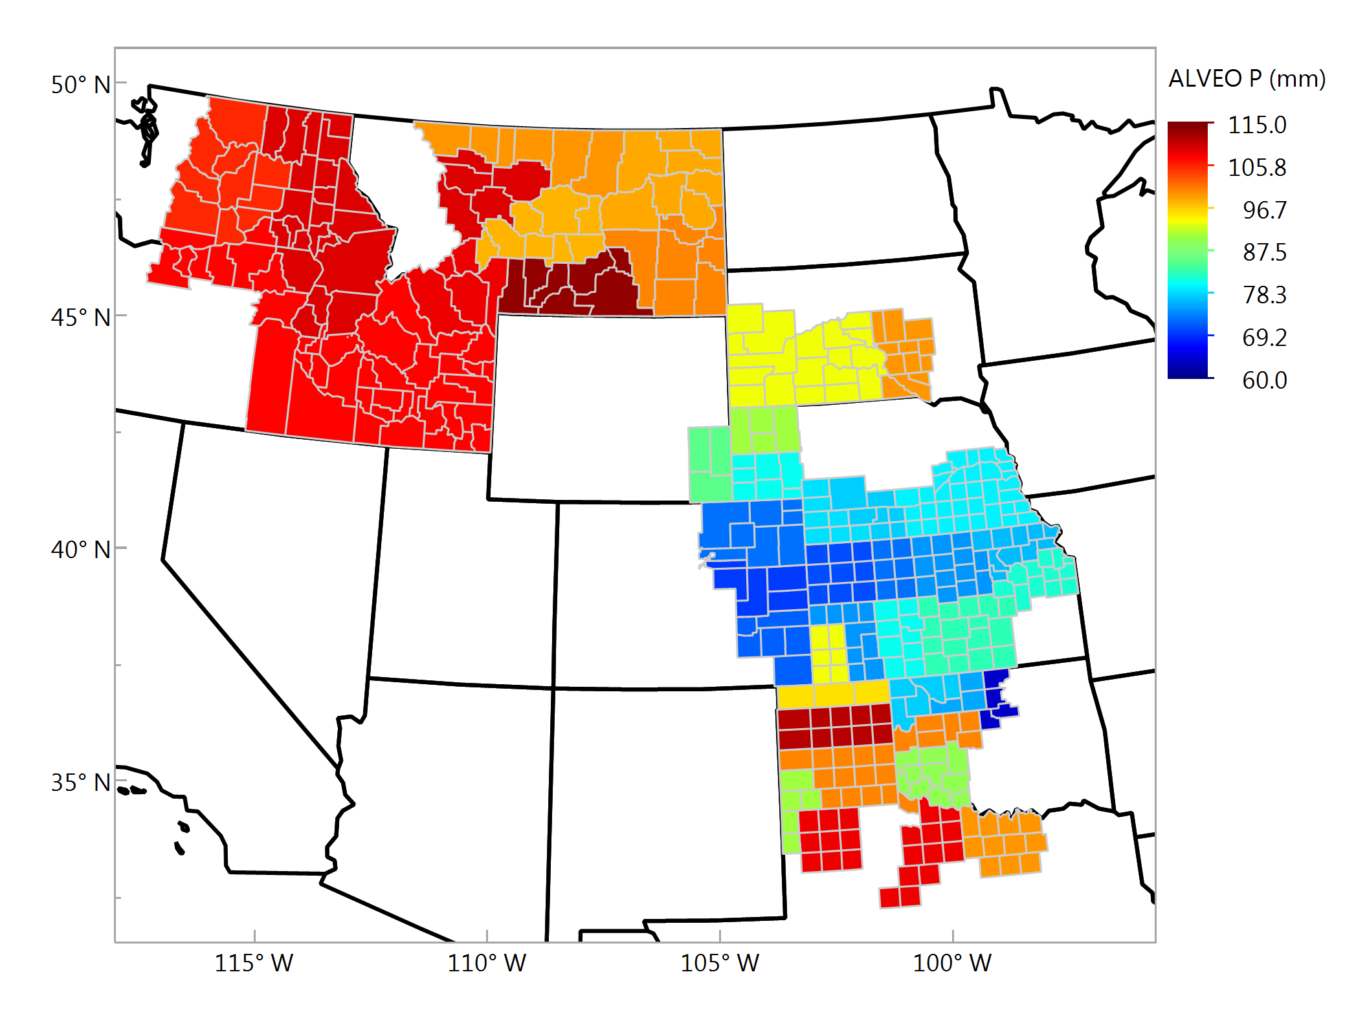
Alveograph P, mm Composite Samples

Slide 21
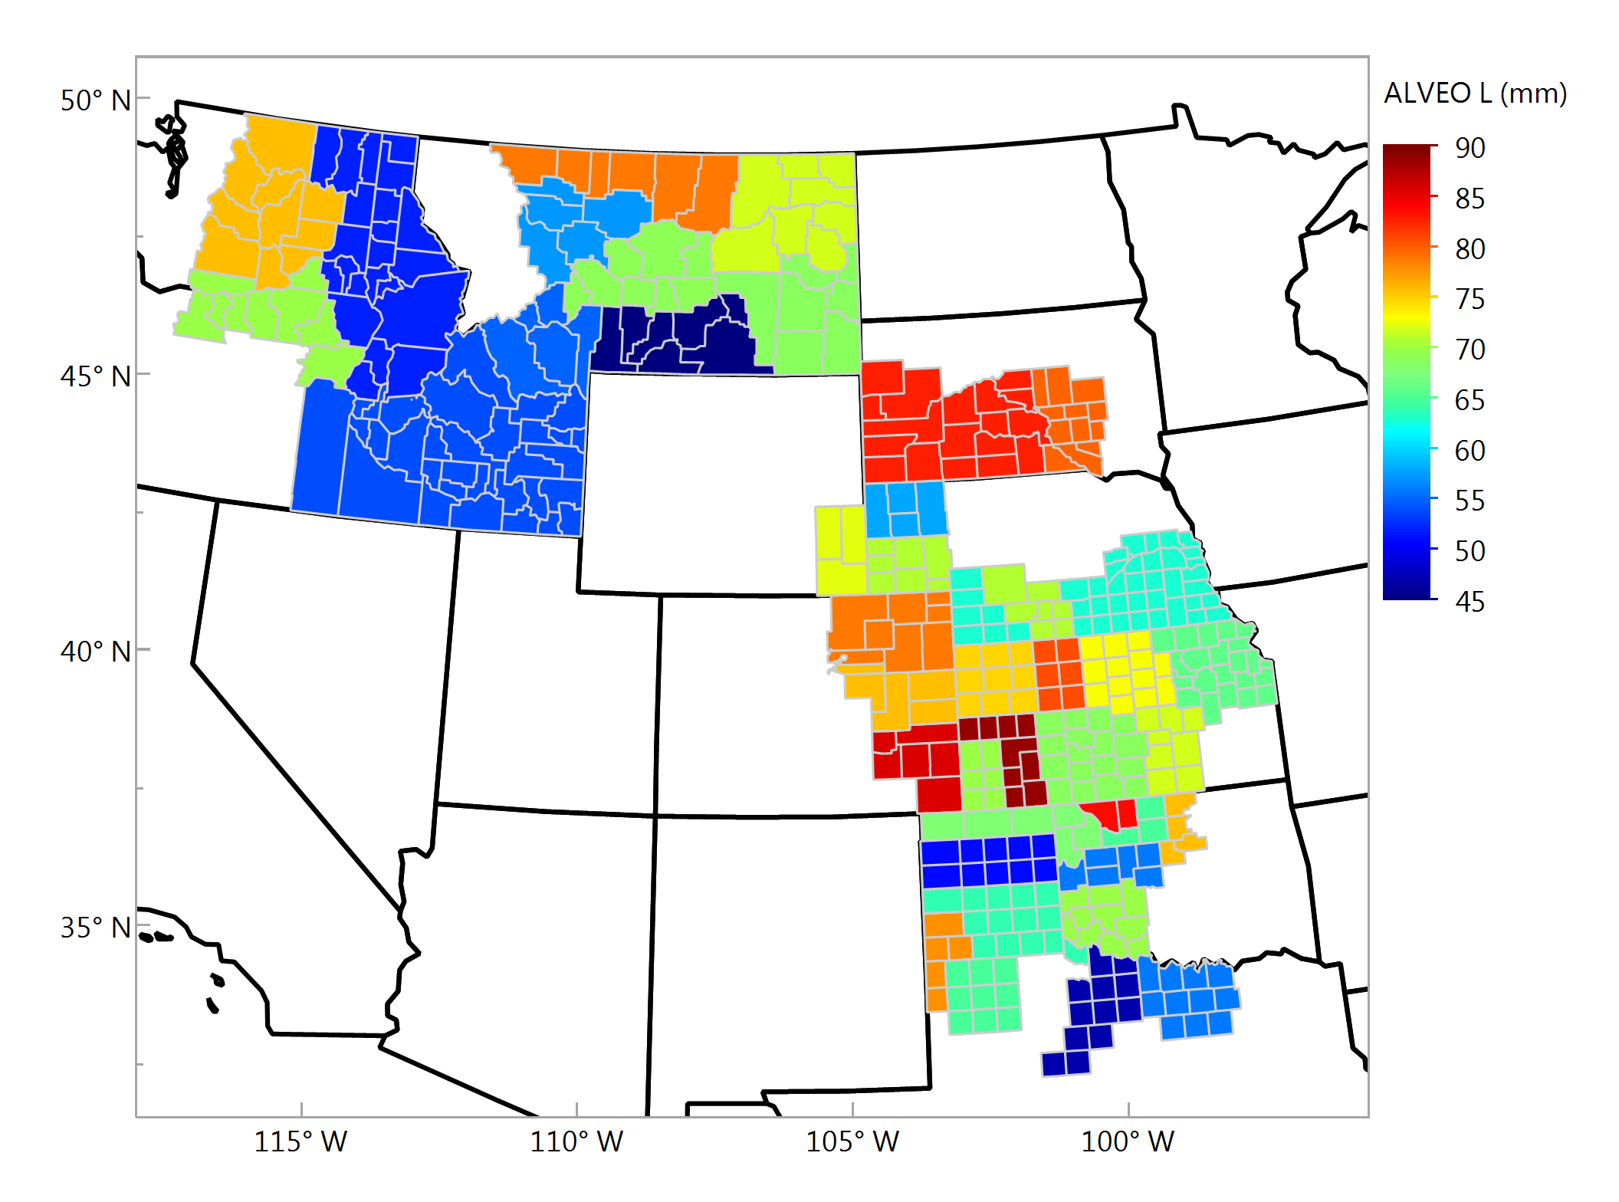
Alveograph L, mm Composite Samples

Slide 22
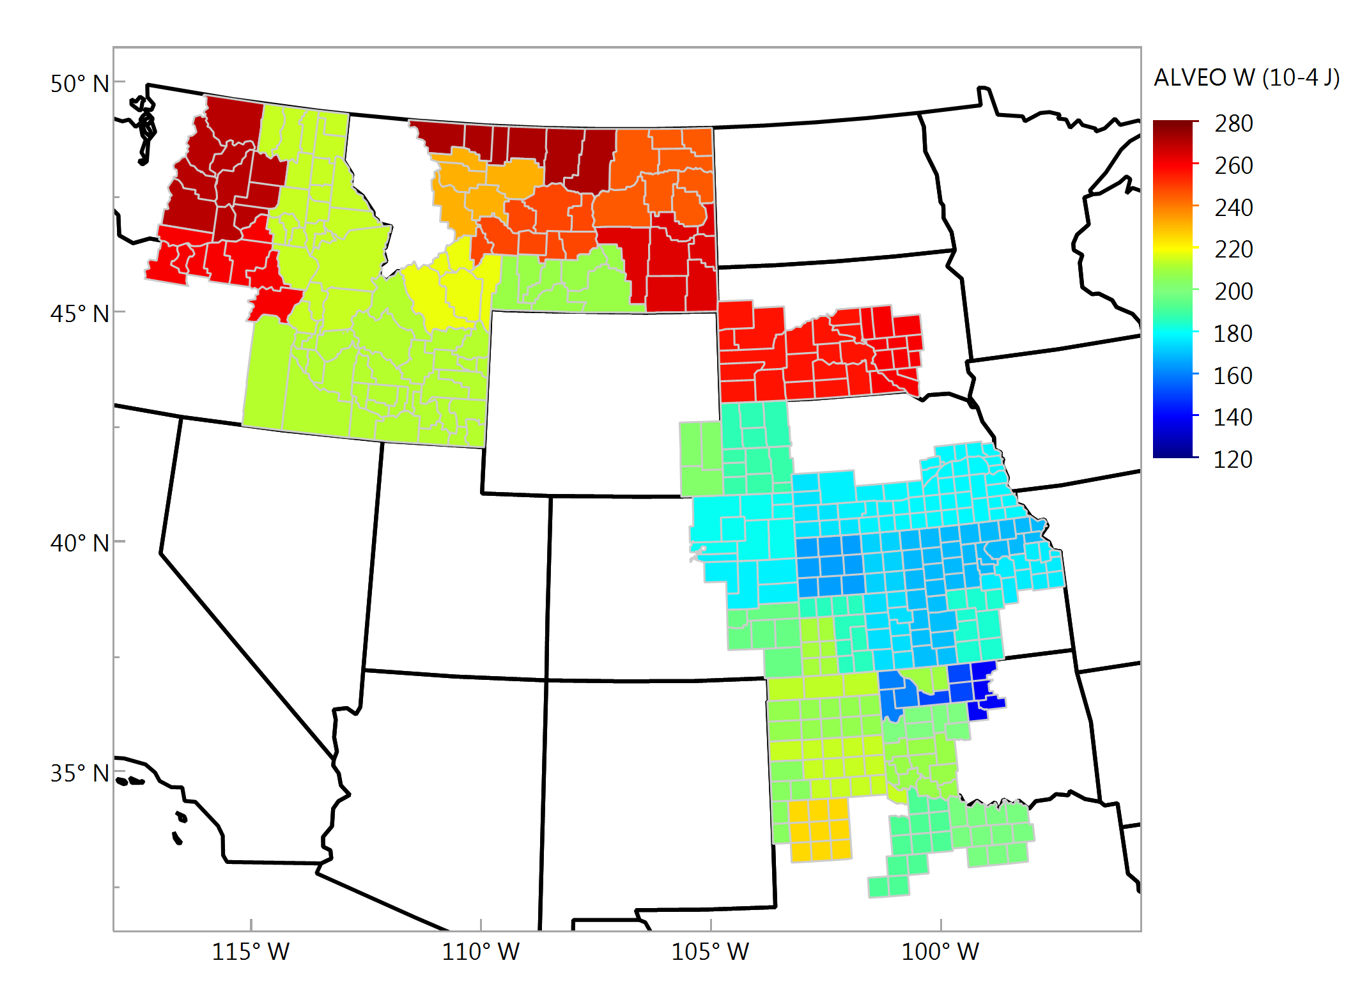
Alveograph W, 10⁻⁴ j Composite Samples

Slide 23
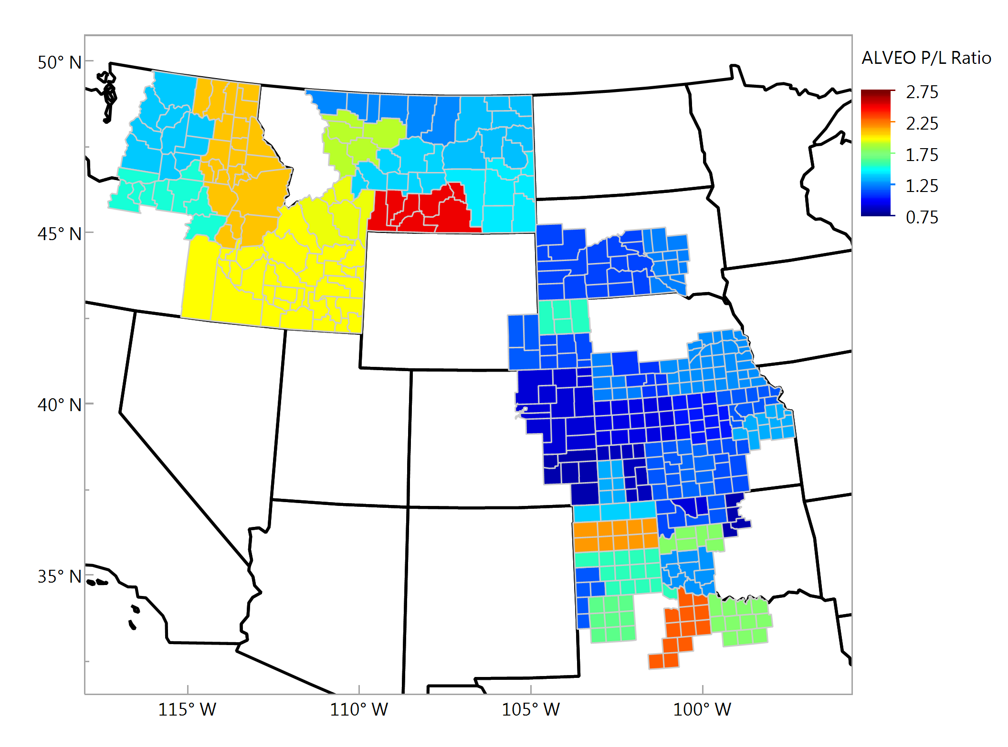
Alveograph P/L Ratio Composite Samples

Slide 24
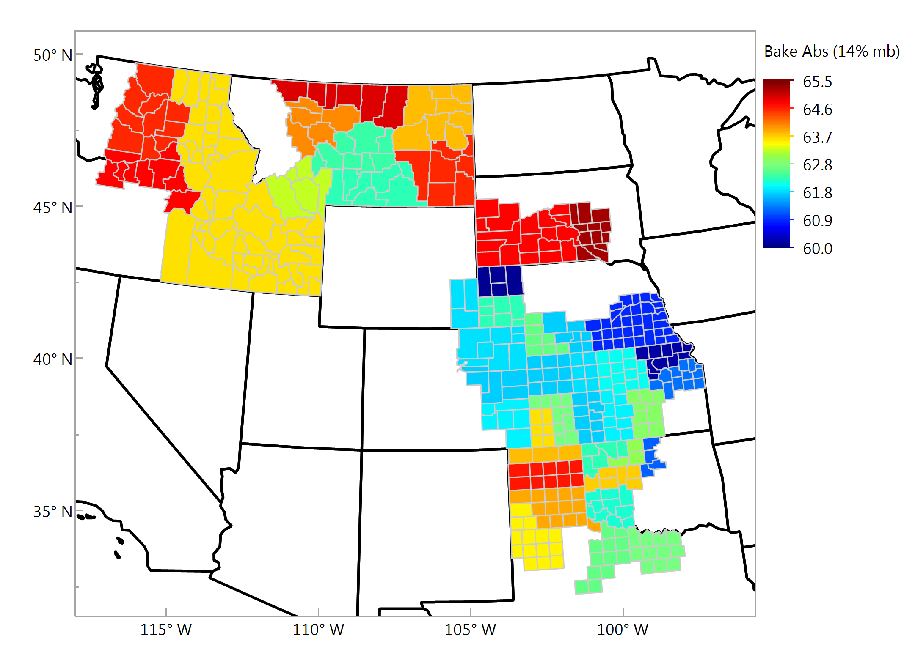
Bake Absorption (14%), % Composite Samples

Slide 25
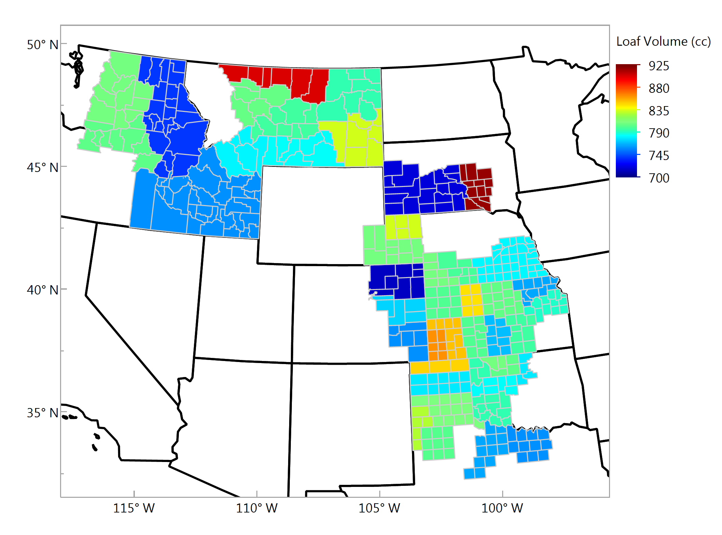
Loaf Volume, cc Composite Samples

