Slide 1
Hard Red Winter Wheat Quality Maps Based on Crop Survey by Plains Grains, Inc.
October 13, 2016

Slide 2
Plains Grains, Inc. Grainsheds

Slide 3
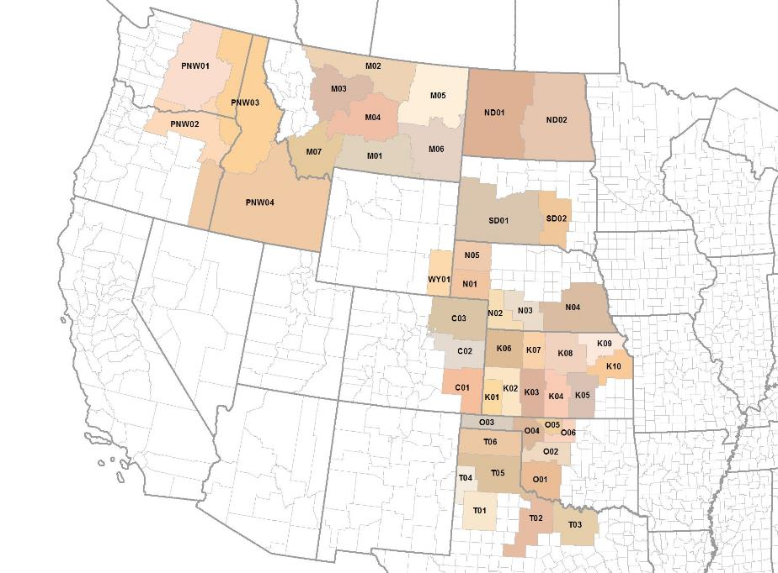
Plains Grains, Inc. Grainsheds Gulf (darker background) and PNW Export Areas

Slide 4
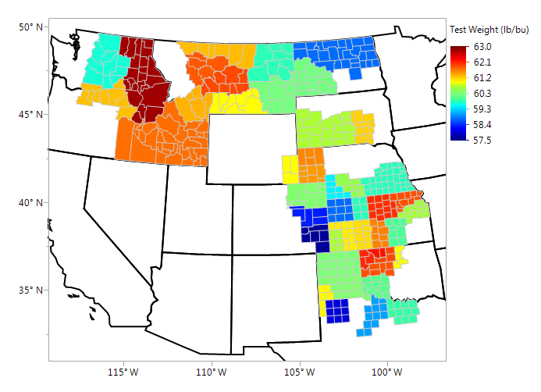
Test Weight (lbs/bu), By Grainshed Individual Samples

Slide 5
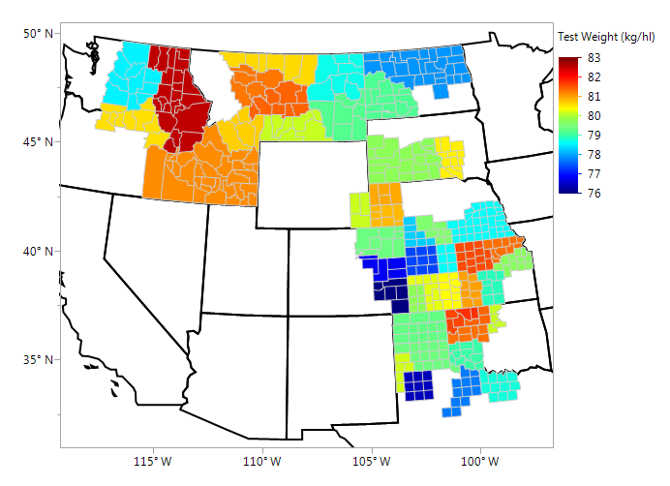
Test Weight (kg/hl), By Grainshed Individual Samples

Slide 6
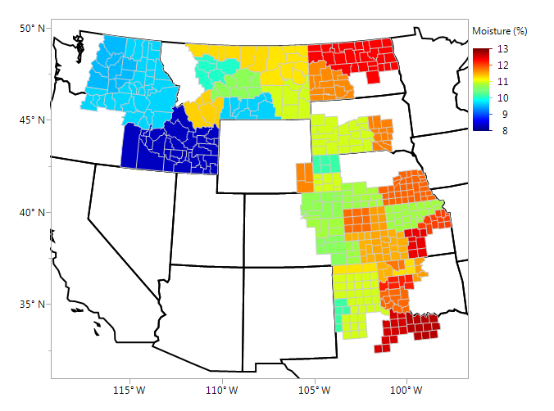
Wheat Moisture (%), By grainshed Individual Samples

Slide 7
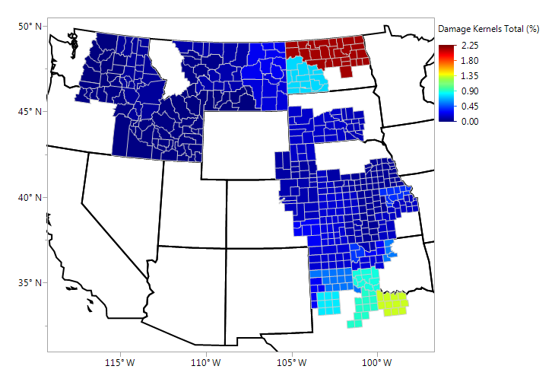
Damaged Kernels (%), By Grainshed Individual Samples

Slide 8
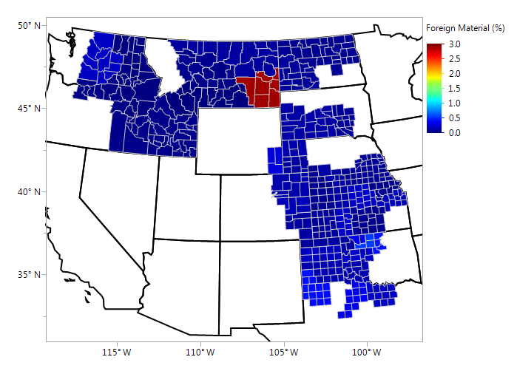
Foreign Material (%), By Grainshed Individual Samples

Slide 9
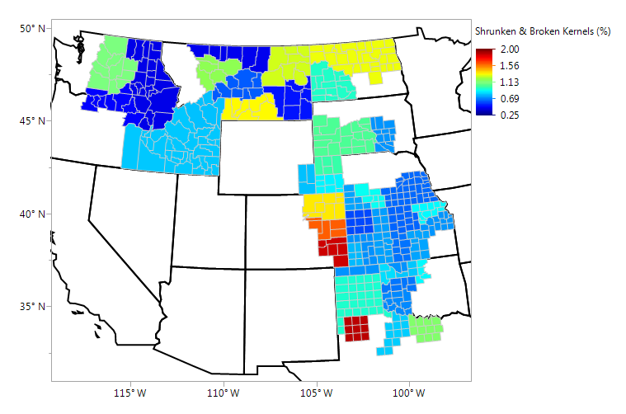
Shrunken & Broken (%), By Grainshed Individual Samples

Slide 10
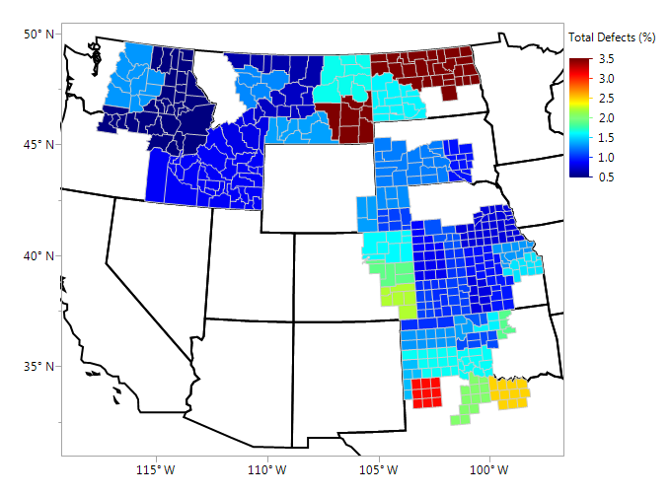
Total Defects (%), By Grainshed Individual Samples

Slide 11
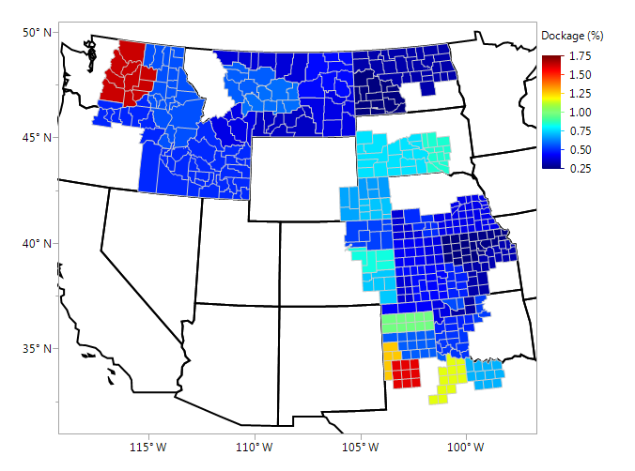
Dockage (%), By Grainshed Individual Samples

Slide 12
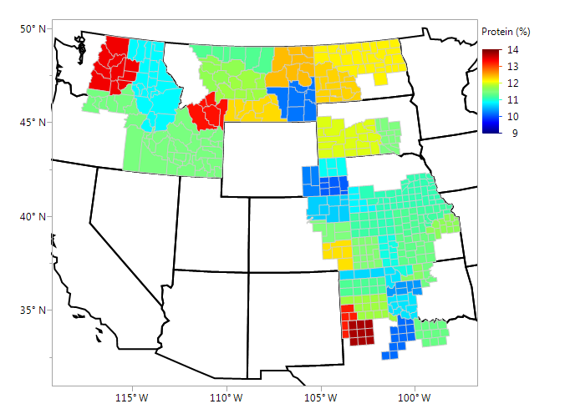
Wheat Protein (%), By Grainshed Individual Samples

Slide 13
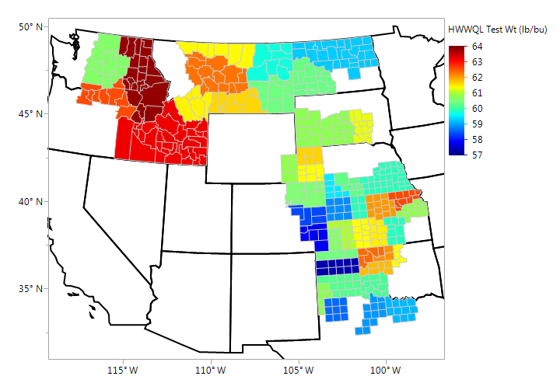
Test Weight (lbs/bu), By Grainshed HWWQL, Individual Samples

Slide 14
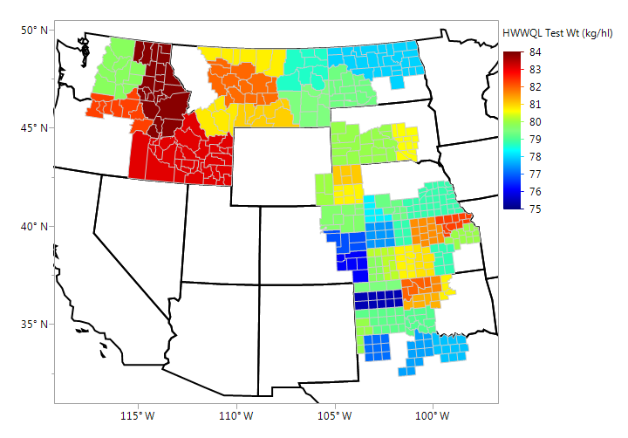
Test Weight (kg/hl), By Grainshed HWWQL, Individual Samples

Slide 15
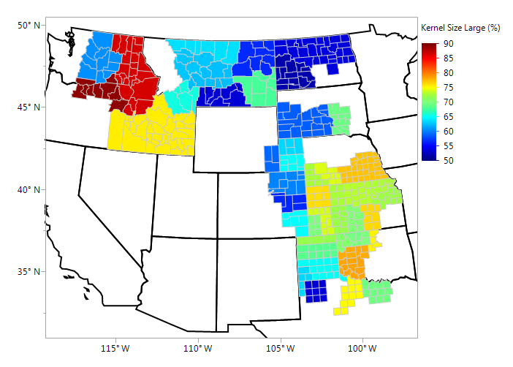
Kernel Size, Large (%), By Grainshed Individual Samples

Slide 16
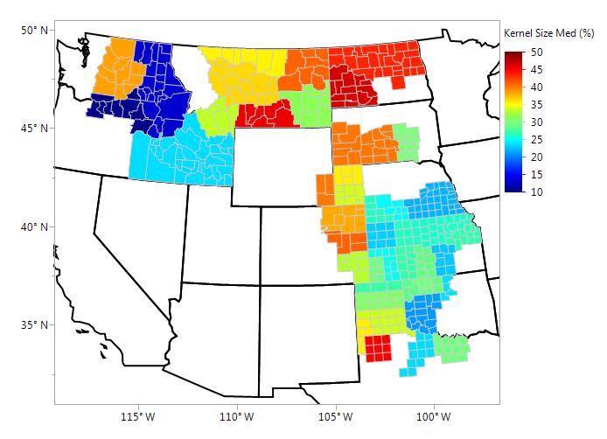
Kernel Size, Medium (%), By Grainshed Individual Samples

Slide 17
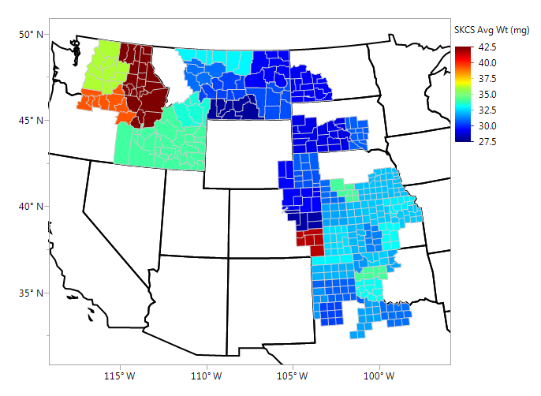
Average Kernel Weight (mg), By Grainshed SKCS, Individual Samples – Updated 10/13/2016

Slide 18
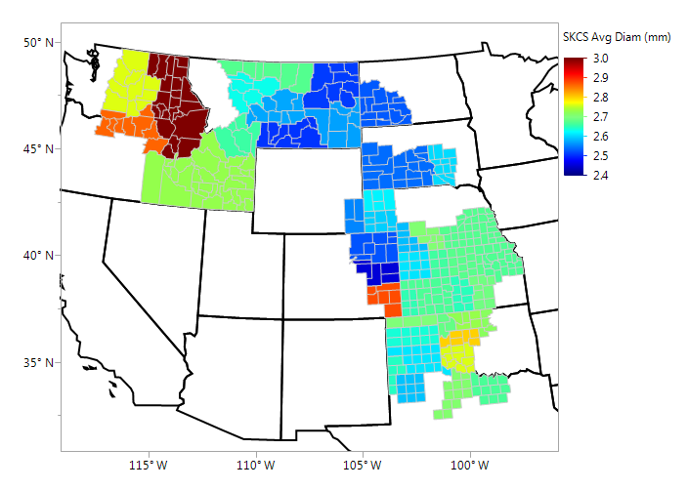
Average Kernel Diameter (mm), By Grainshed Individual Samples - Updated 10/13/2016

Slide 19
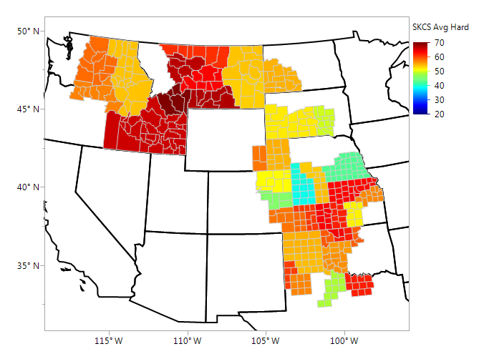
Average Kernel Hardness (SKCS), By Grainshed Individual Samples - Updated 10/13/2016

Slide 20
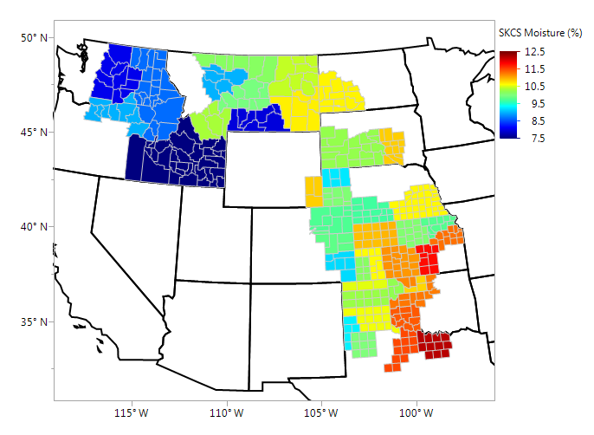
Kernel Moisture (%), By Grainshed SKCS, Individual Samples - Updated 10/13/2016

Slide 21
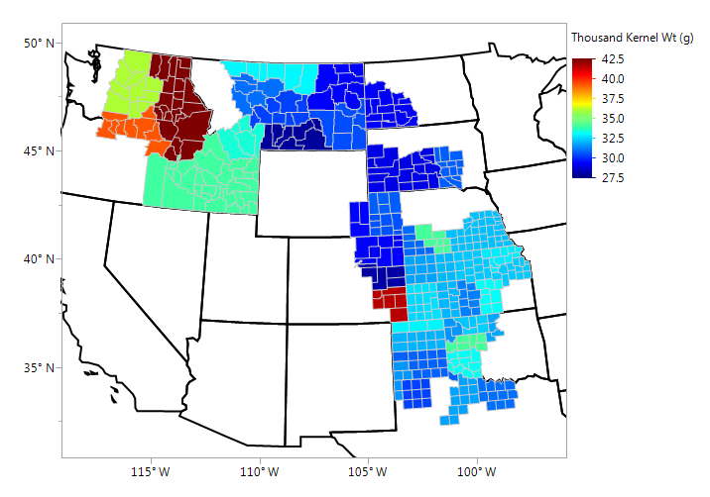
Thousand Kernel Weight (g), By Grainshed Individual Samples - Updated 10/13/2016

Slide 22
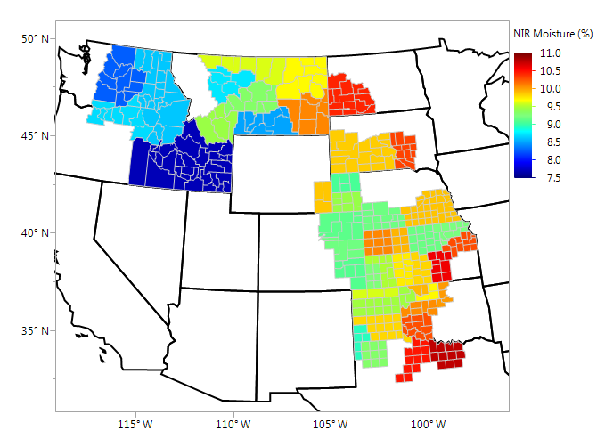
Wheat Moisture (%), By Grainshed NIR, Individual Samples - Updated 10/13/2016

Slide 23
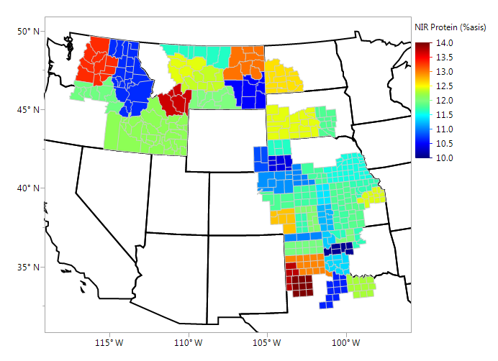
Wheat Protein (12% mb, %) NIR, Individual Samples - Updated 10/13/2016

Slide 24
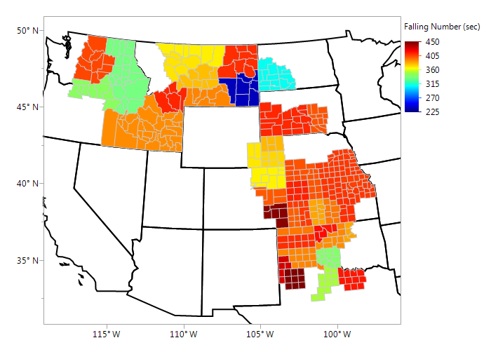
Wheat Falling Number (sec), By Grainshed Individual Samples - Updated 10/13/2016

Slide 25
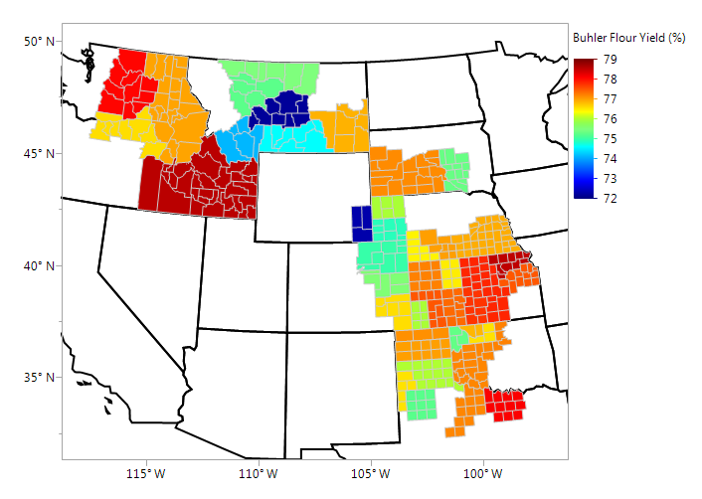
Buhler Flour Yield(%), By Grainshed Composite Sample Averages - Updated 10/13/2016

Slide 26
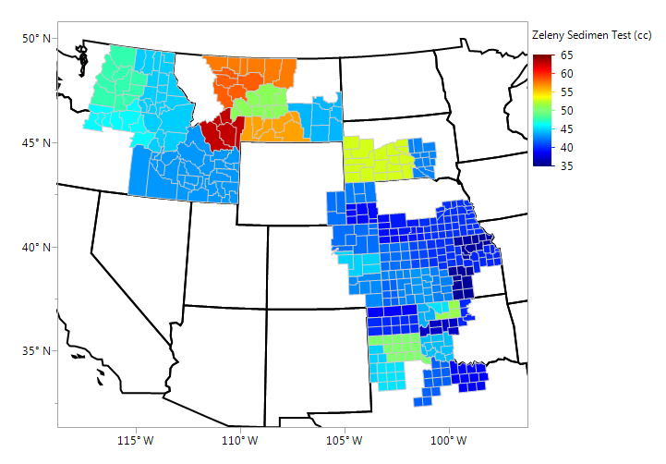
Zeleny Sedimentation (cc) By Grainshed, Composite Sample Averages Updated 10/13/2016

Slide 27
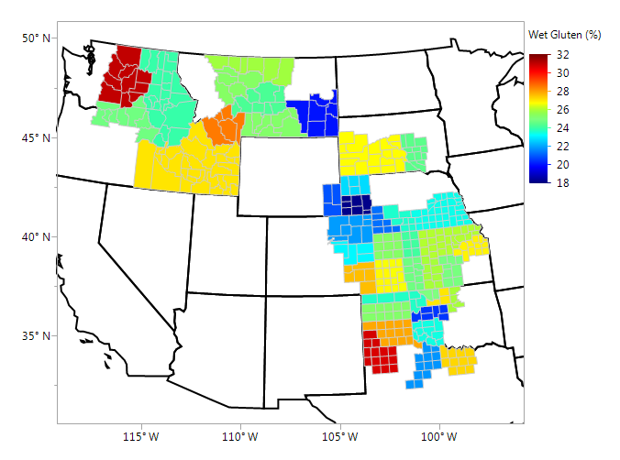
Wet Gluten (%), By Grainshed Composite Sample Averages - Updated 10/13/2016

Slide 28
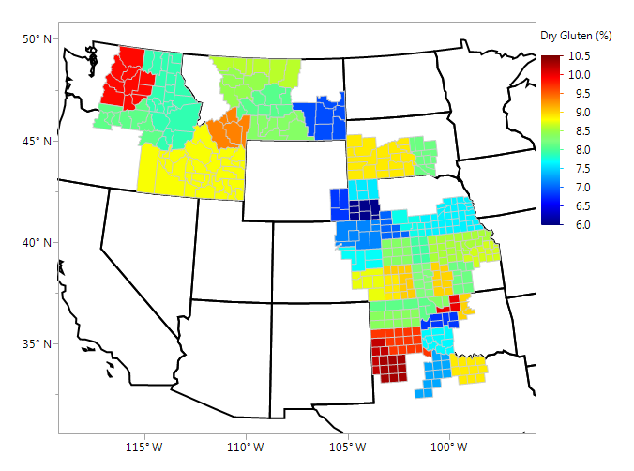
Dry Gluten (%), By Grainshed Composite Sample Averages - Updated 10/13/2016

Slide 29
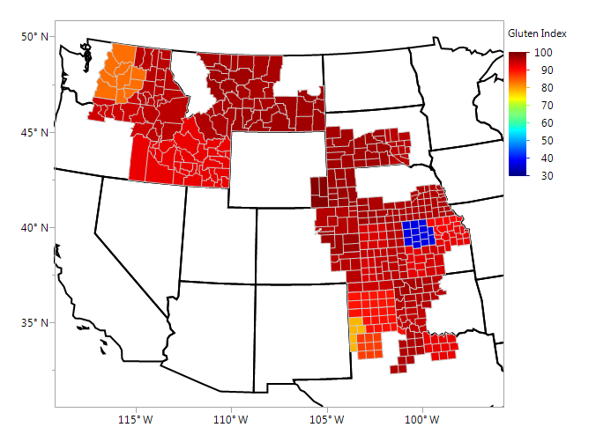
Gluten Index, By Grainshed Composite Sample Averages - Updated 10/13/2016

Slide 30
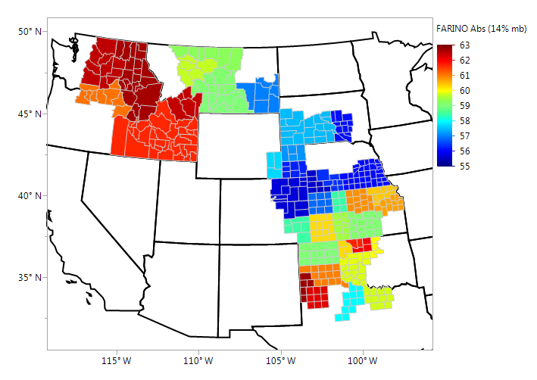
Farinograph Absorption (%, 14% mb), By Grainshed, Composite Sample Averages Updated 10/13/2016

Slide 31
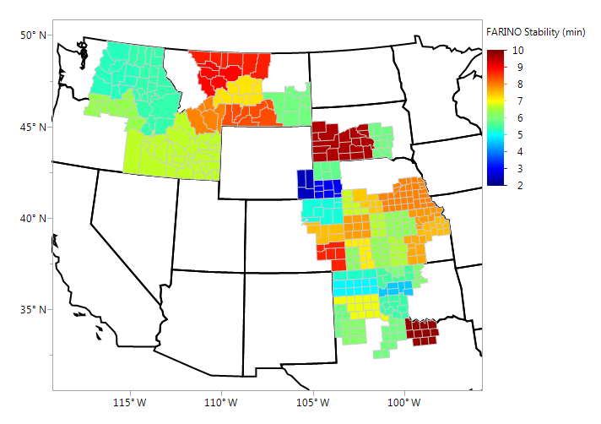
Farinograph Stability (min), By Grainshed, Composite Sample Averages Updated 10/13/2016

Slide 32
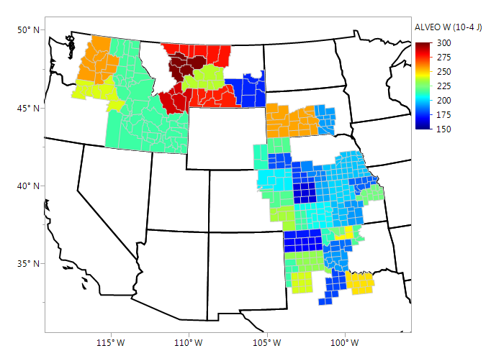
Alveograph W (10-4j), By Grainshed Composite Sample Averages - Updated 10/13/2016

Slide 33
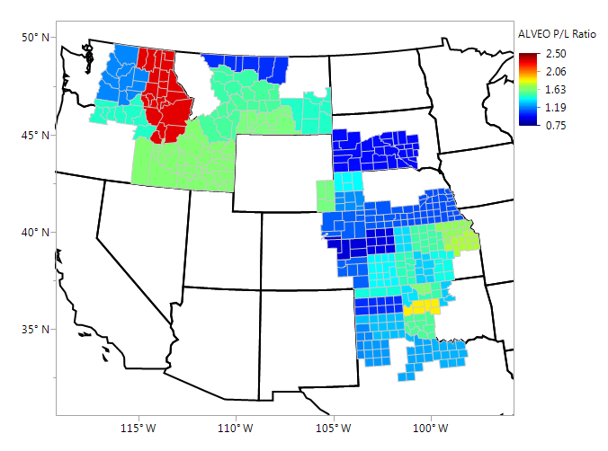
Alveograph P/L Ratio, By Grainshed Composite Sample Averages - Updated 10/13/2016

Slide 34
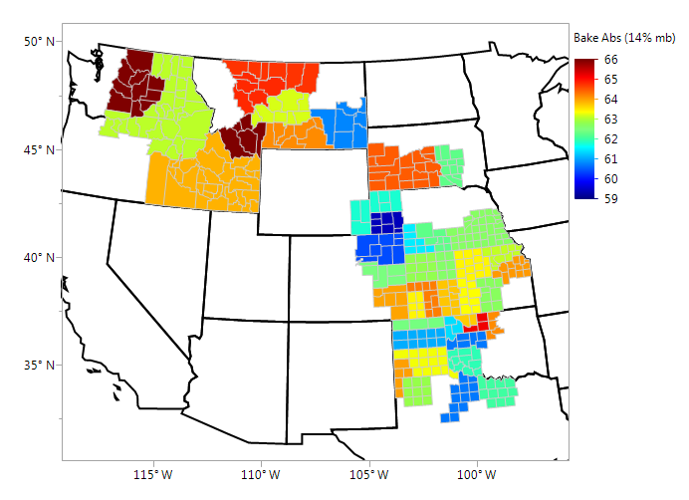
Bake Absorption (%) Composite Sample Averages - Updated 10/13/2016

Slide 35
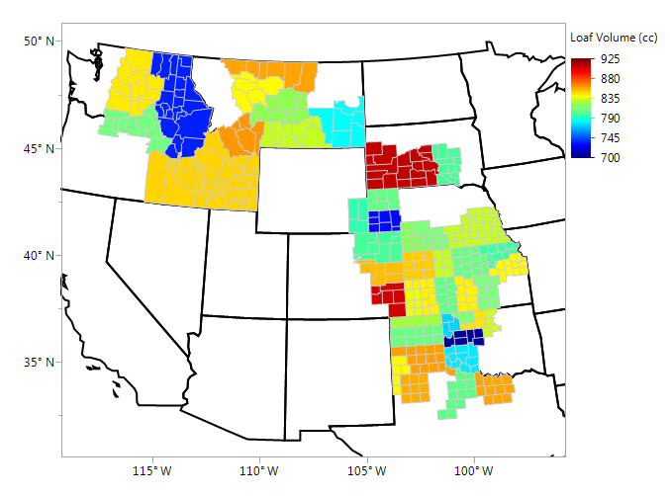
Loaf Volume, cc Composite Sample Averages - Updated 10/13/2016

